Slide 1


Microsoft Teams
How to…..

Slide 2
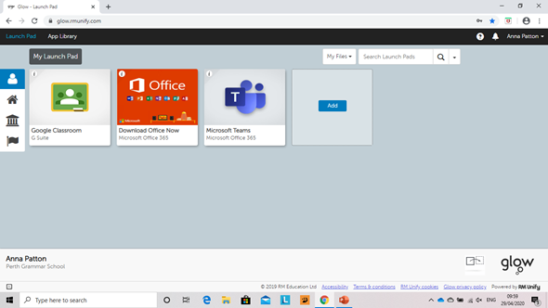
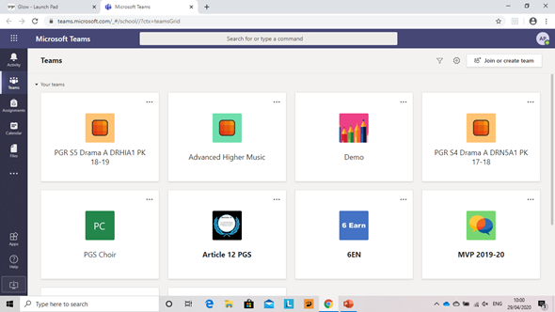
From you GLOW launchpad, select Teams.
You can join a team here, using the code given by your teacher
The main screen shows all your teams (classes)
The tabs on the left are available in any screen.
‘Activity’ is where you can see what’s been happening, if anyone has posted..etc.
‘Teams’ clicking here, will take you back to the page that is shown
‘Assignments’ this will show you a list of all the tasks set for different teams
‘Calendar’ will give you an overview of what’s happening when (assignments due/meetings etc’
' Files' will give you access to the documents for all of your subject teams.
Now select the class you want to access

Slide 3
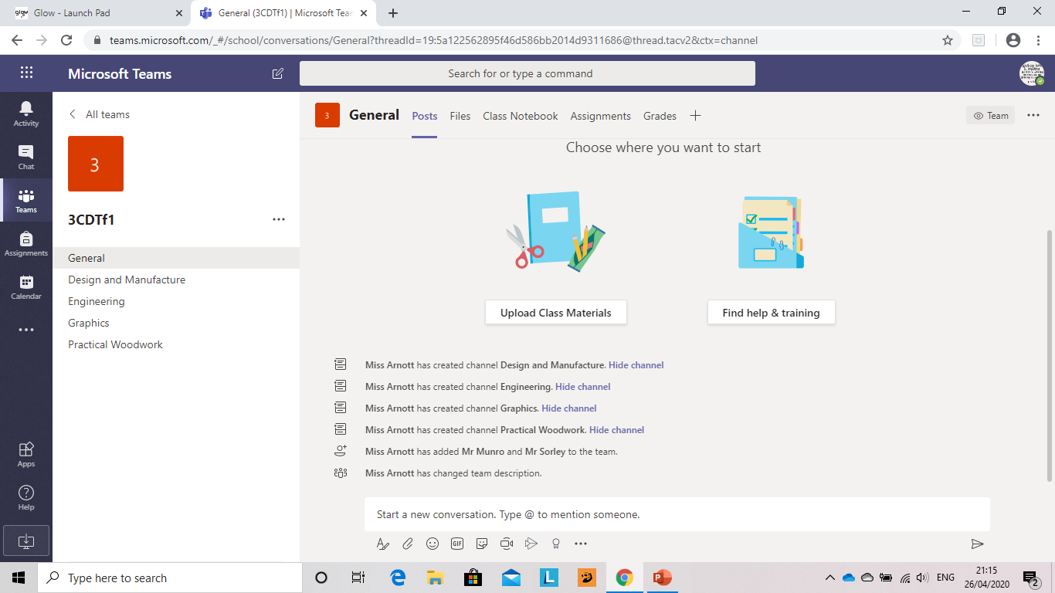
Files: In the general section these will be relevant to the whole course.
Class Notebook: This can be used to take notes on different areas and complete tasks.
Assignments: Only available in the general section. It will show a record of what task have been assigned and what's been completed
General Page
On selecting your team, it will go to the ‘general page. This is the main page and you can navigate your way to different areas from here.
Down the left, there are ‘channels’ for the different topics you will study. The names of these will be specific to your subject.
More information on these is on another page.
You can chat with your teacher and other students in a respectful and encouraging manner about general matters relating to the course.

Slide 4
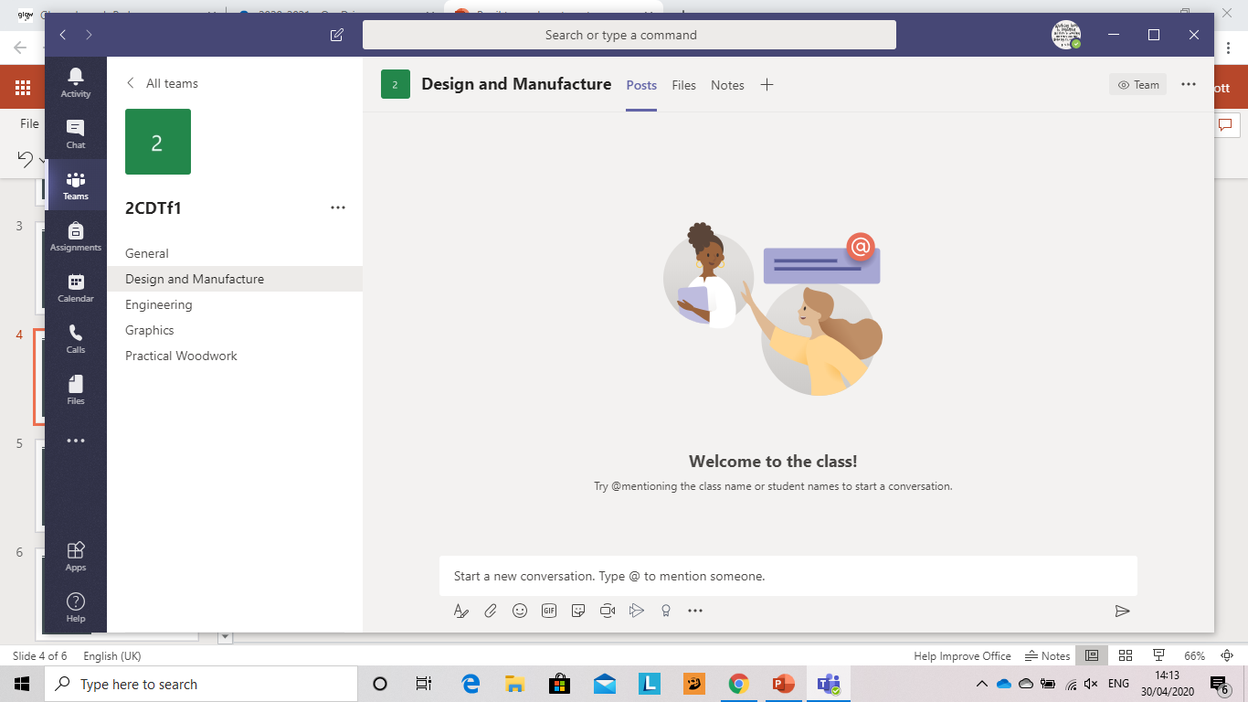
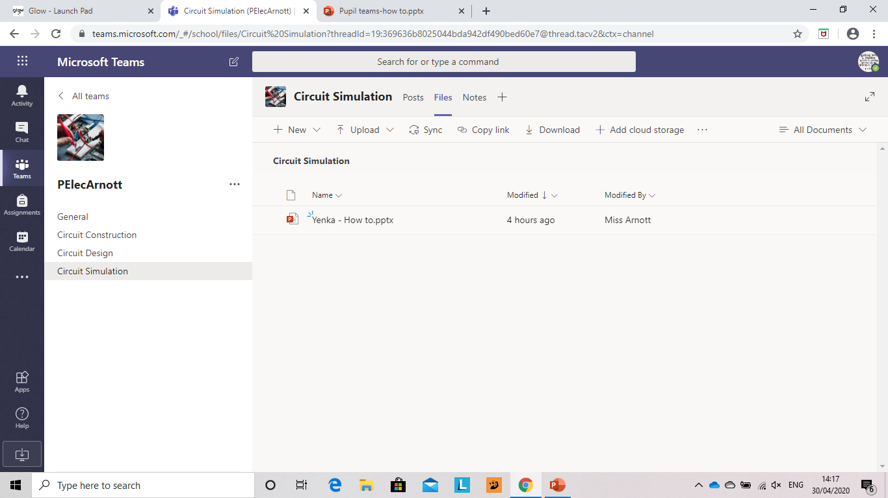
Topic Page
When you select one of the 'channel' pages from the left; you will have access to two areas.
1. Posts: This again is for chatting to your teacher and other pupils, in a respectful manner, to anything relating to the topic.....maybe asking for help on an assignment
2. Files: As this is a Topic page, you will find resources specific to that topic in here. Your teacher will direct which file to access. These will also remain here and can be accessed for revision.

Slide 5
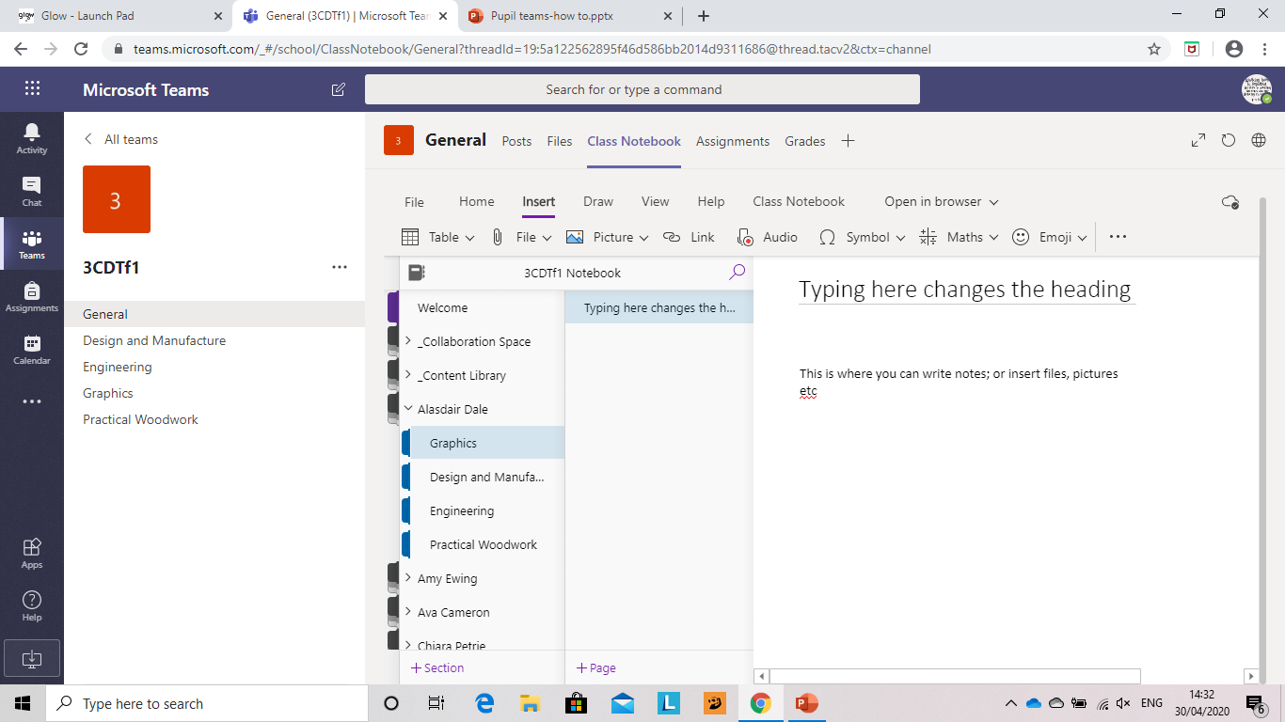
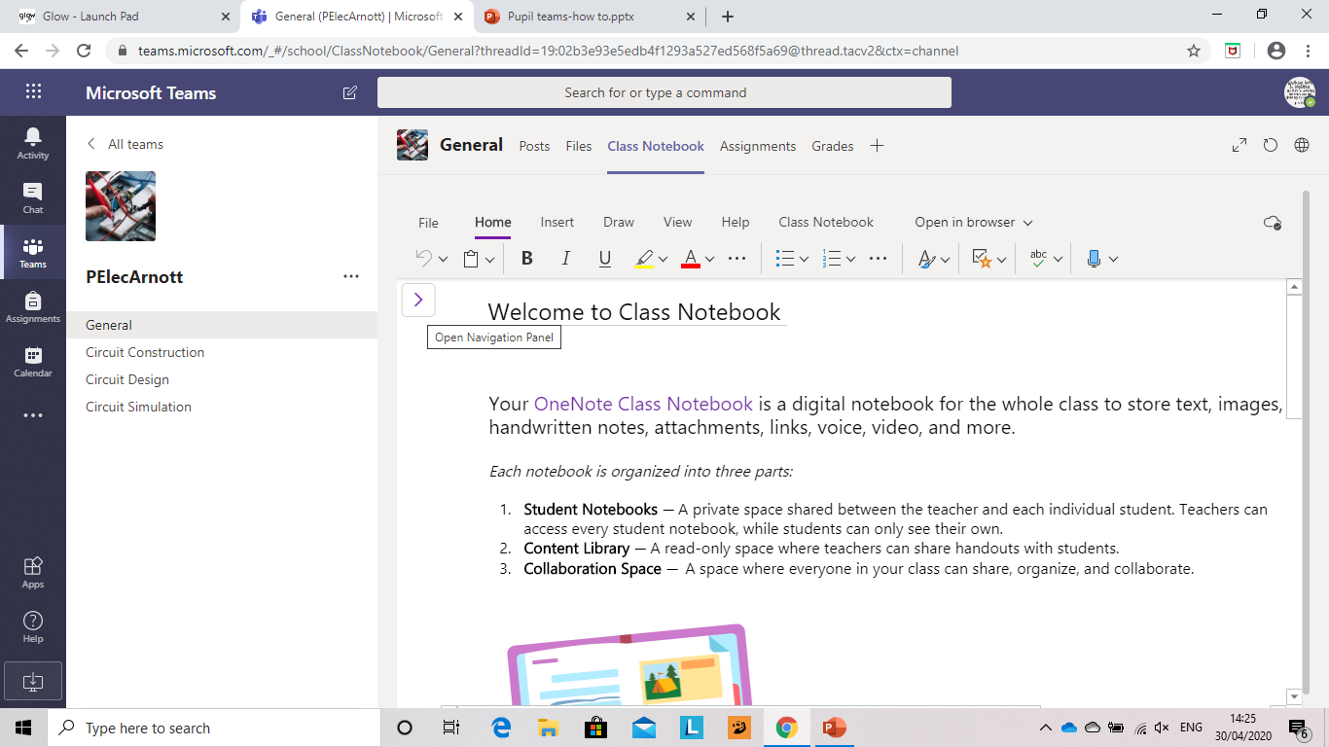
Class Notebook
On selecting class notebook from the top tabs; it will initially open like this
Click on the arrow to open the Notebook.
Make sure you give your page a heading.
Every pupil has their own notebook, only they and the teacher can read.
Inside is different sections to work in.
Complete any work here, using the tabs to help insert anything.
You can add a page by clicking here.

Slide 6
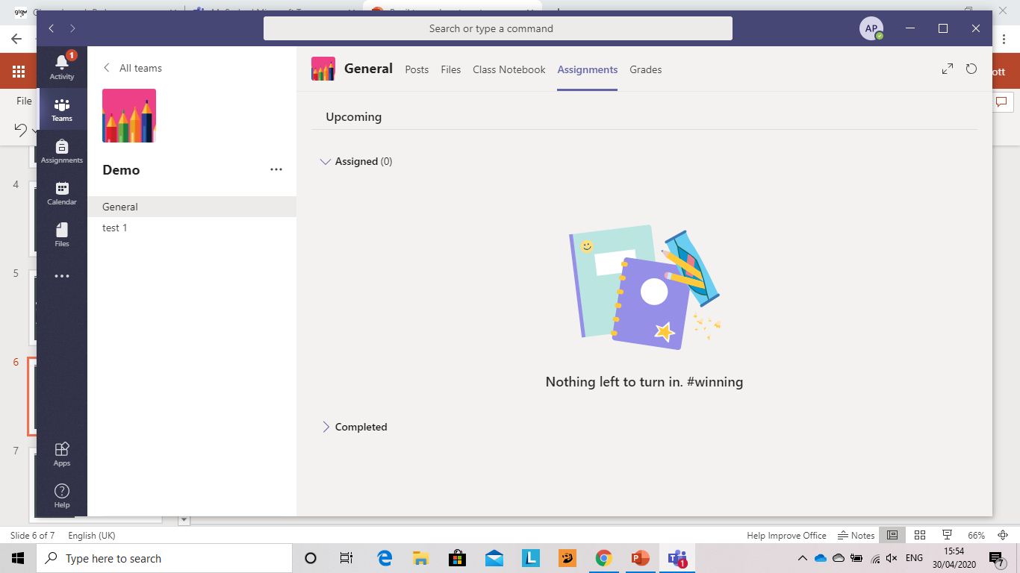
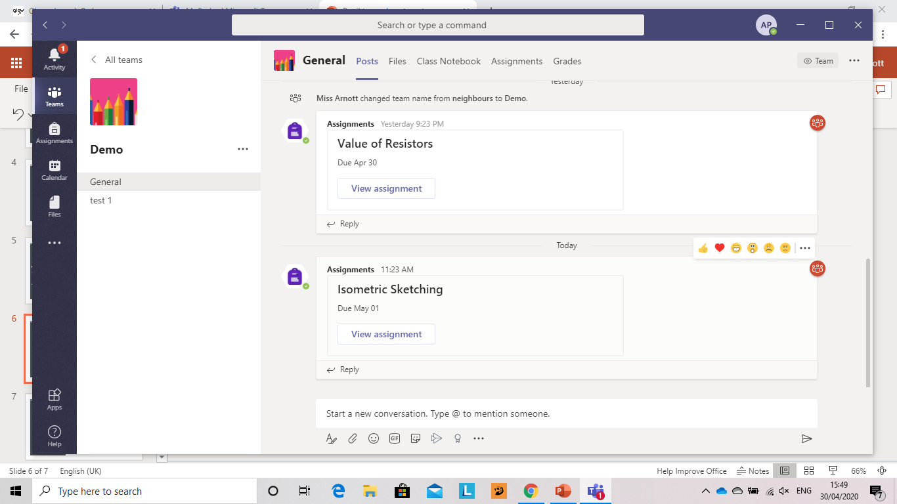
Assignments
On opening the Assignments tab, there will be two sections. The tasks you need to do and the tasks you have completed.
Your teacher will tell you how to submit your work. It will most likely either be to their email address or directly in the assignment section.
If by email:
Download task
Complete
Save to your computer
Email a copy to your teacher.
If submitting as a Teams assignment, go to the next slide......
Assignments will also show in the General posts and can be accessed from there.

Slide 7
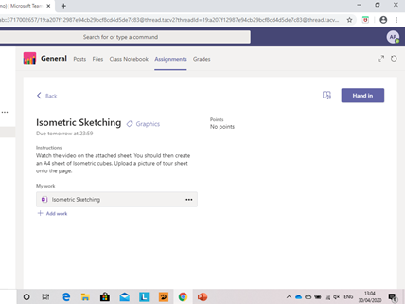
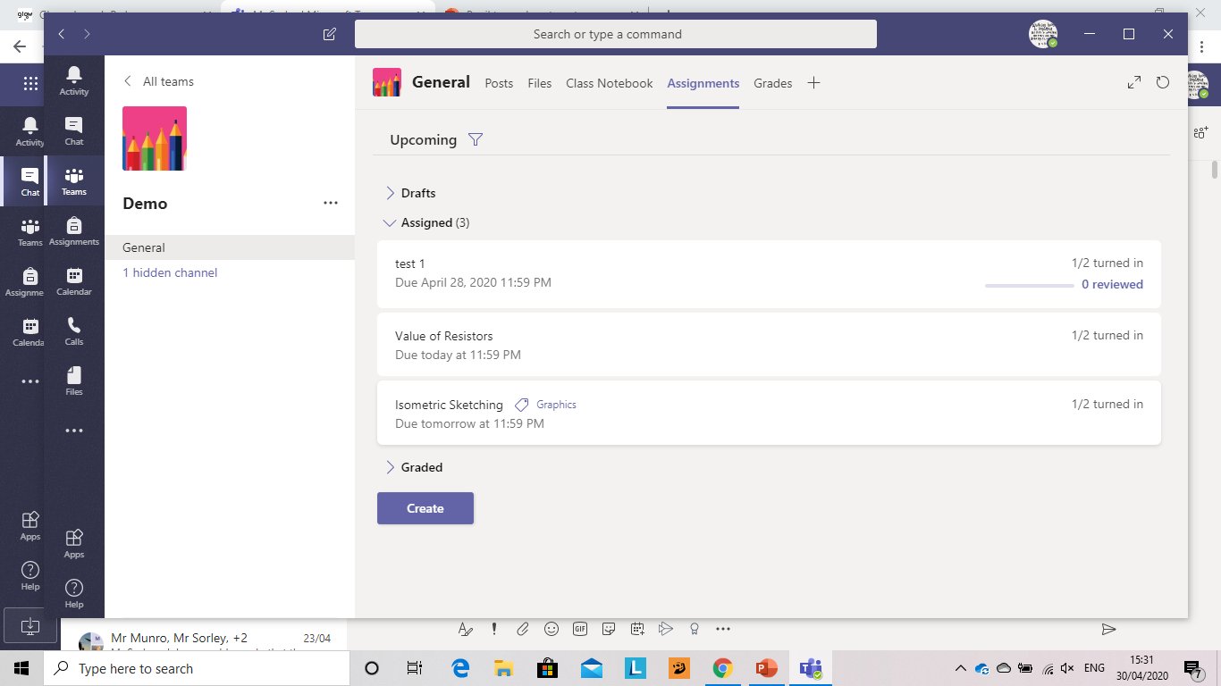
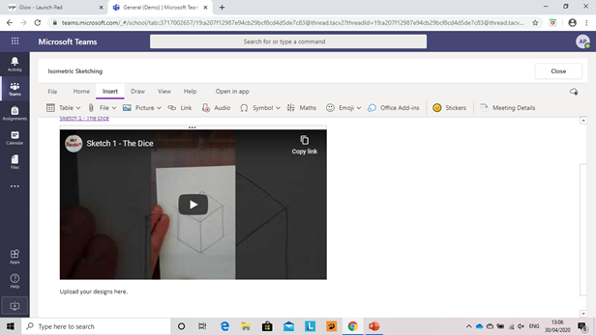
Completing Assignments in teams:
Select the assignment to be completed:
4. When you are happy the task is finished, then select hand in.
This will return it to your teacher, who will assess it and give you feedback
The assignment will open, with a description of the task.
1. Open the link.
2. Complete the task, write in your response, or upload a file or picture of evidence.
3. Once complete, select close....don't worry you can open again If you need to change anything.

Slide 8
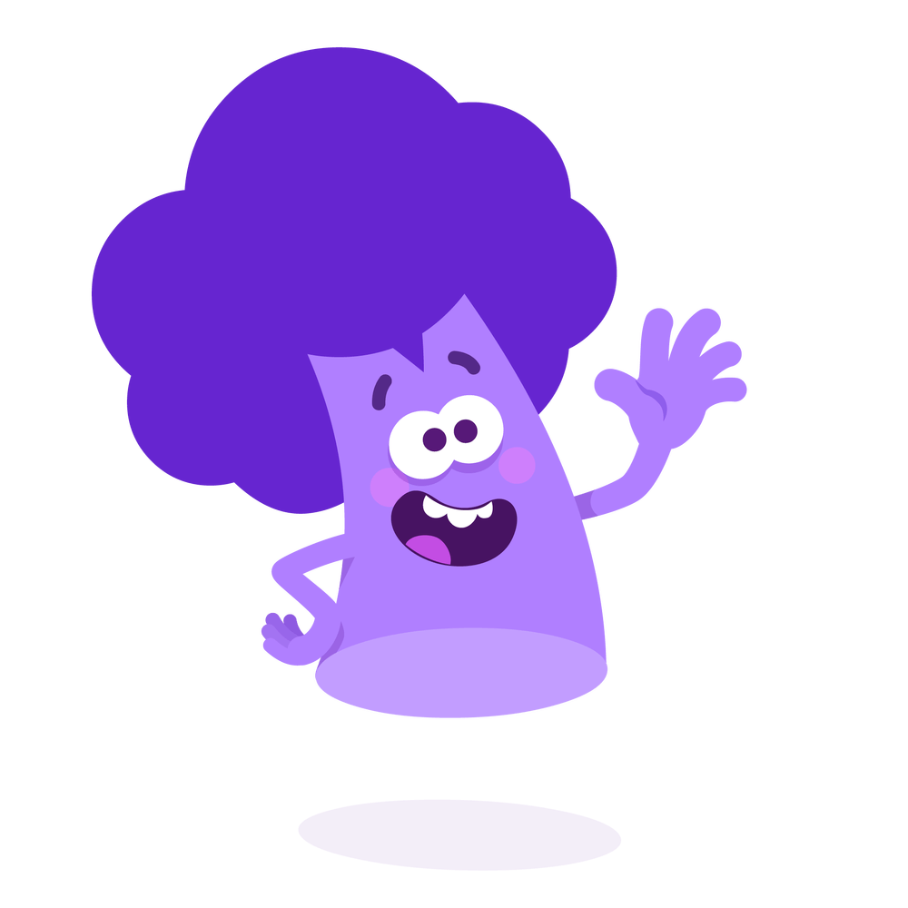
The end......
If you work out how to do other things........
Let your teacher know......
They're learning too!!!

