Slide 1
Key Health and Safety Measures – 28th August 2020

Slide 2
What changes are we going to see from Monday?
In corridors and social areas – using face masks
In the canteen – how to get your food
At lunchtimes – being outside

Slide 3
Advice about wearing facemasks
Applies in corridors, social areas, toilets, canteen, study areas, library.
You can choose to wear a facemask in class if you wish.
Applies to everybody in school, young people and adults.
Applies on all school buses

Slide 4
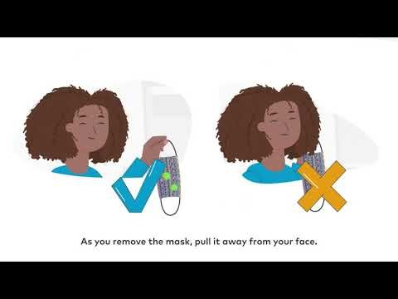
Guidance on how to wear a mask

Slide 5
At home you need to be ready to
Have a good supply of masks for use in school.
Have a good supply of sealable plastic bags for putting your mask in
Wash masks regularly – washing in water over 60 degrees, or boiling water
Ensure disposable masks are put in a bin safely and hygienically

Slide 6
You do not need to wear a mask in these circumstances:
You have a health condition or you are disabled, including hidden disabilities, for example, autism, dementia or a learning disability, and this means you cannot war a mask safely.
If you have breathing difficulties
If you need urgent medical assistance
you need to eat or drink (although you must put in on straight afterwards)
you are taking medication
When you are in a classroom, or the library for a lesson.
you are communicating with someone else who relies on lip reading and facial expressions to communicate
If you fit into these categories please speak to your registration teacher at the end of this session. We can then work out what to do on Monday morning.

Slide 7
Other important points
If you forget, or you mask breaks, you may use one of the school spare masks for that day only.
Please do not wear a mask that is in any way offensive.
Please have your mask on before you step into school.

Slide 8
Canteen Arrangements
Grab and go is a great option for everyone – for S1 and S6, this is the only way to ensure you can have hot food. Complete the bag before school, or at break and place in the tray in your area. Bags will not be completed in registration.
You must queue in the designated queue for your year – do not mix years. You must wear a mask when queuing.
Go outside, disposing of your food wrappers and waste in the bins.
If you stay inside, stay distant, remove your mask only to eat, and go outside straight afterwards.
We will open up the hall for S3 if a very wet lunchtime.

Slide 9
Change to the school day
Break for S1-3 will be after period 2, at 10:30am
This means no more split classes in period 2 for S1-3.
Break for S4-6 will be after period 3, at 11:20am
This means cleaning can take place between the two break periods.

