Slide 1
Study strategies to boost learning

Slide 2
Learning intention
To learn how to use the most effective study strategies

Slide 3
Success criteria
By the end of this session you will know how to use the most effective study strategies

Slide 4
Starter
Rank these study strategies from most effective to least effective:
Keyword mnemonic
Spaced practice
Re-reading material after an initial reading
Highlighting important information after reading
Retrieval of knowledge

Slide 5
MOST EFFECTIVE STRATEGIES
Retrieval
Spaced practice

Slide 6
Retrieval – what is it?
Deliberately recalling (retrieving from memory) material that you need to learn
Learning can be defined as a change in long term memory – this is what we are aiming for
“If nothing has been changed, nothing has been learned” (Kirschner)

Slide 7
retrieval – why does it work?
The act of recall helps to strengthen the memory until, eventually, the information will pass into long term memory.
When you get something wrong, you will have a clear idea of where the gaps in your knowledge are

Slide 8
https://static1.squarespace.com/static/56acc1138a65e2a286012c54/t/56fd8bd7d210b8df71bb9a46/1459456983864/Retrieval+Practice+concept+map.pdf

Slide 9
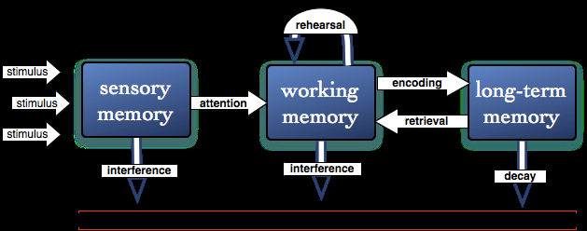

Slide 11
Retrieval – how to do it
You need to know what you need to know! Knowledge organisers/revision notes/flashcards
The importance of forgetting a little bit (Spacing – more later!)
Do it without notes and write it down
https://www.youtube.com/watch?v=Pjrqc6UMDKM&feature=youtu.be

Slide 12
Creating digital flashcards
https://www.cram.com/flashcards/macbeth-11655043

Slide 13
Spaced practice
Spacing out your study (embrace the effect of forgetting)
Set aside a little time each day
The opposite of cramming

Slide 14
HOW TO DO IT
https://www.youtube.com/watch?v=3WJYp98eys8

Slide 15
FINALLY
Make a study plan for the next week. Set aside around an hour each weekday and specify exactly what you are going to do.
What is one concrete thing you can take away from today ?

