Slide 1
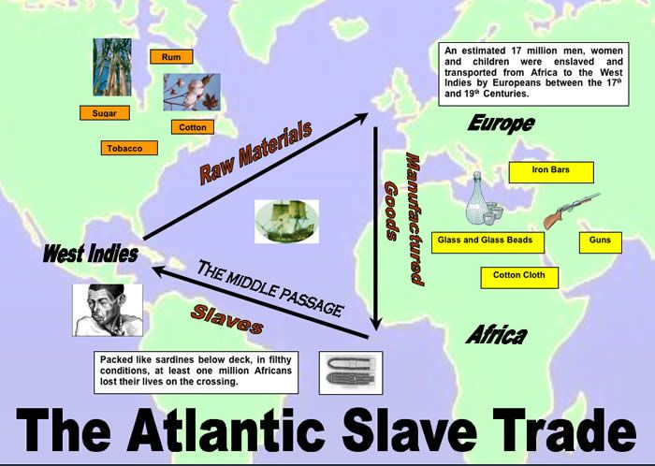
Triangular Trade
Effect on British Ports
Benefits for ports such as Liverpool, London and Bristol- mass growth of area, people move to cities, jobs are created such as ship hands, sailors, smeltors, new housing is built to house all the new workers, money- the cities become richer and people have more spare income.
Effect on African Societies
African societies are wiped out as their population is sold off (Ashanti tribe), there is infighting with guns to gain more slaves, become poorer due to a lack of workers, lose of tribe identify, racism booms and there is fear of ‘white men’.
Middle Passage
Slaves are transported in tight pack (spooning position) or loose pack (lying stretched out). Tight pack allows more slaves to be transported but less slaves will survive the journey due to illness.
There is minimal food and slaves are given tasks on board such as cleaning the deck & singing. There are revolts/ rebellions which result in deaths and punishments for slaves who survive. There is a serious lack of sanitation- slaves are covered in others urine and faeces and due to this, diseases are rife such as Typhus and Yellow Fever. Slaves are treated like animals and chained together.
Nature
Slaves are kidnapped usually from their village when collecting water, at night or when they are isolated from their tribe. The trade is about making profit and gaining materials. Goods created by slaves on the plantations are brought back to Britain- sugar, tobacco, cotton.
Organisation
Ships leave Britain with goods to trade in Africa, ships gain slaves in Africa to work on the plantations (mainly kidnapped) and put them onto ships then ships travel to America/ West Indies for slaves to work on plantations.
Slave Factories
Women are raped, poor conditions, minimal food, disease, punishment for deserters- death.
Effect on West Indies Plantations
Money taken from farmers who had plantation land previously, goods stripped from West Indies for Britain.

Slide 2

Britain and the Caribbean
The Impact of the Caribbean Trade on the British Economy
In terms of banking, loans were needed as people bought ships in order to make the journey to Africa for slaves. Two big banks were created from slave trade money: Lloyds and Bank of England. Ship building boomed as more people were involved in the trade and this led to better ships for Royal Navy. Liverpool became the biggest dockyard with lots of jobs and wealth created. The textile industry grew as well as cotton factories that grew bigger from profits.
Sugar
Sugar is a cash crop that is easy to produce and was worth a lot of money as it was hard to get ahold of at this time. It was used in food and drinks especially by the wealthy people.
British Impact in the Caribbean
They created new roads and laws to change the running of the country to be more similar to Britain.There was a new mixed society of blacks and whites which was unique. Women kept at home and seen as subservient to men. There was a mass population increase as many people were transported onto the plantations as well as children created from white plantation owners raping slaves.
Negative Impact on the Caribbean
There was a large amount of unskilled workers left in the Caribbean who could only work on farms. This damaged the economy as they could not compete with other countries who had technological advances. There was a loss of goods as the British took them away to sell. Women seen as lesser than men. Racism grew with the idea of blacks as lesser. Many healthy young black men and women died in slavery meaning there was an aging population and not even young people able to reproduce to bring population levels back up.

Slide 3
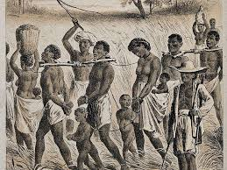
Captives Experience and Slave Resistance
Discipline
Plantation owners took discipline very seriously as it was a means of control. Some would brand their slaves with initials or whip and mutilate them. Punishments were , always done in public as a warning to other slaves.
Fear of Revolt
Slaves were not allowed to meet in groups and were stopped from speaking in their own language as there was a fear that they would organise a revolt. Any slave who was suspected of planning a revolt was killed usually by hanging as a warning to other slaves who may be planning a revolt.
Resistance
There were many ways that slaves could resist on the plantations such as poisoning owners food or learning to read and write in English. Some slaves may have been brave enough to actively resist by running away. Other slaves would passively resist their owners by working slowly or pretending not to understand their instructions.
Plantations
Slaves on the plantations worked all day from sunrise to sunset. Slaves would be punished if they were not working hard enough. Slaves would sleep in wooden huts that would hold up to 10 people and they would sleep on the floor. Many slaves were separated from their families. They were given minimal food to keep them weak. They would be given new British names and forced to go to church with their masters.
Slave Labour
There were white indebted servants on the plantations who were people who owed a debt to plantation owner. They would mainly working as servants/ maids in the big house. Criminals may also be used as slave labour on the plantations alongside black slaves.

Slide 4
The Abolitionist Campaign
Origins/ Arguments of Abolition
Abolition stemmed from three key arguments: religious (idea that it was not Christian to hold another person as a slave and against the Bible), humanitarian (it was not fair and a waste of human life) and economic (the slave trade was not financially beneficial for Britain and goods could be created cheaper in India).
Methods
Public meetings and petitions were popular methods used by abolitionists as well as newspaper articles and the use of evidence to convince people about abolition.
Support for Abolition
Support was evident in the increase of MPs voting for abolition in bills in parliament. People started to boycott sugar that was created on the plantations and there started to be discussions about the conditions of the slaves in public. Newspaper articles were written about the horrific conditions slaves had to suffer. People spoke positively about Wilberforce who was trying to push through change in parliament.
William Wilberforce
Wilberforce was active in parliament presenting bills for over twenty years to abolish the slave trade. In 1789, he gave a three hour speech to parliament against slavery.
Arguments for Keeping the Slave Trade
People argued that jobs would be lost that could cause Britain to have a revolution just like France had. People thought the British economy would collapse as well as a halt to the Industrial Revolution, and that slaves were actually being treated well.
First Hand Evidence
Olaudah Equiano was kidnapped and became a slave. He later managed to escape slavery and wrote a book about his first hand experiences. This became a best seller and he toured the country promoting his book. Thomas Clarkson collected evidence such as chains used on slaves and presented these at public meetings to let people see what was used on slaves.
Reasons for Success
The continual pressure of the abolitionists as well as the amount of evidence of the poor conditions for slaves helped slavery become abolished. The case of the Zong highlighted the horrific treatment of slaves as subhuman. The economic arguments saw people realise they could save money paying workers who would work harder. Public support also helped significantly.

