Slide 1

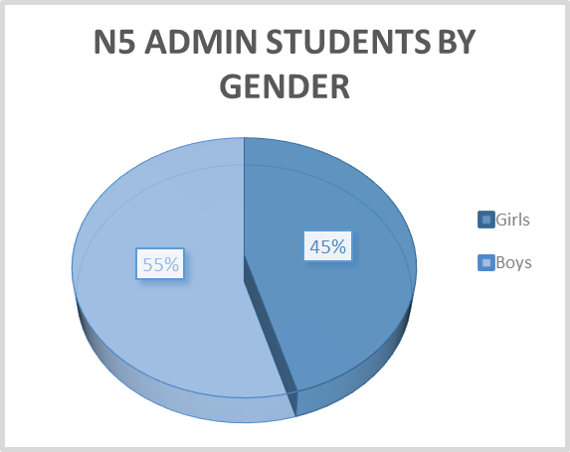
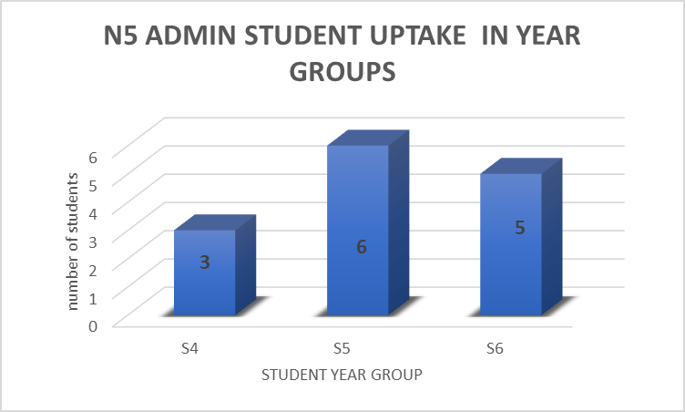
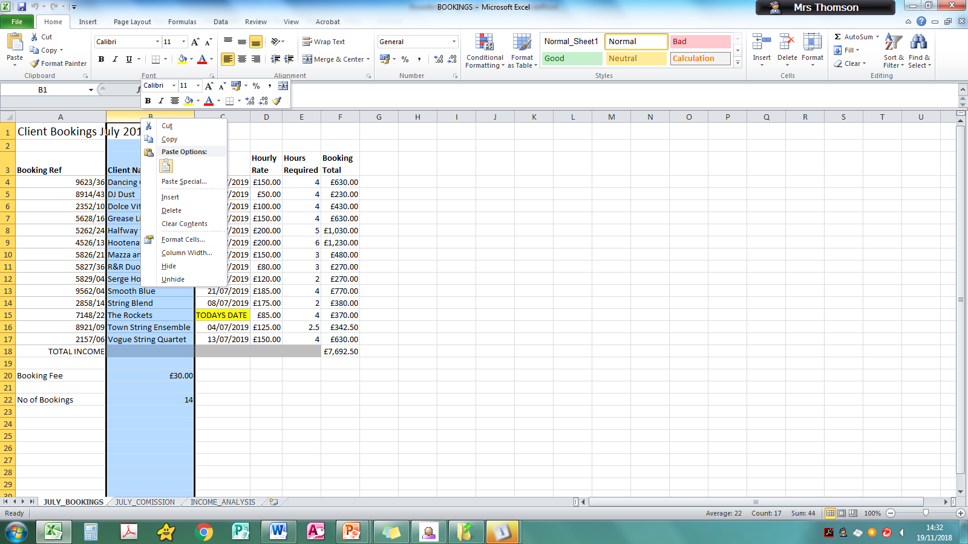
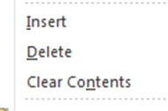


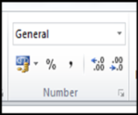
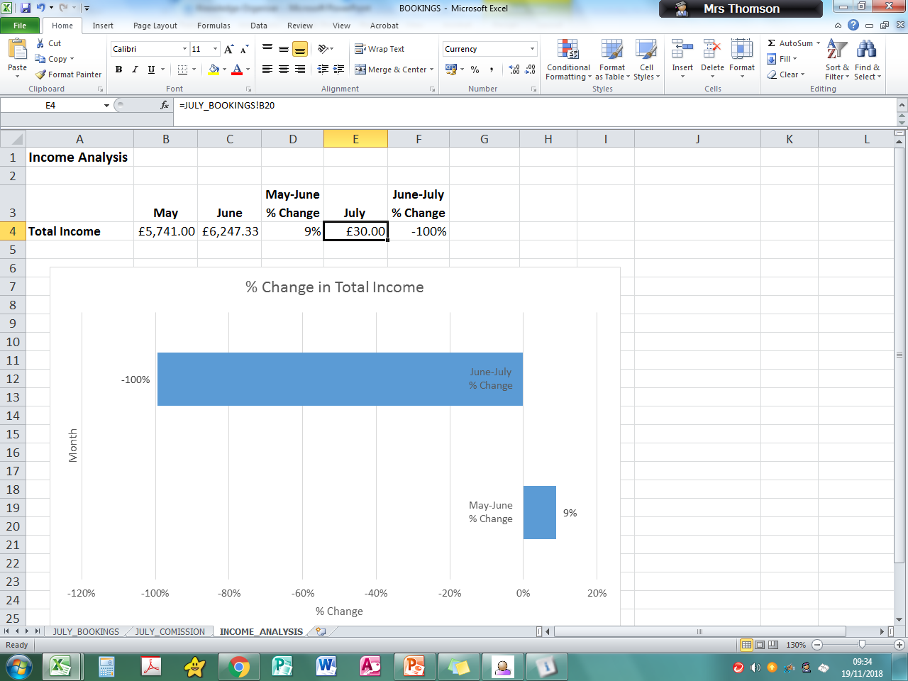
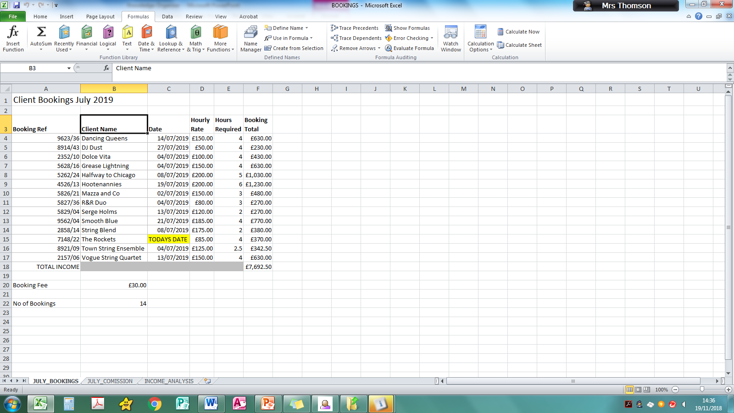
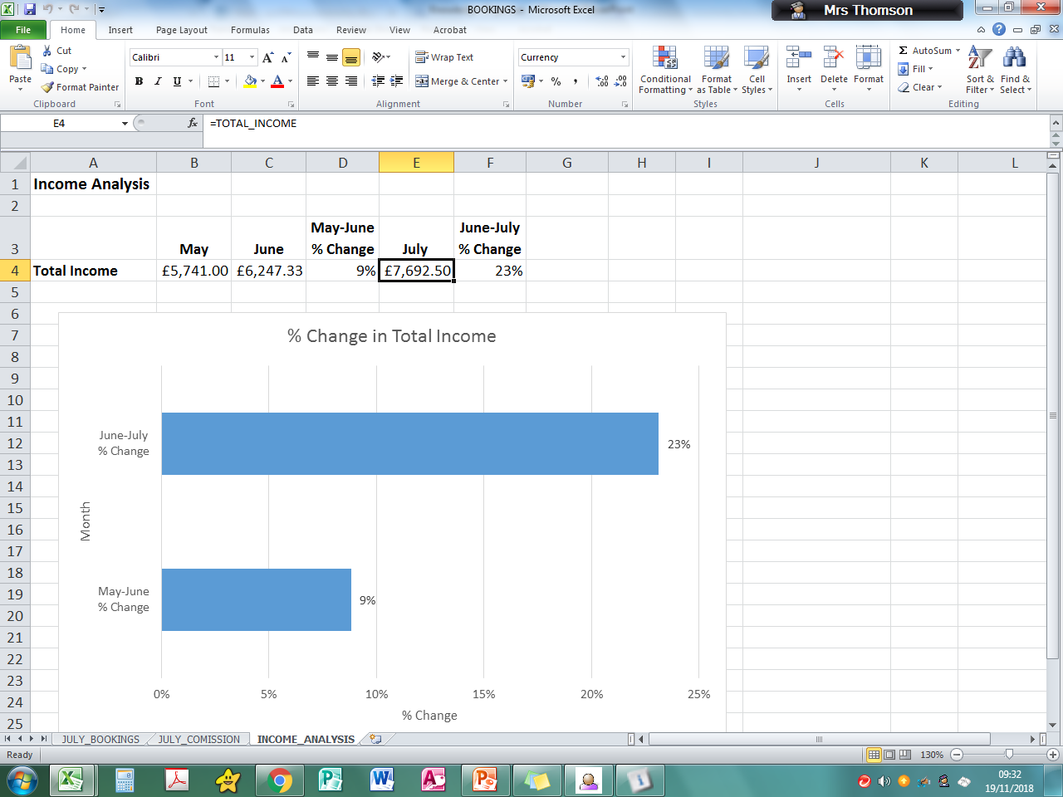





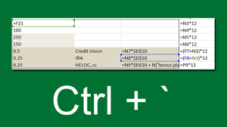

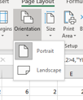
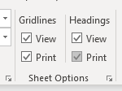
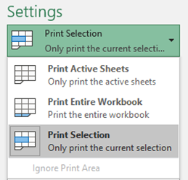
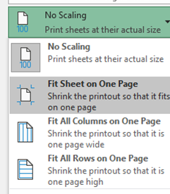
N5 Administration & IT Spreadsheets Knowledge Organiser
Basic Skills Checklist
Structure Function | Additional Guidance – what does it look like?
Hiding rows/columns | Right Click Mouse
Inserting/deleting rows | Right Click Mouse
Aligning data/merging
Cell formatting (currency, date etc, decimal places)
Link cells in worksheets
Name cells
Absolute cell reference | $A$4
Sort data vertically on one or 2 columns (filter) | Use advanced sort
Print charts/using patterns Embedded or separately | Look carefully at printing instructions to see if just chart or c hart within worksheet
Create and label charts | See key elements of charts
Format text and cells | Change size/embolden etc
Formulas
ALL Formulas start with =
Average |  | Shows the average of values in a range
Max |  | Displays the biggest value from a range
Min |  | Displays the smallest value from a range
Sum |  | Adds up the total value of the cells in a range
Count |  | Gives the number of entries in range – containing numbers
CountA |  | Gives the number of entries in range – containing numbers and text
IF |  | A logical function to test to see if a condition is true
Numerical Operators
> | greater than |  | < |  | less than
>= | Greater than or equal to |  | <= |  | Less than or equal to
Showing Data Graphically
Key Elements of a Chart
Title | Think carefully about the title given – consider what it is showing – key the title in UPPERCASE. Always insert a suitable title even if not instructed
Axes | Label both horizontal and vertical axes – make sure that all info is visible.
Legend | Insert this if required (bar/line/column). Ensure that it makes sense not just series 1 etc.
Data Labels | These should be inserted if instructed – pay attention to whether it is vale or percentages.
Printing
It is crucial you pay attention to the instructions with regards to value view and formula view. Also make sure the entire formula is visible and no truncation!
Calculating % Change
(NEW-OLD)/OLD (FORMAT TO PERCENTAGE!)

Slide 2
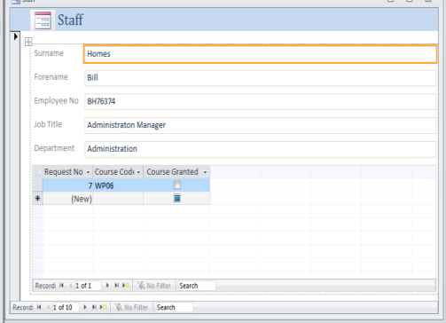
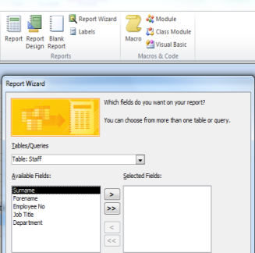

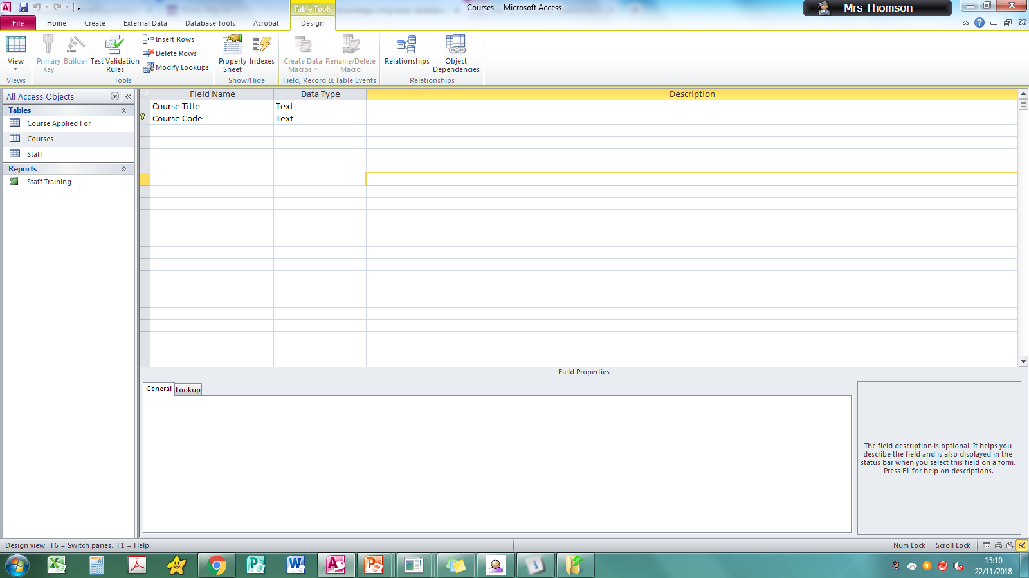
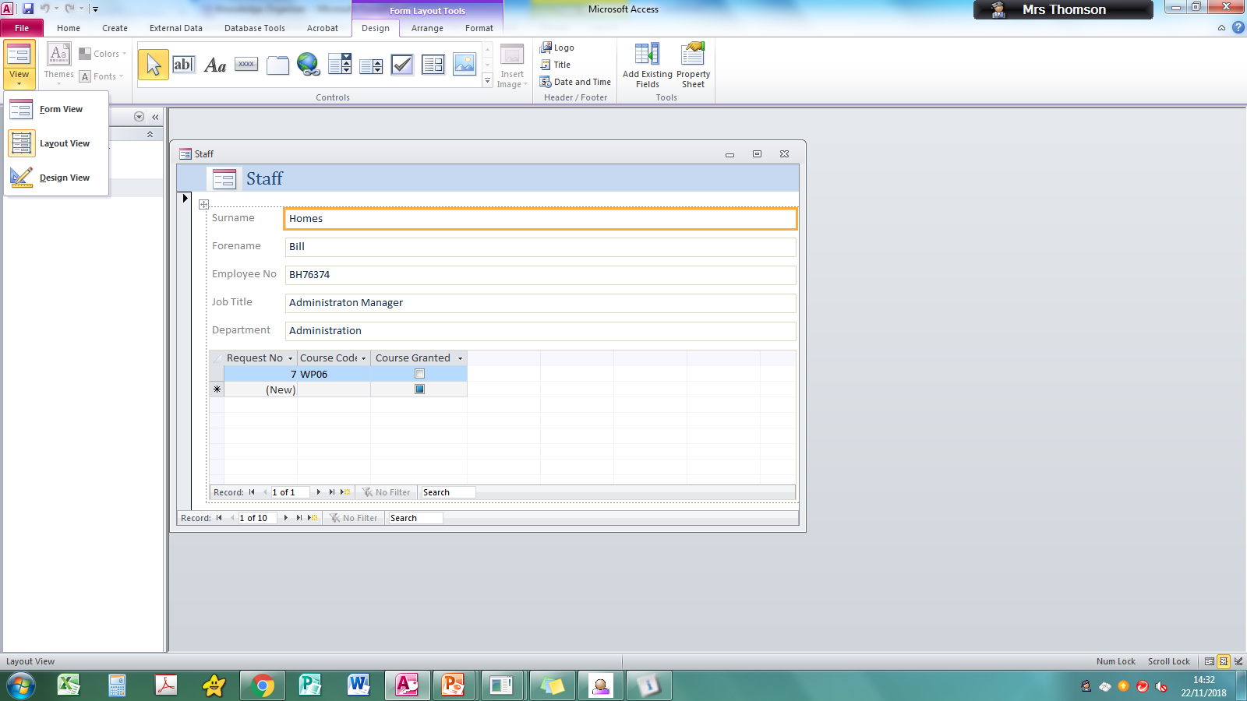
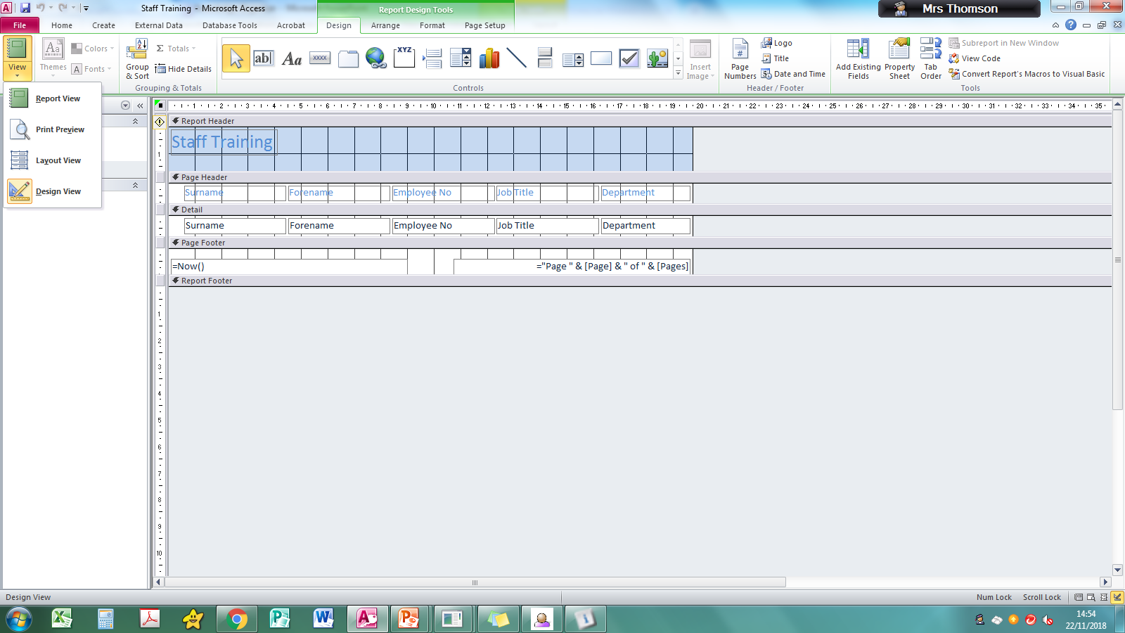
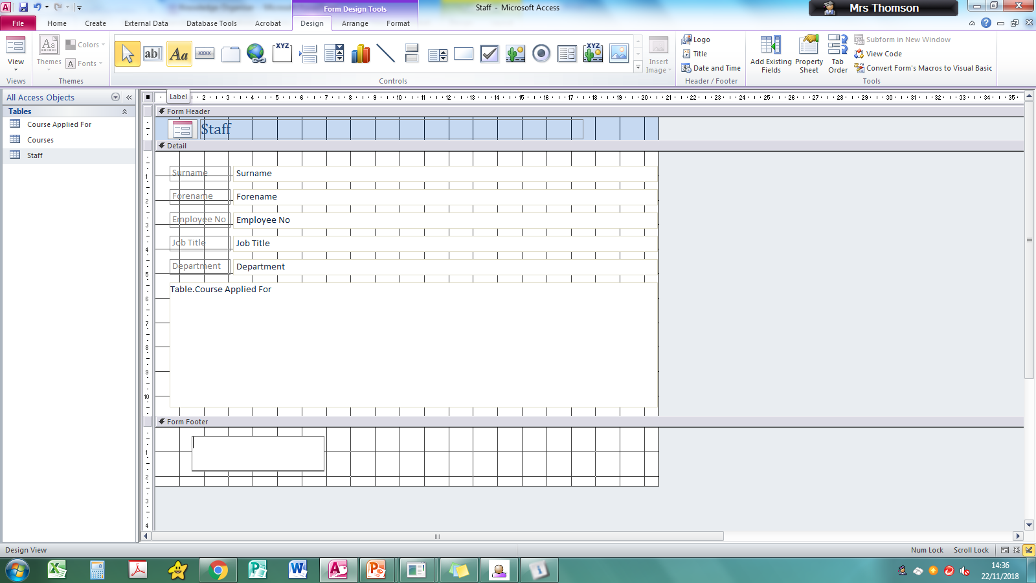

N5 Administration & IT Databases Knowledge Organiser
Basic Key Terms
Key Terms | Definition?
Field | A single piece of information about the person/thing eg Surname
Record | A collection of fields that provides information about one person/thing
Relational database | A database using more than one table which are linked through common fields
Query | A search made within a database
Primary key | A unique field that prevents 2 records having the same information
Forms
professio
You should be able to create a form using selected fields from more than one table. Be careful when Naming the form – key in UPPERCASE to avoid losing marks for inappropriate use of initial caps
 | When working with forms you may need to work between Design view and Form view This will allow you to ensure that all data is visible and will allow you to add in any footers that are requested. Use this icon to add the footer text
 | Print forms directly from the database – when selecting Print use the Print option NOT quick print – this allows you to print the selected record or to choose which records to print – you will NOT be asked to Print all.
Reports
You should be able to create a REPORT using selected fields from more than one table. Be careful when Naming the Report– key in UPPERCASE to avoid losing marks for inappropriate use of initial caps
 | When working with Reports you may need to work between Design view and Form view This will allow you to ensure that all data is visible and will allow you to add in any footers that are requested and Graphics.
 | Print reports directly from the database. Ensure ALL data is visible and that any imported graphics are not covering text. Check if it is to be landscape or portrait and whether it should be displayed on one page.
Use the Report Wizard and select the fields you require from the Tables or from the Queries in the drop down list
It is usually a Query that you would use for a report!
Searching – Queries
You should be able to search for an exact match in one or more fields of for a range within fields. Search is called CRITERIA.
Search Operators
> | Greater than | < | Less than
>= | Greater than or equal to | <= | Less than or equal to
Or | Used when 2 search criteria | Not | Used when you want to eliminate something
WildCards Use this to search for incomplete or partial data – placement of * is important. *admin admin * *admin*
Mail Merge
Information from your database file can be merged into a word processing file to make the document personalised common for letters and name badges etc.
Labels – should be completed in the database package – be aware of any header/footer that needs to be put in.
Tables
When inserting new fields use DESIGN View – make sure capitalisation is consistent with other fields.
Tables should be printed in Word to allow you to put your name and task number in the footer. Use the External Data tab.
Notes:
Be careful that you use the same formatting as the field eg if currency no need to enter £.
Be very careful with date formats

Slide 3







N5 Administration & IT ADMINISTRATIVE THEORY Knowledge Organiser
File Management
Features of File Management ; naming, back-up, folders, files , antivirus, passwords
Benefits of Good File Management; finding files efficiently, time saved, frees up space, no duplication
Consequences of Poor File Mgt; time wasted, files are duplicated, takes space
General Data Protection Regulations (GDPR)
Europe wide data protection law applied to personal data that has 7 principles
Info should be processes lawfully and fairly
Data should be collected for a specific purpose
Data should be limited to what is necessary for the purpose
Data should be accurate and error free so must ensure it is updated
Data has a storage limitation – meaning it should not be kept for longer than necessary
Confidentiality – should insure security to protect against unlawful processing etc
Accountability – the organisation is responsible for what they do and must comply with the other principles
Tasks, Skills and Qualities
Tasks and Duties of an Administrator: Answer phone, update databases, organise meetings and events, file documents, reception duties etc
Skills and Qualities of an Administrator: Organised, able to communicate well, team worker, good IT skills, patient, tactful, approachable
Security
Security of People; name badges, uniforms, visitors report to reception, CCTV, panic alarms, security guards
Security of Property; locks on windows/doors, list of equipment, staff lockers, attach equipment to desks, security blinds, alarms
Security of Information (electronic and paper files); change passwords, fingerprint/face recognition., lock screens on computer, access rights, usernames, train staff, install anti-virus, encrypt files
Features of Current Legislation, including- GDPR 2018 Computer Misuse Act 1990
Health and Safety
Current legislation Health & Safety at Work Act 1974 Fire Precautions (places of work) Regulations 1995 Health & Safety (Display Screen Equipment) Regulations 1992 Health & Safety (First Aid) Regulations 1981
Responsibilities of Employers and Employees; provide training, provide safety equipment, provide protective clothing. Employees should report hazards, take reasonable care, not misuse any H&S equipment
Identification of Hazards in the Workplace; trailing wires, overloaded sockets, spillages etc
Explanation of Ensuring Safe Practice; use of accident forms and the accident book
Customer Service
Features of Good Customer Service; customer service policy, feedback forms, staff training, dealing with complaints, hiring suitable friendly staff
Benefits of Good Customer Service; loyal customers, good reputation, attracting new customers, fewer complaints, competitive edge, increased sales
Consequences of Poor Customer Service; dissatisfied customers, more complaints, lose of sales/profits, legal action, increased wastage, poor reputation, bad publicity

Slide 4

N5 Administration & IT Marking Principles Knowledge Organiser
Spreadsheets
Please be careful to include: The value view The formula view Watch for gridlines on and off Watch for row and column headings on/off
Named Cells must be keyed in accurately (eg spelling and caps). If name not given choose something relevant!
Formula | For addition with 3 or more cells you must use SUM – this is the ONLY time you use SUM. No marks are awarded if formula is truncated.
Formatting | Ensure consistency in cell formats.
Databases
When inserting graphic or logo in a Form or Report – it should be to the right or left of centre
Your name should not appear in a Report or Form header
If you are asked to do a query, report that includes name you MUST include the Title, First Name and Surname UNLESS specifically instructed otherwise.
Forms should not include duplicate fields. Watch format of fields when using queries.
Field names must not be truncated.
Theory: Command words
Outline | make a brief statement appropriate to the question. 1 mark will be given for each accurate brief statement.
Describe | make a detailed statement, as appropriate to the question. 1 mark will be given for each accurate detailed statement.
Explain | make an accurate relevant point that relates cause and effect. 1 mark will be given for each accurate cause and effect.
Capitalisation
Consistency is key – if error made this is a loss of 1K mark for each question the error is made in
Key in ALL titles in CAPS
Other Hints …
Watch spacing after full stops, commas and other punctuation Never highlight punctuation Watch the difference between a hyphen and a dash No spaces in Telephone numbers No text speak or emojis in Emails Consistency and fit for purpose PROOFREAD Tick off instructions in QP as completed
Standard Formats
Dates Any standard format acceptable 23 November 2018 23rd November 2018 23/11/18 All dates must have a year | Times Any standard format acceptable 1000 hours/1000hrs 10:00 hours/ 10.00hrs 10 am/10am Do not use a.m or p.m
There must be consistency of style within a task
Headings
These should be enhanced in some way – even if not told! Block capitals with or without bold Initial capitals and bold Initial capitals and underscore Increased size of font
Headings with initial capitals eg – ‘Models for Graziella Photoshoot’ - conjunctions should NOT be capitalised
If your stuck in exam …
Don’t Panic - stay calm Print what you mange to do Move on – don’t waste time You have got this!!!
Notes:
.

