Slide 1
Senior Choices
Choices and Qualifications in S4

Slide 2
Key principles – S4
Pupils are at the start of a process to ensure Pupils are placed in the right courses.
Pupils will study at National level.
Every S4 pupil studies English and Maths.
There are 5 free choices, based around subjects on offer in 5 columns.
In S4, pupils are continuing courses started in S3, exceptions are RMPS, Media, Computer Game Development, Construction, a joint National 4 Social Subjects course, NPA Art and Design, NPA Photography, Admin and IT , College courses.
S4, 5 and 6 pupils can be timetabled together in these columns.
Courses are delivered by school staff and staff from Borders College.
Pupils need to be thinking in terms of their learning pathways for the rest of their time at school and beyond.

Slide 3
Comprehensive online information
Pastoral interview after Feb Break
Course choices collected in your Pastoral Interview
We allocate classes – students will find out before after Easter.
Senior Phase Choice Sheets
Speak to class teachers and PTs about courses
Can request interview with Gillian Millar from Skills Development Scotland.
If classes need adjusting, we will complete this process in August
College Applications

Slide 4
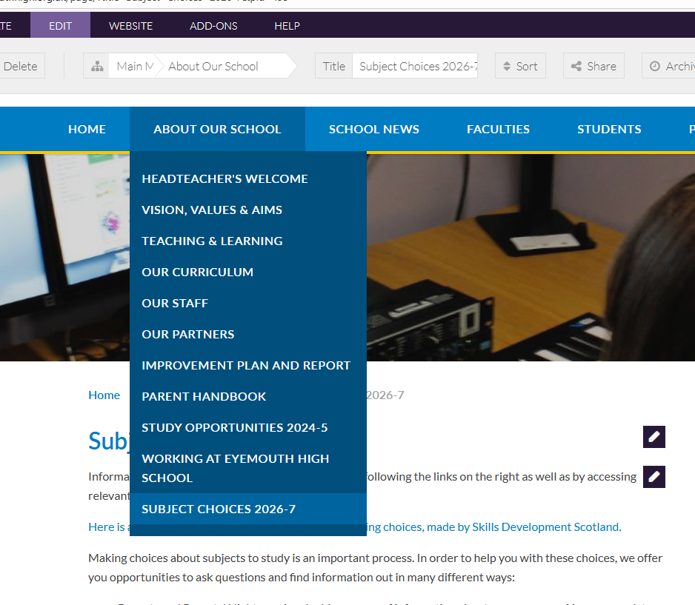
Using the website

Slide 5
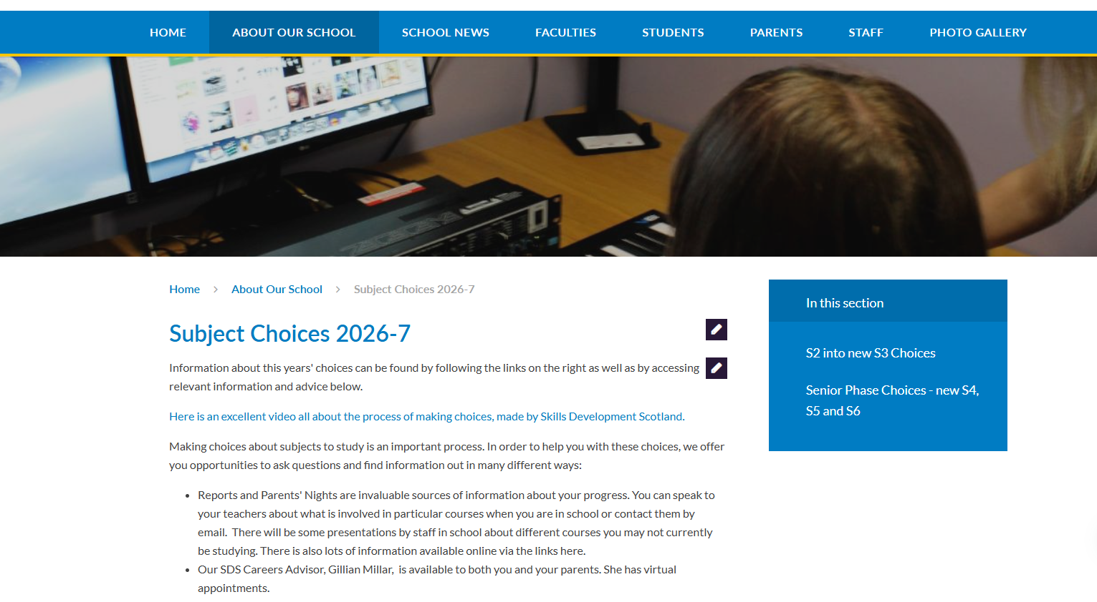
Using the website

Slide 6
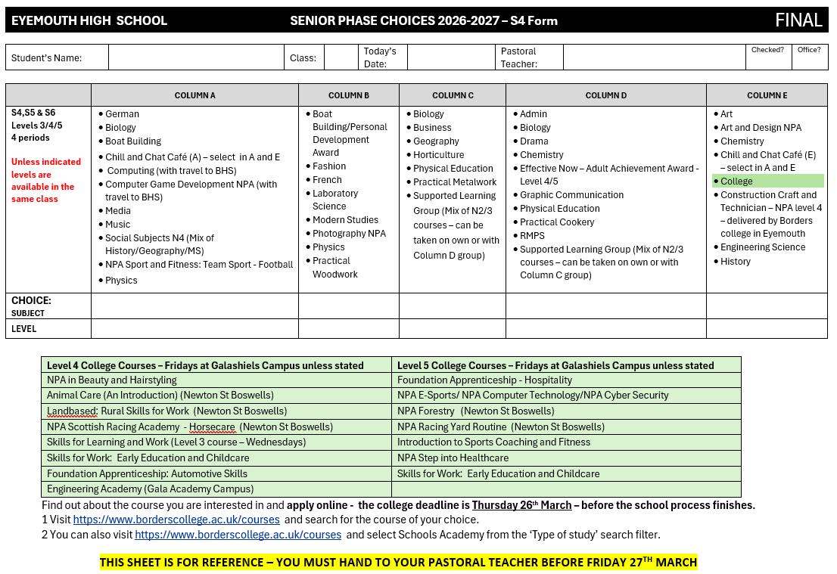
S4 Choices

Slide 7
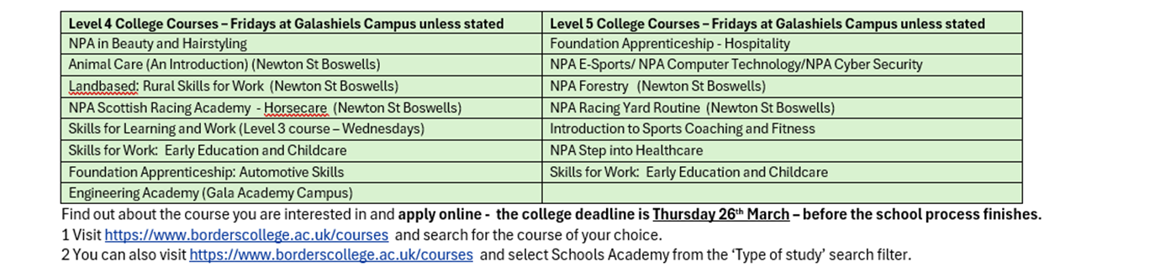
College Options – Friday
More information online via the college website, speak to Pastoral Teacher to apply.

Slide 8

Five Columns
Five Choices

Slide 9
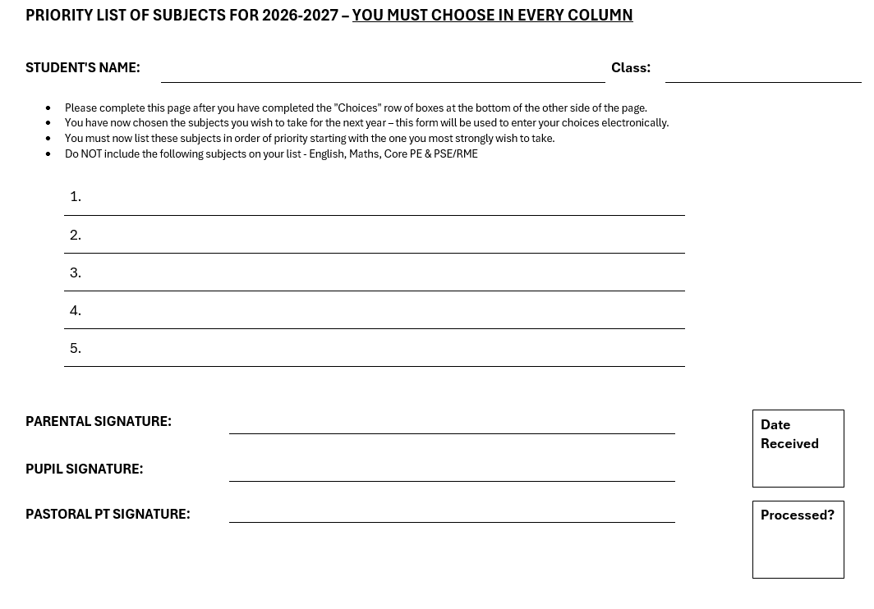
Choices, will be collected by your Pastoral Teacher this year

