Slide 1
S2 Choices for S3
Having choices in a broad, general education to prepare for the Senior Phase.

Slide 2
7 Qualifications in S4
Broad General Education –S3
Broad General Education –S1-2
5 Qualifications in S5
Further study in S6
Potential exit points

Slide 3
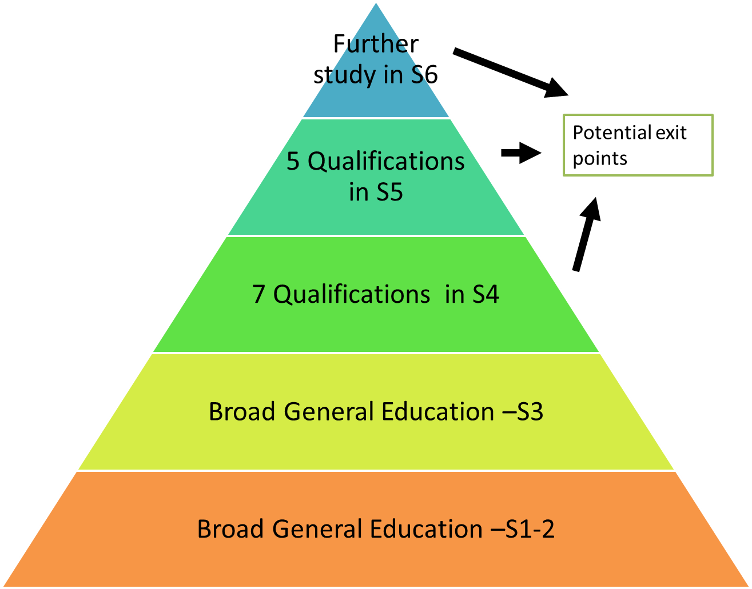
Preparing for a lifetime of learning!
‘New’ jobs
Technology
Community Involvement
Leadership development
Volunteering
Running Businesses
Career Progression
Professional Training
Employment
Apprenticeships
Further Education
Higher Education
98%

Slide 4
Making good choices?
What I am good at?
What are my friends doing?
What I enjoy?
What is easy?
What job it could lead to?
Do I get on with the teacher?

Slide 5
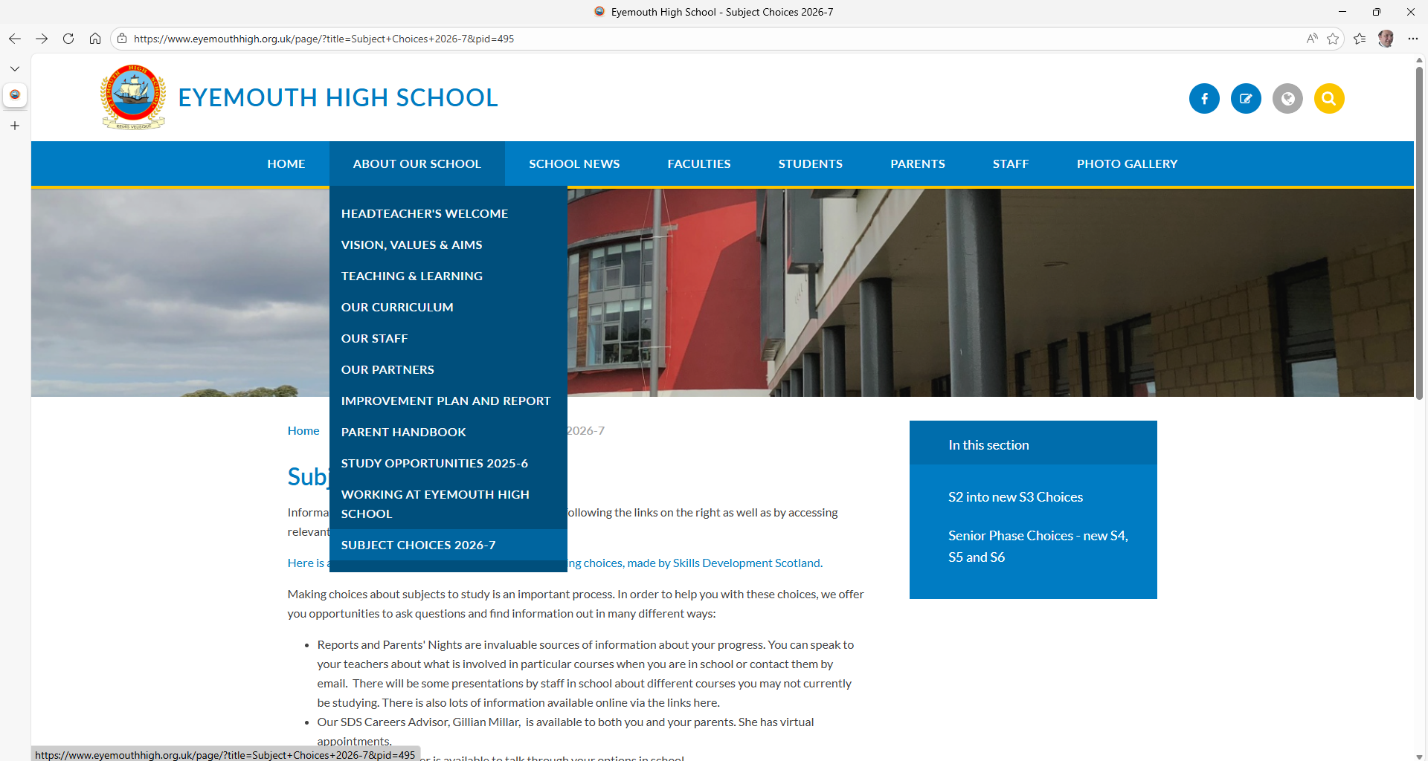
Using the website

Slide 6
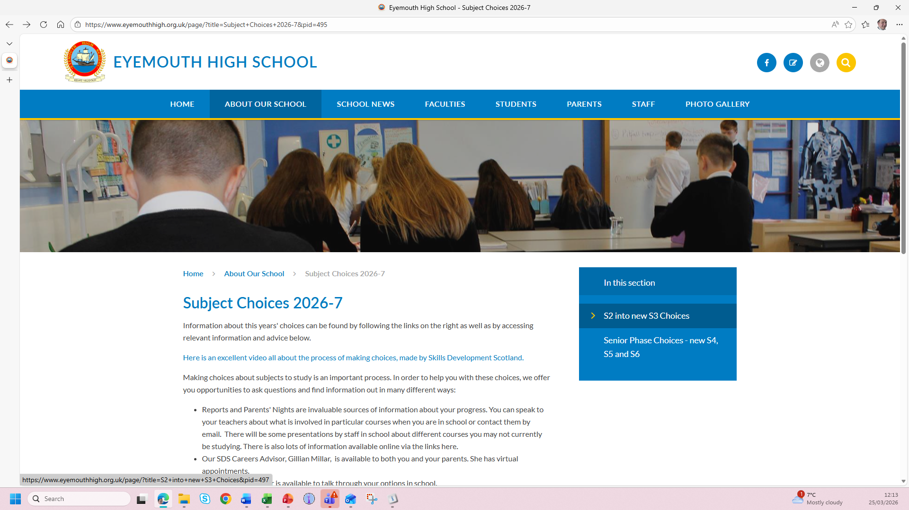
Using the website

Slide 7
Key principles
We are at the start of a process to ensure students are placed in the right courses.
Students study at Curriculum for Excellence levels 2-4.
Every S3 student studies English, Maths, PSE, PE and RME, alongside a broad range of options.
There are 7 free choices, based around subjects on offer in 7 columns.
Many choices are available in two different columns.
You need to be thinking in terms of your learning pathways for the next four years.

Slide 8
Process
There is online information available about each subject on offer on our website.
You will be issued with the S3 course choice sheet.
Conversations taking place in classes about courses now and after Easter.
Your young person will have an interview with their Pastoral teacher to discuss their options further.
They have the option of an interview with Gillian Millar, our Skills Development Scotland Careers Advisor.
Choices will be collected electronically by Monday 27th April
We allocate classes – you will find out shortly after. New courses start in June.

Slide 9
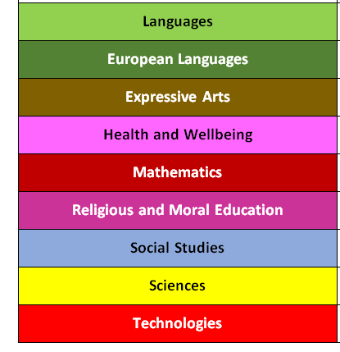

Slide 11
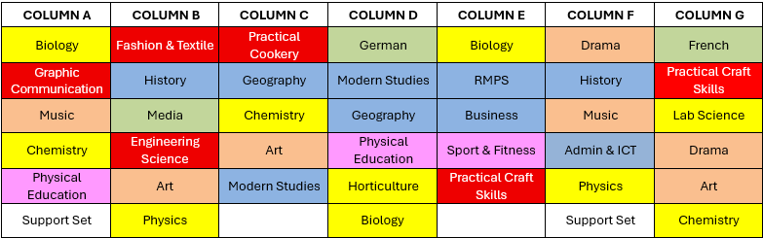
There are lots of different ways students can study a particular set of subjects – think carefully about what they want to do first, then see how it fits in.

Slide 12
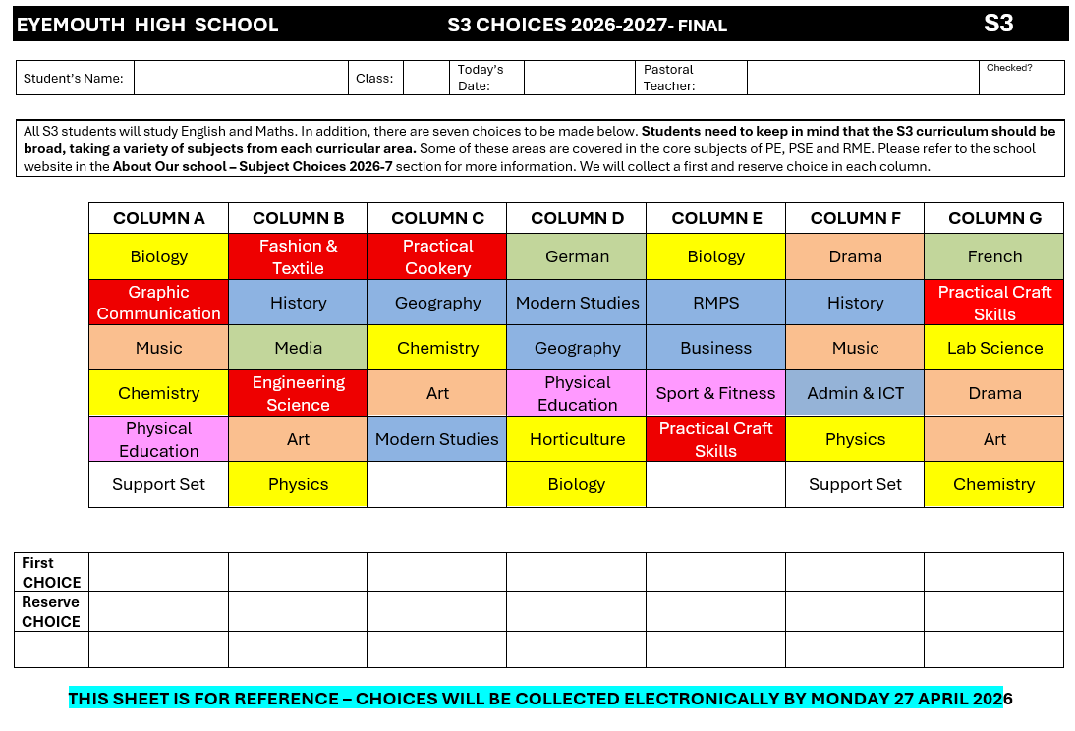

Slide 13
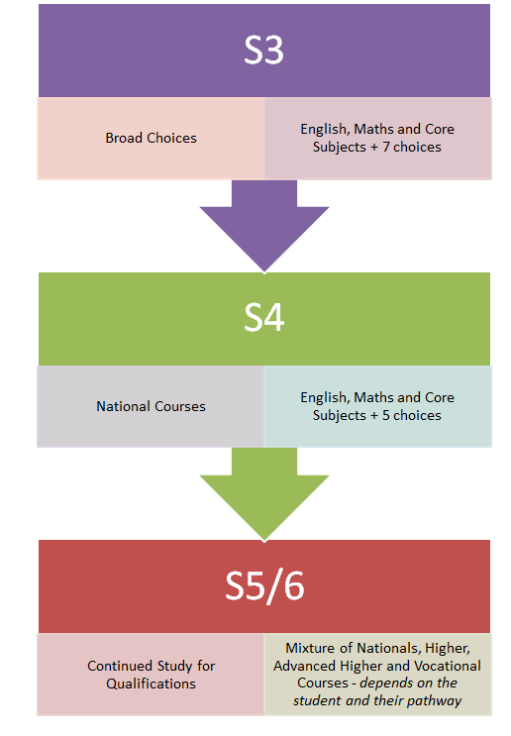
We expect students to take on subjects studied in S3 into S4, S5 and S6.
There are details online about subjects on offer in S4, S5 and S6.

