Slide 1
Towards great teaching
Linking international research to classroom practice
Bruce Robertson
September 2018

Slide 2
Aims
Repeat and consolidate some of the teaching and learning themes we have looked at and discussed over the past 18 months.
Get you to think more about how messages from international research can help you to make teaching and learning in your classroom (even) better.

Slide 3
February 2018 In-Service
To what extent is Eyemouth High School a great school?
The key measure of greatness is the quality of teaching and learning
  Every teacher can directly influence this
  Underpinned by strong relationships, leadership, curriculum and support.
There is nothing to stop the quality of teaching and learning in Eyemouth High School being the best in the Borders, or indeed, the best in the country.

Slide 4
EHS
Climate & Culture
Climate & Culture – what it’s like to be part of our school
Outputs – what we are aiming to achieve
Successful Learners; Confident Individuals;
Effective Contributors; Responsible Citizens
KEY
Measures – what we gather data on
Engagement
Enjoyment
Achievement
Drivers – what we should focus on
Curriculum
Pedagogy
Support
Foundations– what everything is built upon
Leadership
Relationships
Vision
Aims
Values

Slide 5
How do we ensure great teaching?
By ensuring that teaching and learning is ‘the thing’ – that we are always thinking about it and always talking about it.
By ensuring that we have a shared understanding of what we mean by great teaching and learning.
By ensuring that we have a culture of professional learning (or learning).
    Not seeing classrooms as discrete and autonomous – rather, we steep ourselves in collaboration.

Slide 6
How do we ensure great teaching?
By ensuring that we think about barriers and do something to address these.
    Not seeing the idea of ‘continuous improvement’ as being about criticism that we aren’t good enough – we value learning and we value learning from each other.
    Accepting that time will always be an issue but to strive to make time for our own learning every week – otherwise we are just busy ‘doing’, not ‘improving’.

Slide 7
Your classroom
How would you rate (typical) teaching and learning in your classroom?
10, 9, 8, 7, 6, 5, 4, 3, 2, 1

Slide 8
Professional Learning
Read
Books
Observe
Other teachers
Do
& self-evaluate
Discuss
Faculty meetings
Get feedback
Articles
Peers
PT
Practise
After observed lessons
Blogs
SMT
Students
Use the LET
PT T&L
In-school groups

Slide 9
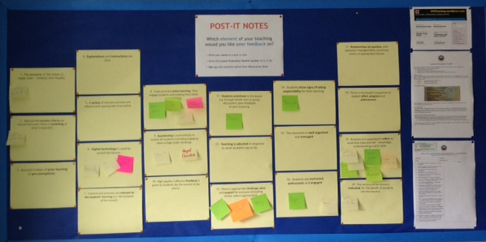

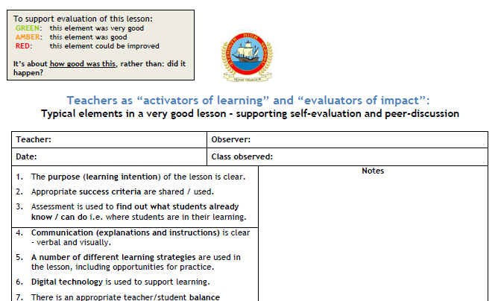

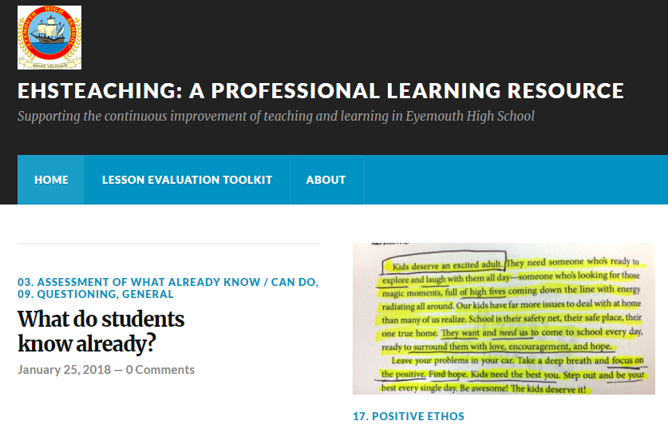
Lesson Evaluation Toolkit
Learning & Teaching Improvement Group
Workshops
Peer Observation Fortnights
In-faculty peer observation
EHSTeaching website
Sharing practice discussions at faculty meetings
Sharing Practice Boards
Professional Reading Group
Faculty Fortnight Review Programme
PT Teaching & Learning
Teacher Professional Learning Plans
Annual PRD

Slide 10
What is “learning”?
Take 1 minute to discuss with a partner.
“A change in long-term memory” – Kirschner, Sweller, Clark (1998)
Teachers are in the business of developing the long-term memory of young people.
We need to ensure that we have a good understanding of what research says about how we can best do that.

Slide 11
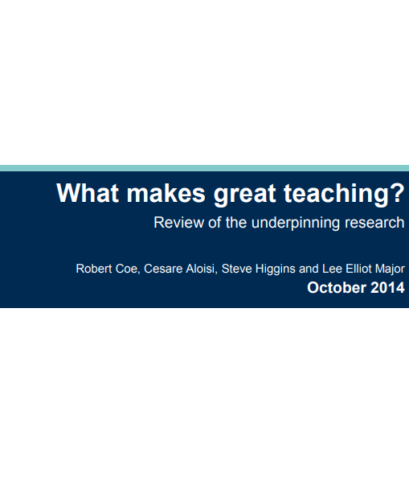

Slide 12
The Sutton Trust
(Pedagogical) content knowledge – having a deep knowledge of what is to be taught and the way that students typically think about it i.e. their common conceptions;
Quality of instruction i.e. pedagogy – how content is taught;
Classroom climate – the interactions between teachers and students, teacher expectations, recognising effort and motivating students;

Slide 13
The Sutton Trust
Classroom management – making efficient use of the time available, use of resources, management of student behaviour;
Teacher beliefs – their theories about learning and how it happens;
Professional behaviours – reflecting on a developing professional practice, participation in professional learning, supporting colleagues, communicating with parents.

Slide 14
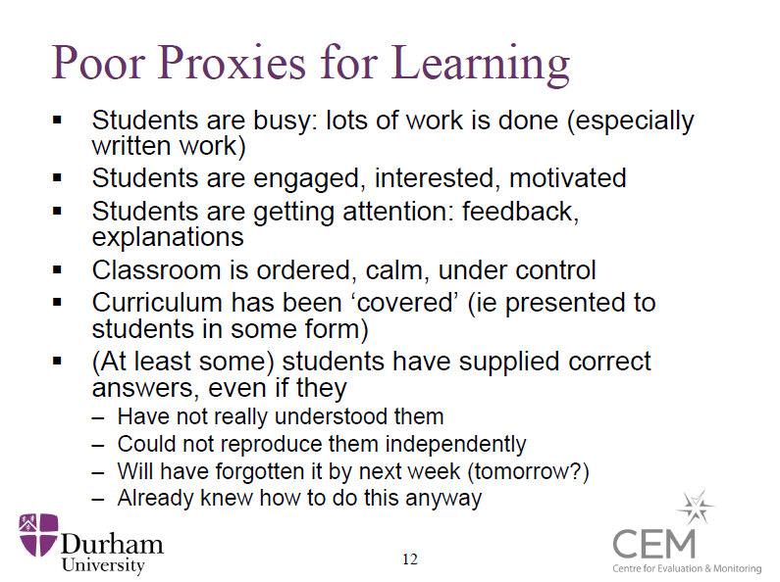

Slide 15
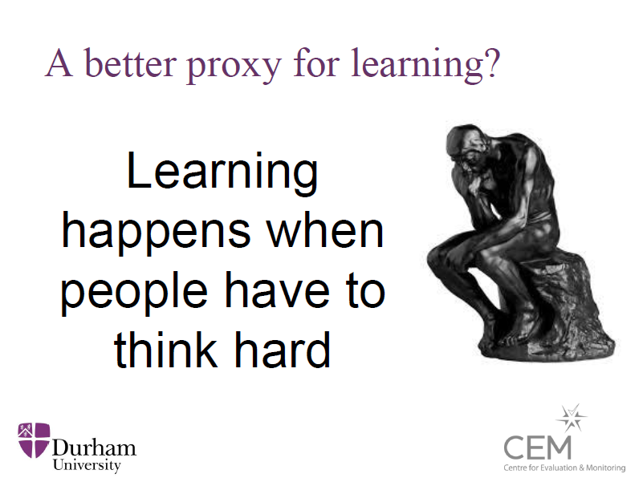

Slide 16
Odd one out?
Student control over learning
Enquiry-based learning
Within-class grouping
Discussion

Slide 17
Effect Sizes

Slide 18
John Hattie’s Effect Sizes
Where would you rate your knowledge and understanding of ‘effect sizes’?
10, 9, 8, 7, 6, 5, 4, 3, 2, 1

Slide 19
Effect sizes
A means to compare the effectiveness of different teaching practices.
John Hattie presents “effect sizes” based on 800 meta-analyses of 50,000 research articles, involving around 240 million students.
Any effect size above zero means that the practice impacted positively on attainment
  Almost any practice can make a difference to student learning.

Slide 20
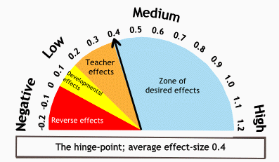
Effect sizes
But Hattie argues that this isn’t good enough and that effect sizes of 0.4 and above (translating into one grade of difference) is what we should be focusing on.

Slide 21
The practice of teaching
Hattie argues that there is a “practice of teaching”
  Not a fixed recipe
  Not a set of principles that apply to all students
  But practices that are particularly effective and practices which are not
  Teachers need to be focusing on the practices that research suggests have the biggest impact on learning

Slide 22
Effectiveness of these practices?
Co-operative learning
Enquiry-based teaching
Take 2 minutes to discuss
Write down the two you think are the highest
Write down the two you think are the lowest
Frequent testing
Goal setting
Within-class grouping
Direct instruction
Questioning
Student control over learning
Feedback
Discussion

Slide 23
Effectiveness of these practices?
Discussion
0.82
Teacher clarity
0.75

Slide 24
“Teacher clarity” (0.75)
Ensuring a clear lesson purpose; clear explanations; clear demonstrations; practice tasks clearly focused on the lesson purpose; checking that students have a clear understanding on the new material.
One of the main points of Hattie’s books about Visible Learning is the importance to clearly communicate the learning intentions of the lessons and the success criteria. Clear learning intentions describe the knowledge, understanding and skills that the student needs to learn. Teachers need to know the goals and success criteria of their lessons, know how well all students in their class are progressing, and know where to go next. Teachers need to be clear what the starting point is in terms of what students already know/can do and build on this.

Slide 25
“Teacher clarity” (0.75)
Without a clear focus, it can be difficult to focus on what really matters.
While it is possible to learn without knowing you’re learning (“tacit knowing”), for most people there needs to be a deliberate attempt to assimilate and accommodate new learning.
Which is why the learning intention and success criteria are so important – WALT and WILF.
“The critical part when evaluating the success of a lesson is a review against the learning intention and success criteria” (VLfT, chapter 8)
  80/20% vs 20/80% split in great vs good teachers (Doug Lemov)

Slide 26
Effectiveness of these practices?
Discussion
0.82
Teacher clarity
0.75
Feedback
0.73
‘Graded’ homework
0.64
Direct instruction
0.60

Slide 27
Direct Instruction
What is this?
  Take a minute to discuss

Slide 28
“Direct instruction” (0.75)
Setting out the learning intentions and success criteria for the lesson;
Reviewing prior learning;
Present new content;
Use of formative assessment to check understanding;
Allowing time for independent practise, with opportunities for teacher support and feedback;
Review learning from the lesson, including how well it was learned and next steps.

Slide 29
Effectiveness of these practices?
Discussion
0.82
Spaced vs mass practise
0.60
Teacher clarity
0.75
Feedback
0.73
‘Graded’ homework
0.64
Direct instruction
0.60

Slide 30
“Spaced vs mass practice” (0.6)
Frequency of different learning opportunities;
Three to four exposures to learning over several days before learning occurs;
Spacing the practise of skills or applying knowledge over a long period of time.

Slide 31
Effectiveness of these practices?
Discussion
0.82
Spaced vs mass practise
0.60
Teacher clarity
0.75
Co-operative learning
0.55
Feedback
0.73
Scaffolding
(worked examples)
0.53
‘Graded’ homework
0.64
Mega-cognition
0.53
Direct instruction
0.60
Goal setting
0.53

Slide 32
Effectiveness of these practices?
Frequent testing
0.52
Web-based learning
0.18
Questioning
0.52
Within-class grouping
0.18
Enquiry-based teaching
0.35
Problem-based learning
0.12
Simulations & gaming
0.32
Ability grouping
0.10
Individualised instruction
0.20
Student control over learning
0.01

Slide 33
Link to Dylan Wiliam
Formative assessment:
  Ensuring students know what they are meant to be learning;
  Finding out what students have learned – from this lesson, a previous lesson or learning out-with lessons;
  Providing feedback that improves student learning;
  Having students help each other learn;
  Developing students’ ability to monitor and assess their own learning.

Slide 34
“Formative evaluation” (0.9)
Teachers receiving feedback on teaching and learning;
Teachers being willing to accept and act upon negative evidence;
Students telling teachers how much/well they have learned.

Slide 35
John Hattie’s Effect Sizes
Where would you rate your knowledge and understanding of ‘effect sizes’?
10, 9, 8, 7, 6, 5, 4, 3, 2, 1

Slide 36



Knowledge or skills?

Slide 37
Skills. People can just look things up. You never use most of the knowledge you’re taught at school.
I I don’t understand what you mean by “skills”.
Should we be teaching our pupils knowledge or skills?
Knowledge. People can’t do things without knowing things. And education is about more than getting a job.

Slide 38
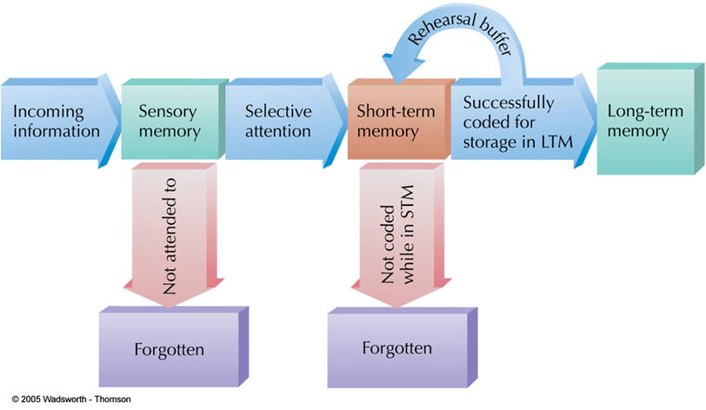
Memory
To answer the ‘knowledge/skills’ question, it helps to keep in mind what we said learning is:
A change in long-term memory.

Slide 39
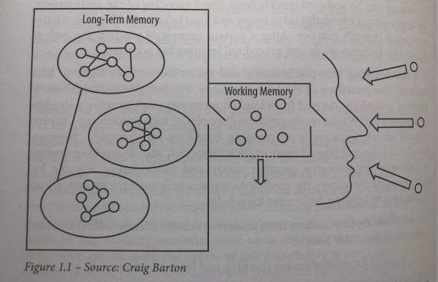
The importance of long-term memory
The more knowledge we have stored and organised in long-term memory:
  the easier thinking is;
  the more we can think about;
  the easier it is to remember new information.

Slide 40
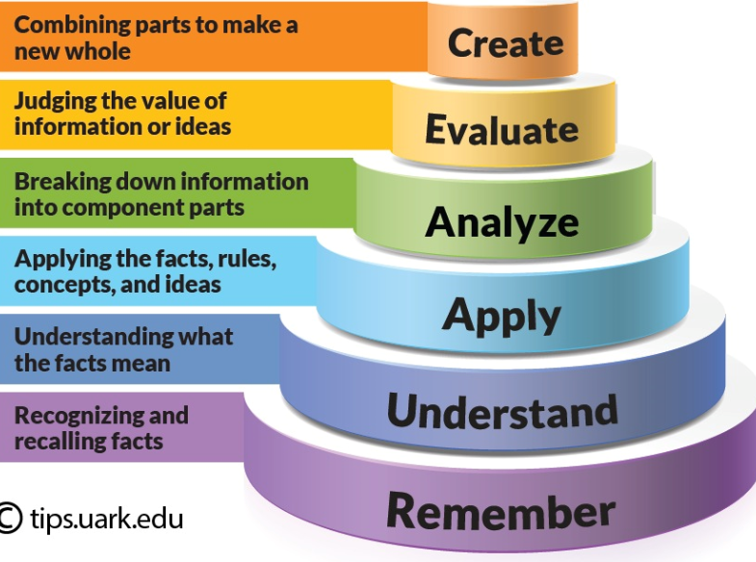
Freeing-up working memory
The more knowledge we have in our long-term memory, the more space there is in our working memory e.g. for critical thinking.
“Are humans causing Earth’s climate to change?”

Slide 41
“Skills”
Literacy
Problem solving
Leadership
Creativity
Numeracy
Critical thinking
Team work
Self-evaluation

Slide 42
“Skills”
Few would argue that these aren’t important to develop.
In fact, our national curriculum expects it.
We need to understand that knowledge is often a prerequisite for skills development…

Slide 43
The necessity of knowledge
Literacy
  You need to know where an apostrophe goes and where it doesn’t go
Numeracy
  You need to know the process to go through to calculate a percentage
Critical thinking
  You need to know quite a lot about wind power and nuclear power before you can think – or argue – critically in favour of one or the other
Creativity
  You need to know about the best materials to use in a particular situation and how they react with one another

Slide 44
The link to great teaching
“Teacher as Activator” pedagogies Mode A teaching KNOWLEDGE | Effect size | “Teacher as Facilitator” pedagogies Mode B teaching SKILLS | Effect size
Teacher clarity | 0.75 | Inquiry-based teaching | 0.35
Feedback | 0.73 | Simulations and gaming | 0.32
Concept mapping | 0.69 | Smaller class sizes | 0.21
Direct instruction | 0.60 | Individualised instruction | 0.20
Mastery Learning | 0.57 | Web-based learning | 0.18
Frequency of testing | 0.52 | Problem-based learning | 0.12
Goal setting | 0.40 | Student control over learning | 0.01
Average | 0.61 | Average | 0.20

Slide 45

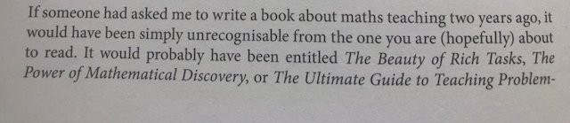
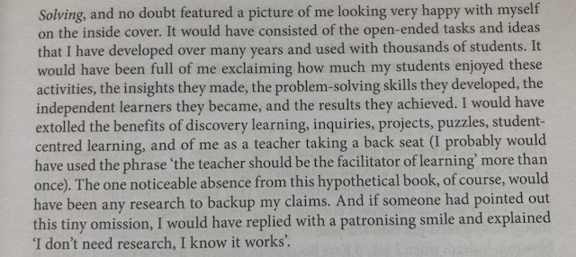
How I Wish I’d Taught Maths
– Craig Barton

Slide 46

The Learning Rainforest

Slide 47

The Learning Rainforest
Exploring the possibilities (Mode B)
Building the knowledge structure (Mode A)
Establishing the conditions

Slide 48
Building the knowledge structure
“Mode A teaching” vs “Mode B teaching” (“Activator” vs “facilitator”)
  80% vs 20%
Explaining: use pictures (“dual coding”)
Think, pair, share
  Pose, pause, pounce, bounce
  “Chat to a partner”

Slide 49
Building the knowledge structure
Probing
  “That’s interesting – what makes you say that?”
  “That’s true, but why do you think that is?”
  “Can you give an example of where that happens?”
  “Really? Are you sure? How sure?”
  “Does anyone agree with that? Why?”
Whole-class response: show-me boards
Check for understanding
  Not: “do you understand this?”

Slide 50
Checking understanding
Multiple choice hinges
Alice ran quickly down the dusty track.
A
B
C
D
Which word is a preposition?
Which word is an adverb?
What is the subject in the sentence?

Slide 51
Checking understanding
Multiple choice hinges
Which of the following are living things?
An oak tree
A volcano
A car
A computer
A chicken
Carefully designed, these can help target common misconceptions.

Slide 52
Checking understanding
Multiple choice hinges
What is 20% of 300?
30
60
15
6000
C. Confusing percentages with division
A. Good at calculating 10% but unsure how to calculate 20%
D. Confused percentages with multiplication

Slide 53
Checking understanding
Multiple choice hinges
Which three of these sentences use the apostrophe of possession correctly?
I accidentally dented the mans’ car.
Jack’s cat went missing.
The tip of Paige’s pencil had broken.
The childrens’ playground was large and colourful.
Sam’s goal won the match.

Slide 54
Checking understanding
Multiple choice hinges
Liberal ideology…
Was invented in the eighteenth century to serve the interests of the British Liberal Party.
Developed as a hostile response to the emergence of industrial capitalism.
Is a compromise between socialism and conservatism.
Is a long-established creed which focuses on individual freedom.

Slide 55
Checking understanding
So multiple choice questions can be used to check understanding of simple ideas and of more sophisticated concepts.
A series of multiple choice questions can give the teacher far deeper information about student understanding than having to read through an essay
  So less time spent marking
  More specific feedback
  A better understanding of where the class is

Slide 56
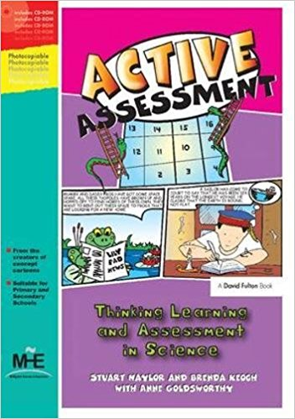
Active Assessment
True or False?
Odd-one-out
Card sorts
Matching
Concept cartoons
KWL grids
Balloon debates
Deliberate mistakes
Rumours
Diamond nines
Graphic organisers
Compare and contrasts

Slide 58
Getting ALL students to think
Learning intention
& success criteria
Traffic-light colours
Pose, pause, pounce, bounce
Exit passes
Formative assessment
“Chat to a partner”
Active Assessment activities
Multiple choice questions
Show-me boards

Slide 59
Formative Assessment Toolkit
10, 9, 8, 7, 6, 5, 4, 3, 2, 1
Learning intention
& success criteria
Traffic-light colours
Pose, pause, pounce, bounce
Exit passes
Formative assessment
“Chat to a partner”
Active Assessment activities
Multiple choice questions
Show-me boards

Slide 60
Regular formative assessment
Learning Rainforest: Daily, weekly, monthly review
Dylan Wiliam highlights the importance of formative assessment:
  Minute-by-minute
  Lesson-by-lesson
  Week-by-week
  Topic-by-topic
10, 9, 8, 7, 6, 5, 4, 3, 2, 1

Slide 61
Aims
Repeat and consolidate some of the teaching and learning themes we have looked at and discussed over the past 18 months.
Get you to think more about how messages from international research can help you to make teaching and learning in your classroom (even) better.

Slide 62
Exit Passes
(For me) Evaluation of this session.
(For you) What you are going to do as a result of this session.

Slide 63
Questions?

