Slide 1
Formative Assessment
Linked to Lesson Evaluation Toolkit Elements 19 and 20
Bruce Robertson, Depute Headteacher
June 2018

Slide 2
Aims
Improve your understanding of what formative assessment is.
Improve your knowledge of formative assessment activities which could help students reflect on their learning and teachers evaluate impact of lessons on learning.
10, 9, 8, 7, 6, 5, 4, 3, 2, 1

Slide 3
What is formative assessment?
Discuss with a partner (45 seconds).
Write your own definition on your show-me board.

Slide 4
What do you think of this definition?
“A strategy to find out what students know or don’t know (or can or can’t do), informing teaching”.

Slide 5
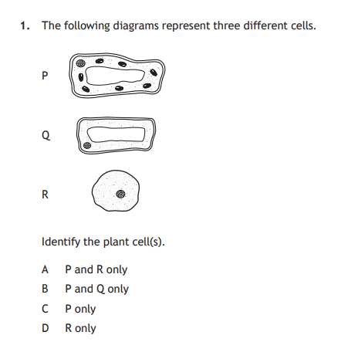
Formative assessment?
You start a lesson off with this Past Paper questions (National 5 Biology, 2017 paper) – is this formative assessment?

Slide 6
Formative assessment?
You set an end of unit test, comprising a mixture of short-answer and extended response questions – is this formative assessment?

Slide 7
Formative assessment?
When is assessment not formative?
What makes good formative assessment?
What formative assessment strategies do you make regular use of?

Slide 8
Dylan Wiliam
Formative assessment is all about:
  Ensuring students know what they are meant to be learning (LET 1 & 2);
  Finding out what students have learned (LET 3, 9, 12 & 20);
  Providing feedback that improves student learning (LET 10);
  Having students help each other learn (LET 9 & 11);
  Developing students’ ability to monitor and assess their own learning (LET 12 & 19).

Slide 9
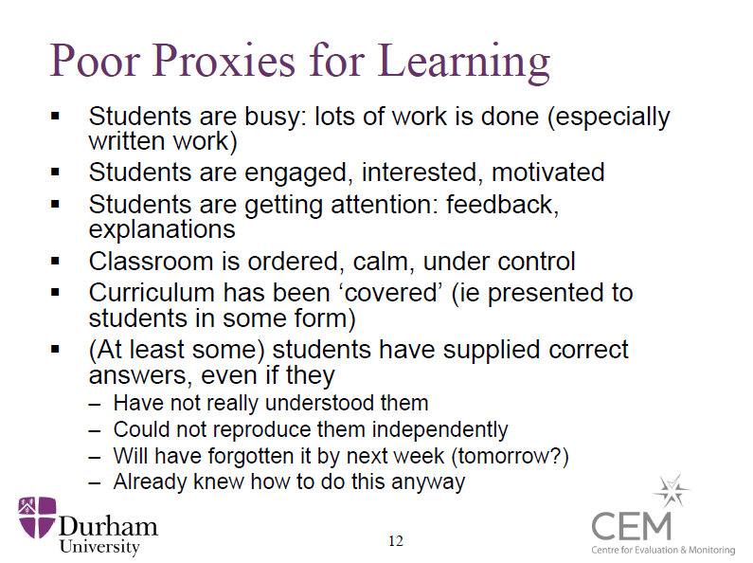

Slide 10
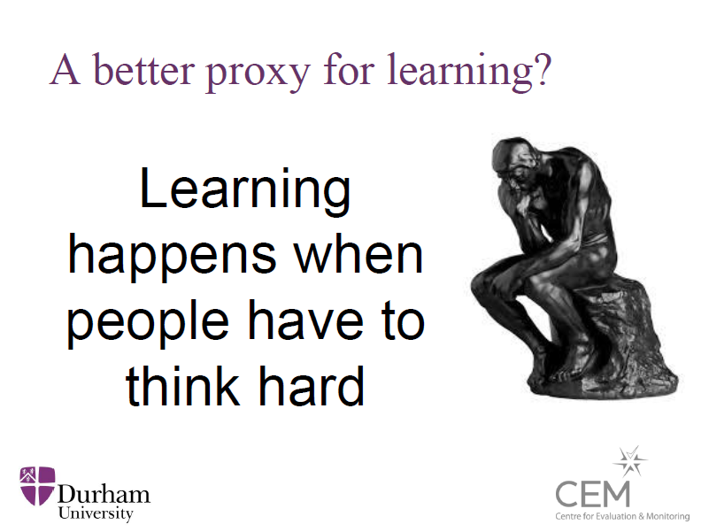

Slide 11
Key ingredients
Learning intention
(WALT)
Success criteria
(WILF)
Traffic-light colours
Exit passes
Formative assessment
Pose, pause, pounce, bounce
Active Assessment activities
Show-me boards
“Chat to a partner”

Slide 12
When?
Teachers should think about formative assessment in terms of taking place at the following points:
  Minute-by-minute e.g. via questioning, show-me boards and ‘active assessment’ methodologies, such as true/false statements, odd-ones-out and deliberate mistakes;
  Lesson-by-lesson e.g. via show-me boards, traffic-light colours and exit passes;
  Week-by-week e.g. via in-class quizzes and homework;
  Topic-by-topic e.g. via end of topic assessments and examinations (including Prelims), used formatively.

Slide 13
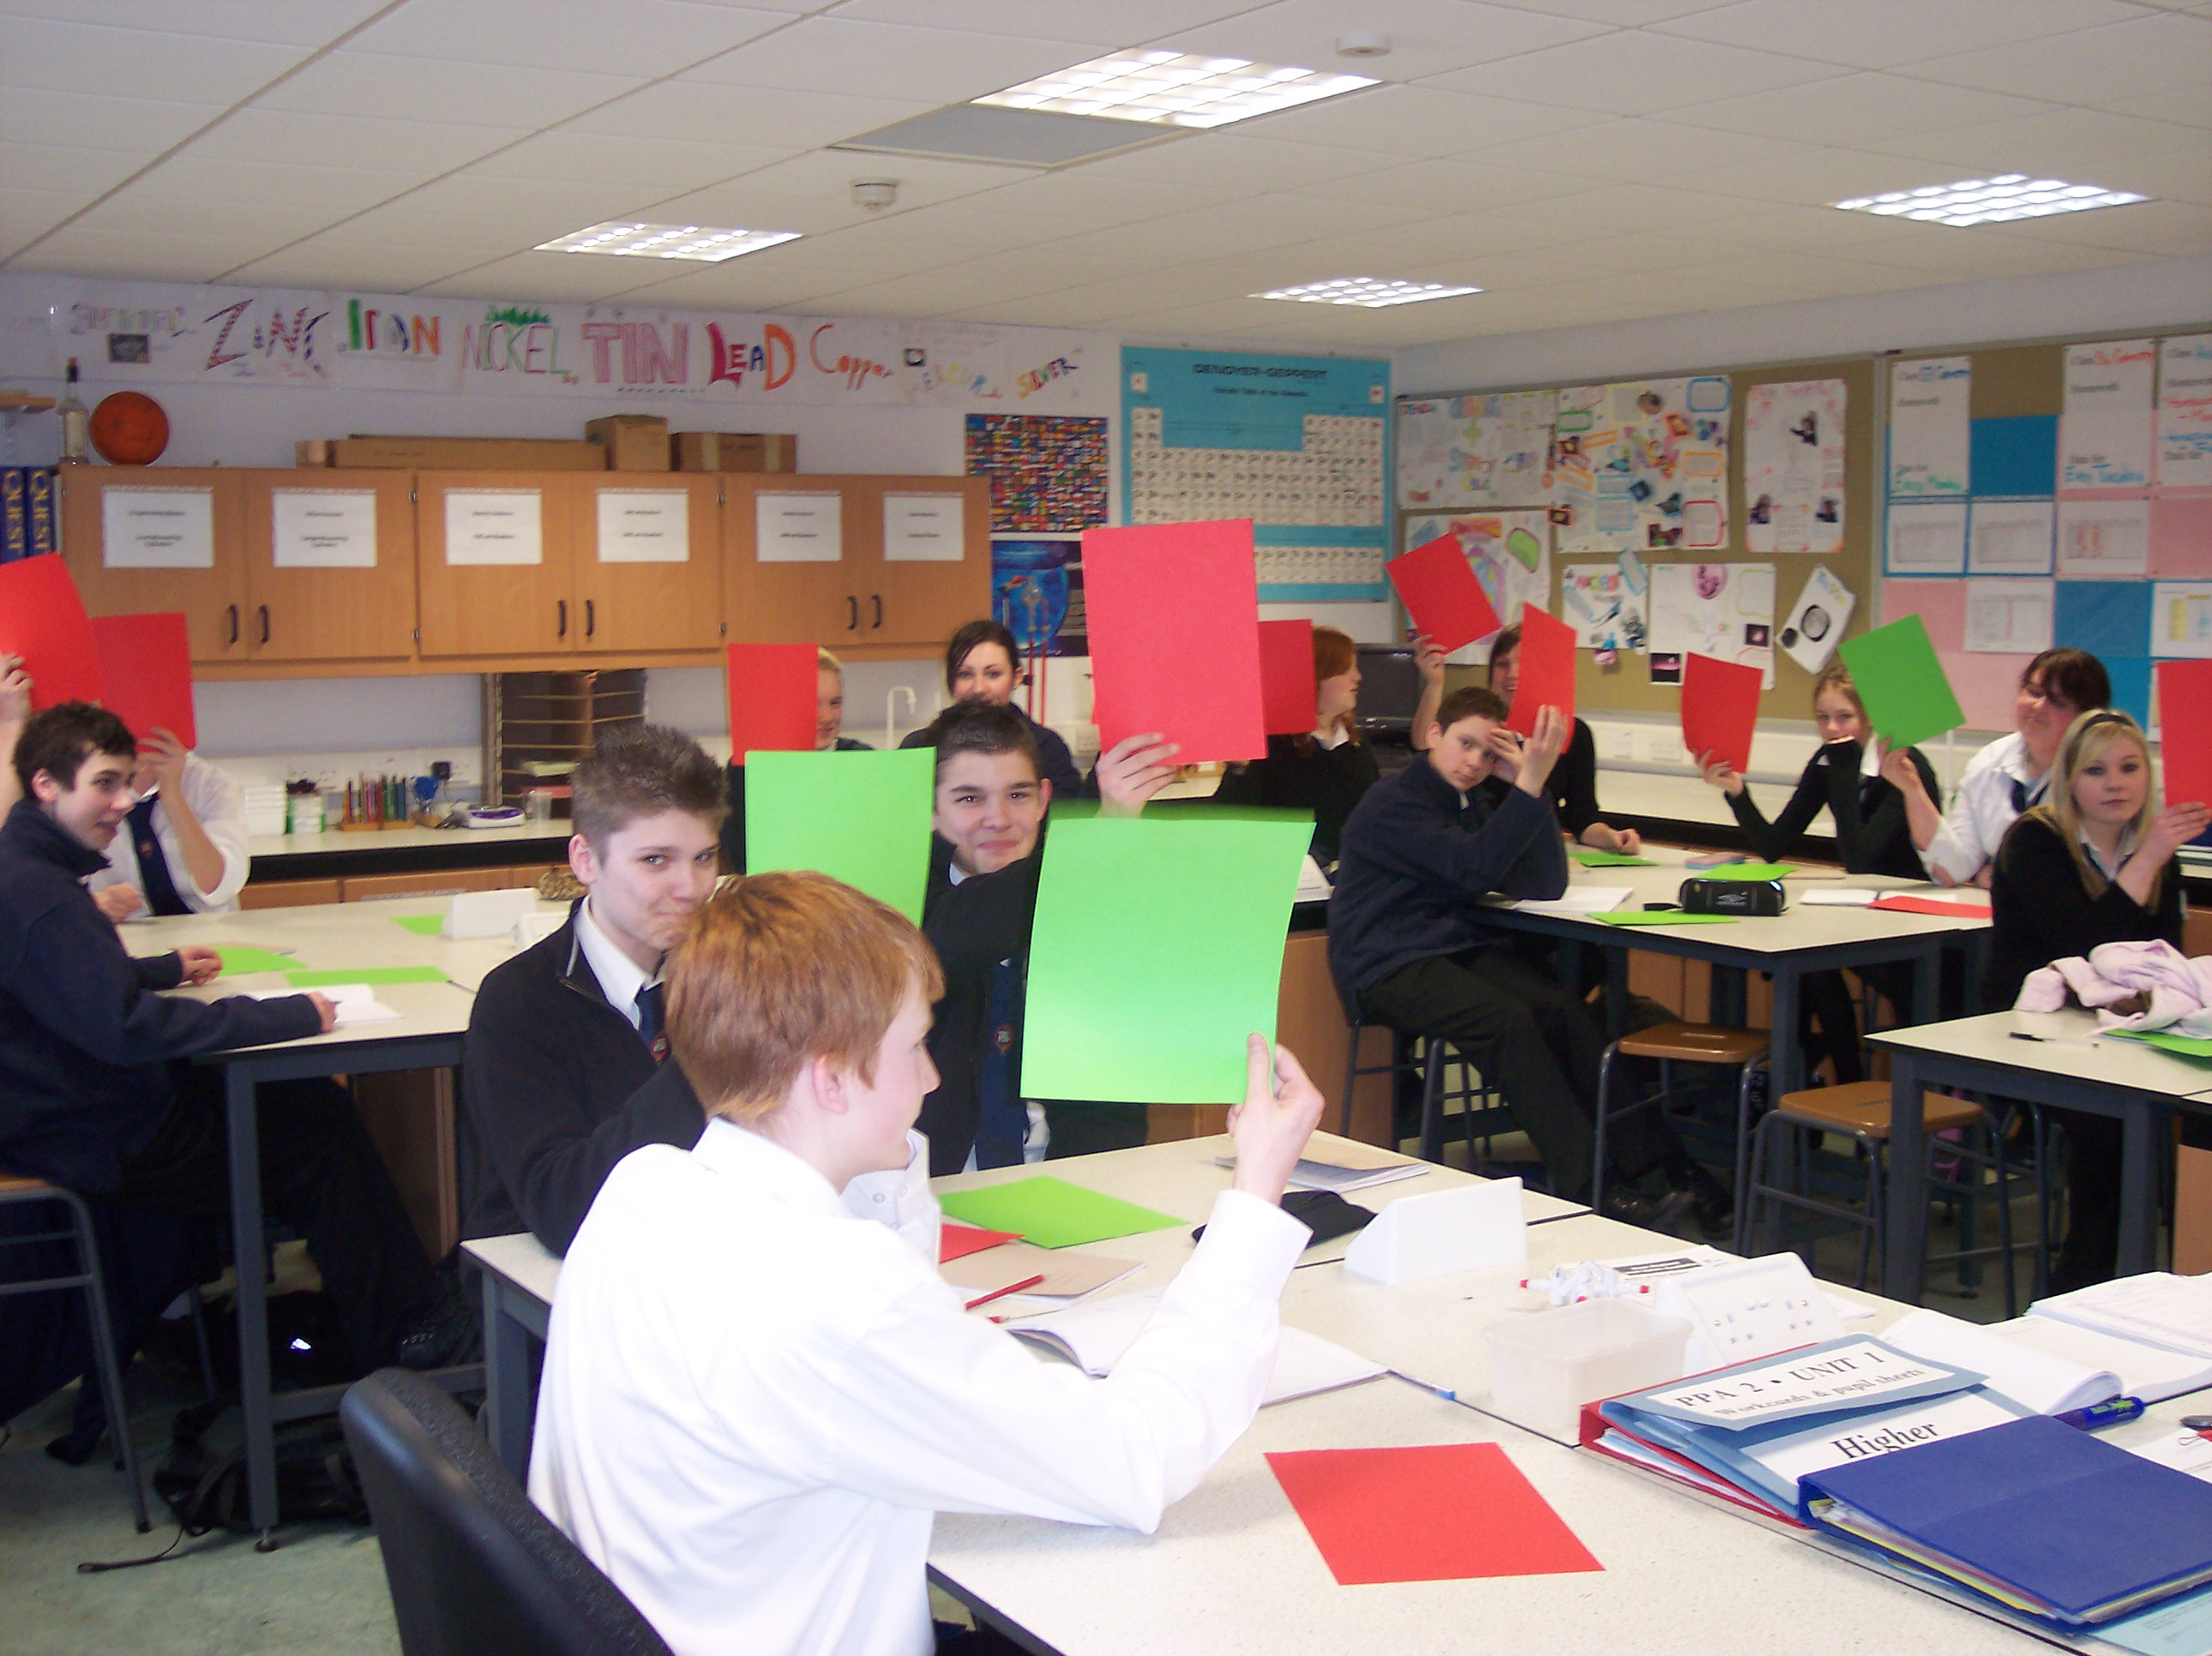
Traffic-light colours
Find out where they are at the start, and find out why they think that.
Find out where they are at the end, and find out why they think that.
Helps you to evaluate the impact of the lesson.
But best when students have evidence to be drawing on to support their evaluation, rather than it just being an impression.

Slide 14
What do you already know about calcium?
Pose, pause, pounce, bounce
“Chat to a partner”
Green / amber / red
90 seconds: Bullet-point as many facts as you can on a piece of paper
1 minute: Chat to a partner
Green / amber / red
  Compare with your initial impression
Show-me boards

Slide 15
Self-evaluation using traffic-lights
 | Green | Amber | Red
The chemical symbol for an atom of it
If it is a metal or a non-metal
The Group number in the Periodic Table where it can be found
A use for it

Slide 16
Learning about calcium
LI (WALT): Improve your knowledge about calcium.
SC (WILF): You can list at least three facts about calcium that you didn’t know when you entered the room.
OR
SC (WILF): You can:
  Write the symbol for an atom of calcium
  Say if it is a metal or non-metal
  Say which group of the Periodic Table it appears in
  Describe at least one use for it

Slide 17
True or false?
 | True | False | Don’t know | Correction (if false)
The chemical symbol for an atom is ‘CA’.
It is a non-metal
It is found in Group 2 of the Periodic Table
It is used in fertilizers

Slide 18
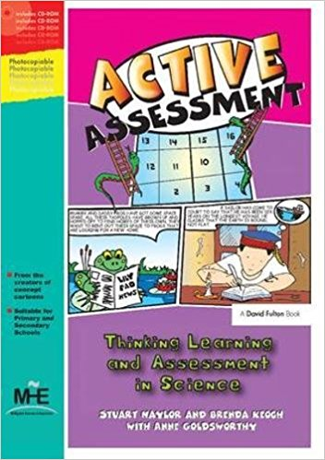
Active Assessment
Active Assessment activities
True or False?
Odd-one-out
Card sorts
Matching
Concept cartoons
KWL grids
Balloon debates
Deliberate mistakes
Rumours
Diamond nines
Graphic organisers
Compare and contrasts

Slide 19
TRUE
FALSE
Jupiter is the smallest planet in the solar system.
Pluto is the planet that is furthest from the Sun.
Planet Earth is next to the Sun.
The astronauts weighed lesson on the Moon than they did on Earth.
The Moon orbits the Earth once per day.

Slide 20
True or false?
On your show-me board, create a four question true/false assessment that you could use with a Senior Phase class to assess prior knowledge.

Slide 21
Brainstorming
What do you know about … ?
Water
Volcanoes
The human body
Farming in the mid-west
The book ‘Lord of the Rings’
The planets

Slide 22
Chemical reaction
Not a chemical reaction
Frying an egg
Breaking glass
Separating sand and salt
Melting plastic
Burning paper

Slide 23
Element, compound or mixture?
Mercury
Krypton
Water
Salt
Sea water
Air
Sugar
Carbon dioxide

Slide 24
Verb | Adverb | Adjective | None of these | It depends
hot
blue
run
car
slowly
fast
bright
girl
again
she

Slide 25
Classifying / Grouping
On your show-me board, create a classifying/grouping assessment that you could use with a Senior Phase class to assess prior knowledge.

Slide 26
What is common? What is different?
Hamlet and Macbeth
In common | Different

Slide 27
Common/different
On your show-me board, create a common/different assessment that you could use with a Senior Phase class to assess prior knowledge.

Slide 28
Odd one out?
Student control over learning
Enquiry-based learning
Within-class grouping
Discussion

Slide 29
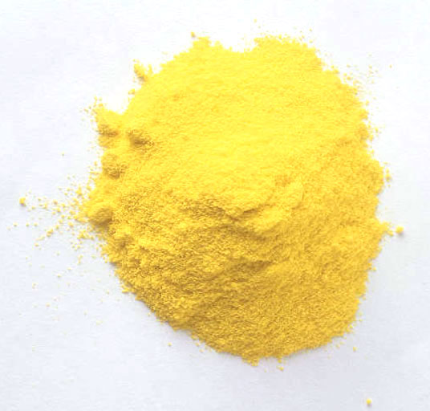
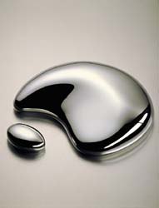
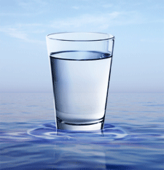
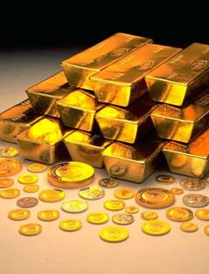
Notes:
Which is the odd one out?
The water is the odd one out. It is the only one which is not an element.

Slide 30
Deliberate mistakes: melting and freezing
Melting and freezing are opposites of each other. To freeze a substance you heat it up and the liquid turns into a solid. This means that the particles become more spread out.
Water freezes at 0ºC and all substances freeze at this temperature. Because of this, whenever a substance freezes it will feel cold.

Slide 31
Deliberate mistakes: melting and freezing
Melting and freezing are opposites of each other. To freeze a substance you heat it up and the liquid turns into a solid. This means that the particles become more spread out.
Water freezes at 0ºC and all substances freeze at this temperature. Because of this, whenever a substance freezes it will feel cold.

Slide 32
Deliberate mistakes
On your show-me board, create a deliberate mistakes assessment that you could use with a Senior Phase class to assess prior knowledge.

Slide 33
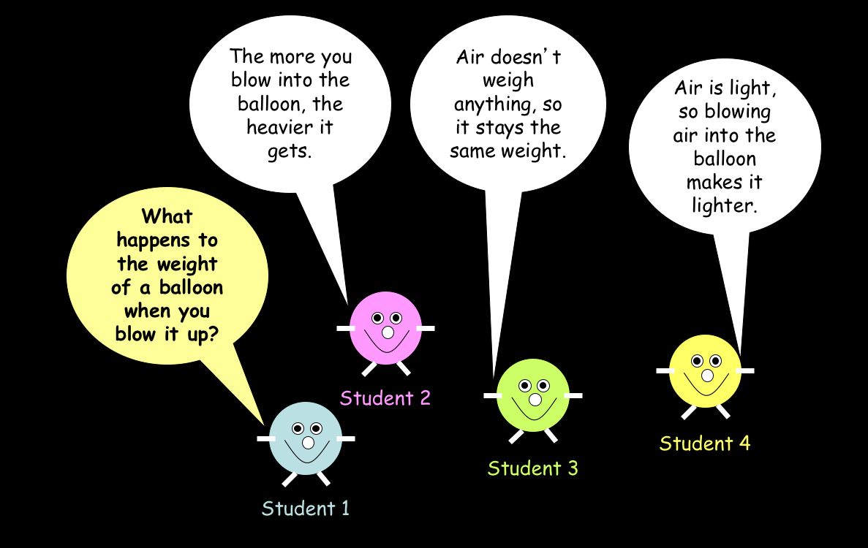

Slide 34
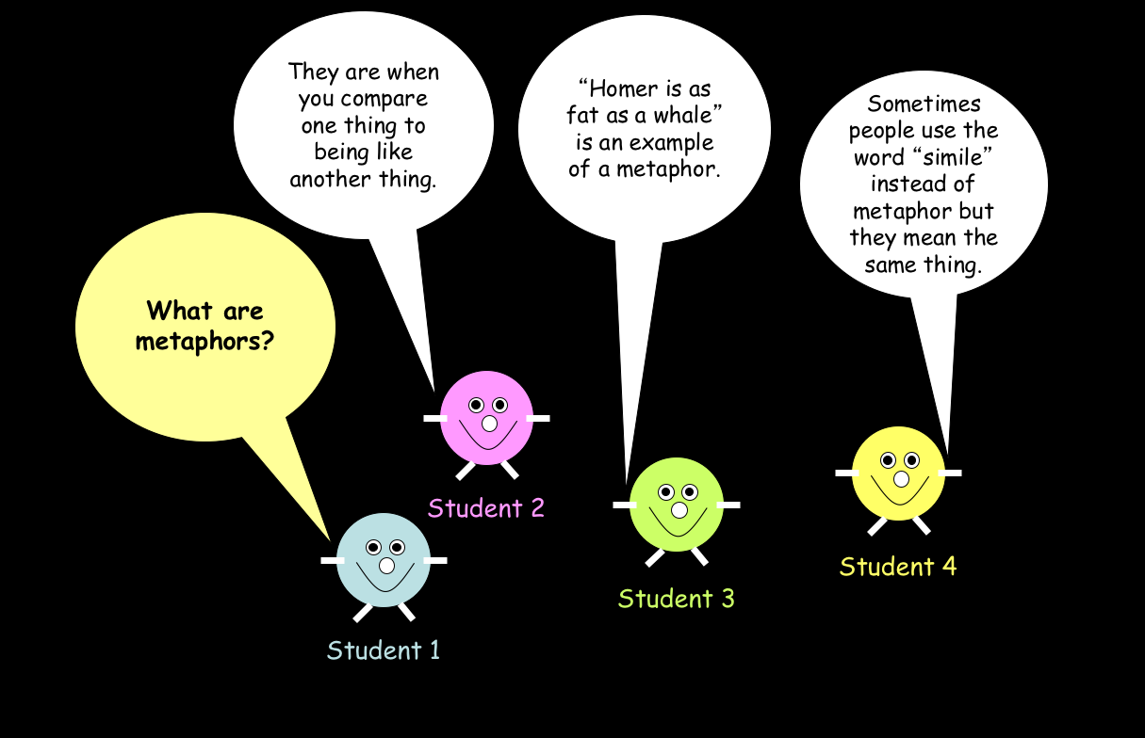

Slide 35
Concept cartoons
On your show-me board, create a concept cartoon assessment that you could use with a Senior Phase class to assess prior knowledge.

Slide 36
Finishing the lesson:
“What have you learned today?”
Get students to write it down – it makes everyone think about something.
  Use a mini-whiteboard; get them to hold it up; have a look at them; use some of them as teaching points.
  Use post-it notes.
Most effective when the focus is brought back to the learning intention and success criteria of the lesson.
A variation might be to write down a question about something that a student’s not sure about.

Slide 37
Learning about calcium
LI (WALT): Improve your knowledge about calcium.
SC (WILF): You can list at least three facts about calcium that you didn’t know when you entered the room.
OR
SC (WILF): You can:
  Write the symbol for an atom of calcium
  Say if it is a metal or non-metal
  Say which group of the Periodic Table it appears in
  Describe at least one use for it

Slide 38
Has your knowledge of calcium improved?
Pose, pause, pounce, bounce
“Chat to a partner”
Green / amber / red
Write down what you have learned out it today.
Show-me boards

Slide 39
Self-evaluation using traffic-lights
 | Green | Amber | Red
The chemical symbol for an atom of it
If it is a metal or a non-metal
The Group number in the Periodic Table where it can be found
A use for it

Slide 40
True or false?
 | True | False | Don’t know | Correction (if false)
The chemical symbol for an atom is ‘CA’.
It is a non-metal
It is found in Group 2 of the Periodic Table
It is used in fertilizers

Slide 41
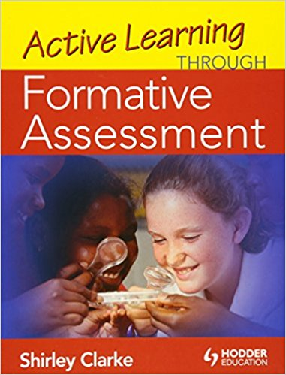
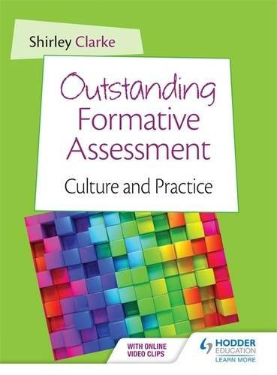
Recommended reading

Slide 42
Aims
Improve your understanding of what formative assessment is.
Improve your knowledge of formative assessment activities which could help students reflect on their learning and teachers evaluate impact of lessons on learning.
10, 9, 8, 7, 6, 5, 4, 3, 2, 1

Slide 43
Next steps
What are they?

