Slide 1
Formative Assessment
Linked to Lesson Evaluation Toolkit Elements 3 and 12
Bruce Robertson, Depute Headteacher
May 2018

Slide 2
Aims
Improve your understanding of what formative assessment is.
Improve your knowledge of formative assessment activities which could enhance your teaching and student learning.
10, 9, 8, 7, 6, 5, 4, 3, 2, 1

Slide 3
What is formative assessment?
Discuss with a partner (2 minutes).
Write your own definition on your show-me board.

Slide 4
What do you think of this definition?
“A strategy to find out what students know or don’t know (or can or can’t do), informing teaching”.

Slide 5
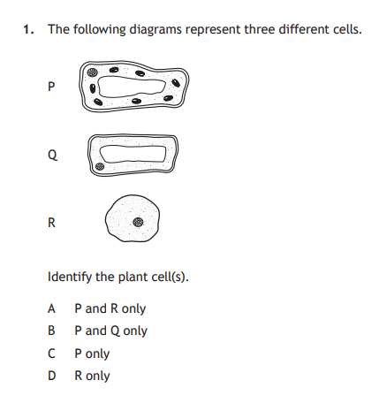
Formative assessment?
You start a lesson off with this Past Paper questions (National 5 Biology, 2017 paper) – is this formative assessment?

Slide 6
Formative assessment?
You set an end of unit test, comprising a mixture of short-answer and extended response questions – is this formative assessment?

Slide 7
Formative assessment?
When is assessment not formative?
What makes good formative assessment?
What formative assessment strategies do you make regular use of?

Slide 8
Key ingredients
Learning intention
(WALT)
Success criteria
(WILF)
Traffic-light colours
Exit passes
Formative assessment
Pose, pause, pounce, bounce
Active Assessment activities
Show-me boards
“Chat to a partner”

Slide 9
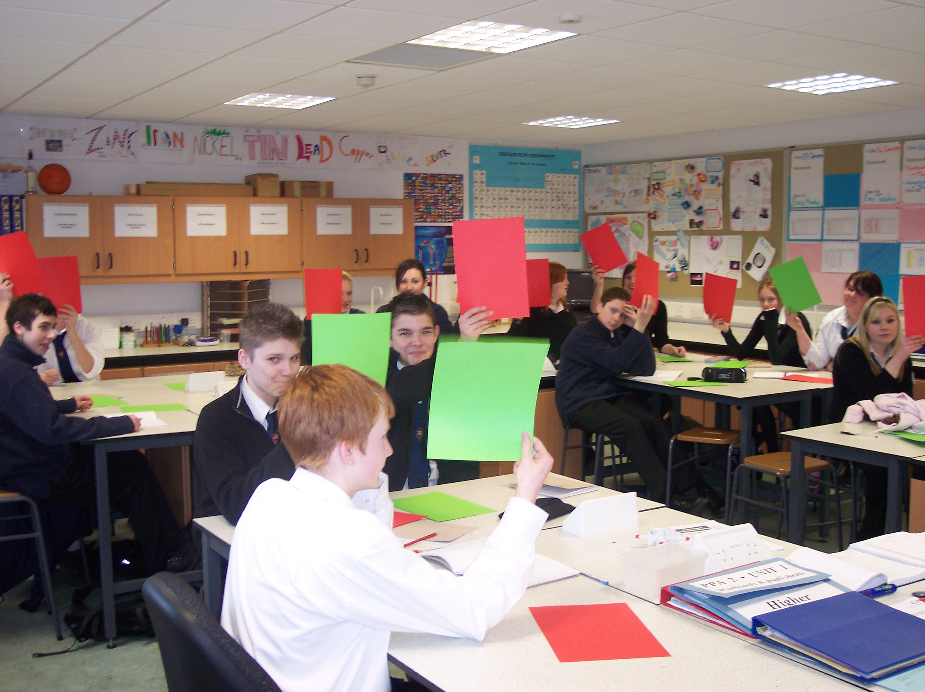
Traffic-light colours
Find out where they are at the start, and find out why they think that.
Find out where they are at the end, and find out why they think that.
Helps you to evaluate the impact of the lesson.

Slide 10
What do you already know about oxygen?
Pose, pause, pounce, bounce
“Chat to a partner”
Think for a few moments
Green / amber / red
90 seconds: Bullet-point as many facts as you can on a piece of paper
2 minutes: Chat to a partner
Bullet point the ones you are reasonably sure about on your show-me board
Show-me boards

Slide 11
Self-evaluation using traffic-lights
 | Green | Amber | Red
The chemical symbol for an atom of it
If it is a metal or a non-metal
The Group number in the Periodic Table where it can be found
The number of protons in its nucleus
The percentage of the air which is made up of it

Slide 12
Learning about oxygen
LI (WALT): Improve your knowledge about oxygen.
SC (WILF): You can list at least three facts about oxygen that you didn’t know when you entered the room.
OR
SC (WILF): You can:
  Write the symbol for an atom of oxygen
  Say if it is a metal or non-metal
  Say which group of the Periodic Table it appears in
  Say how many protons are in its nucleus
  Say what percentage of the air is made up of oxygen

Slide 13
Questions
 | Answer
The chemical symbol for an atom of it
If it is a metal or a non-metal
The Group number in the Periodic Table where it can be found
The number of protons in its nucleus
The percentage of the air which is made up of it

Slide 14
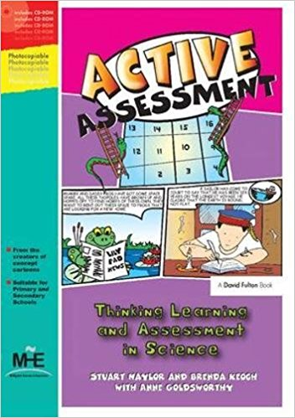
Active Assessment
Active Assessment activities
True or False?
Odd-one-out
Card sorts
Matching
Concept cartoons
KWL grids
Balloon debates
Deliberate mistakes
Rumours
Diamond nines
Graphic organisers
Compare and contrasts

Slide 15
True or false?
 | True | False | Don’t know | Correction (if false)
The chemical symbol for an atom is ‘o’.
It is a non-metal
It is found in Group 6 of the Periodic Table
It has six protons in its nucleus
It makes up roughly 80% of the air

Slide 16
TRUE
FALSE
Jupiter is the smallest planet in the solar system.
Pluto is the plane that is furthest from the Sun.
Planet Earth is next to the Sun.
The astronauts weighed lesson on the Moon than they did on Earth.
The Moon orbits the Earth once per day.

Slide 17
True or false?
On your show-me board, create a four question true/false assessment that you could use with a Senior Phase class to assess prior knowledge.

Slide 18
Brainstorming
What do you know about … ?
Water
Volcanoes
The human body
Farming in the mid-west
The book ‘Lord of the Rings’
The planets

Slide 19
Chemical reaction
Not a chemical reaction
Frying an egg
Breaking glass
Separating sand and salt
Melting plastic
Burning paper

Slide 20
Element, compound or mixture?
Mercury
Krypton
Water
Salt
Sea water
Air
Sugar
Carbon dioxide

Slide 21
Verb | Adverb | Adjective | None of these | It depends
hot
blue
run
car
slowly
fast
bright
girl
again
she

Slide 22
Classifying / Grouping
On your show-me board, create a classifying/grouping assessment that you could use with a Senior Phase class to assess prior knowledge.

Slide 23
What is common? What is different?
Hamlet and Macbeth
In common | Different

Slide 24
Common/different
On your show-me board, create a common/different assessment that you could use with a Senior Phase class to assess prior knowledge.

Slide 25
Odd one out?
Student control over learning
Enquiry-based learning
Within-class grouping
Discussion

Slide 26
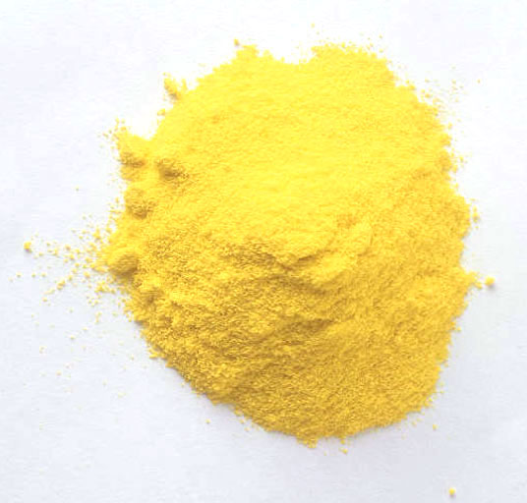
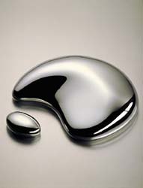
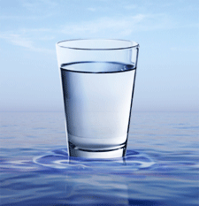
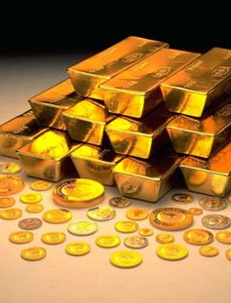
Notes:
Which is the odd one out?
The water is the odd one out. It is the only one which is not an element.

Slide 27
Deliberate mistakes: melting and freezing
Melting and freezing are opposites of each other. To freeze a substance you heat it up and the liquid turns into a solid. This means that the particles become more spread out.
Water freezes at 0ºC and all substances freeze at this temperature. Because of this, whenever a substance freezes it will feel cold.

Slide 28
Deliberate mistakes: melting and freezing
Melting and freezing are opposites of each other. To freeze a substance you heat it up and the liquid turns into a solid. This means that the particles become more spread out.
Water freezes at 0ºC and all substances freeze at this temperature. Because of this, whenever a substance freezes it will feel cold.

Slide 29
Common/different
On your show-me board, create a deliberate mistakes assessment that you could use with a Senior Phase class to assess prior knowledge.

Slide 30
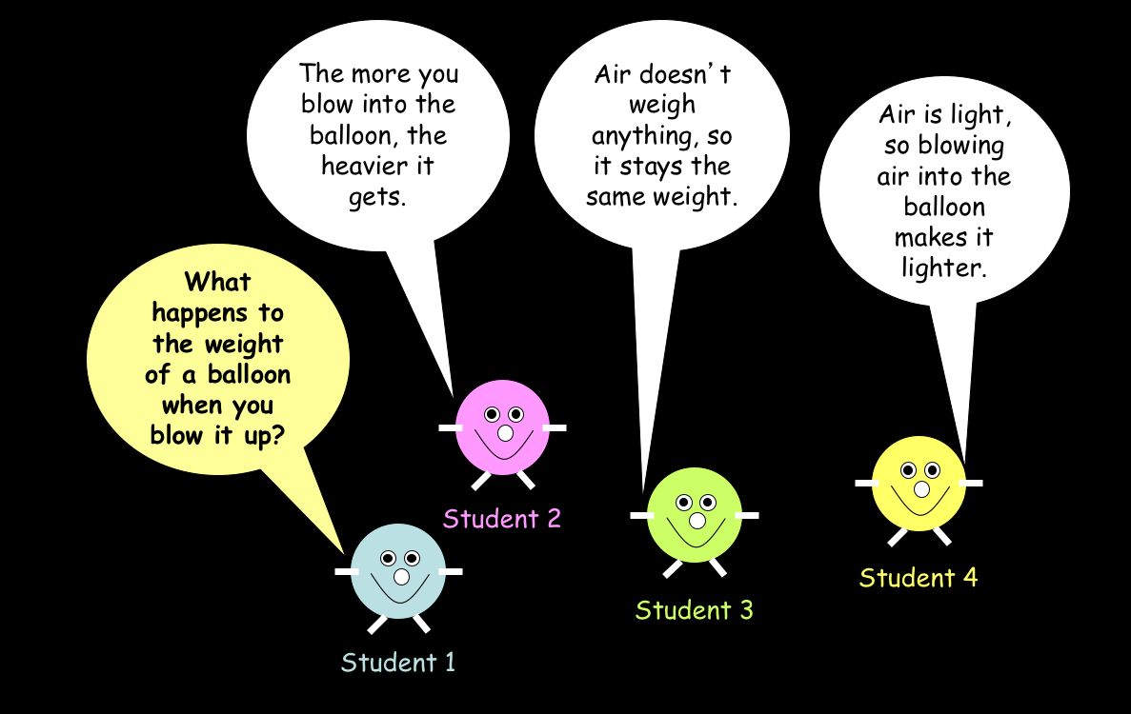

Slide 31
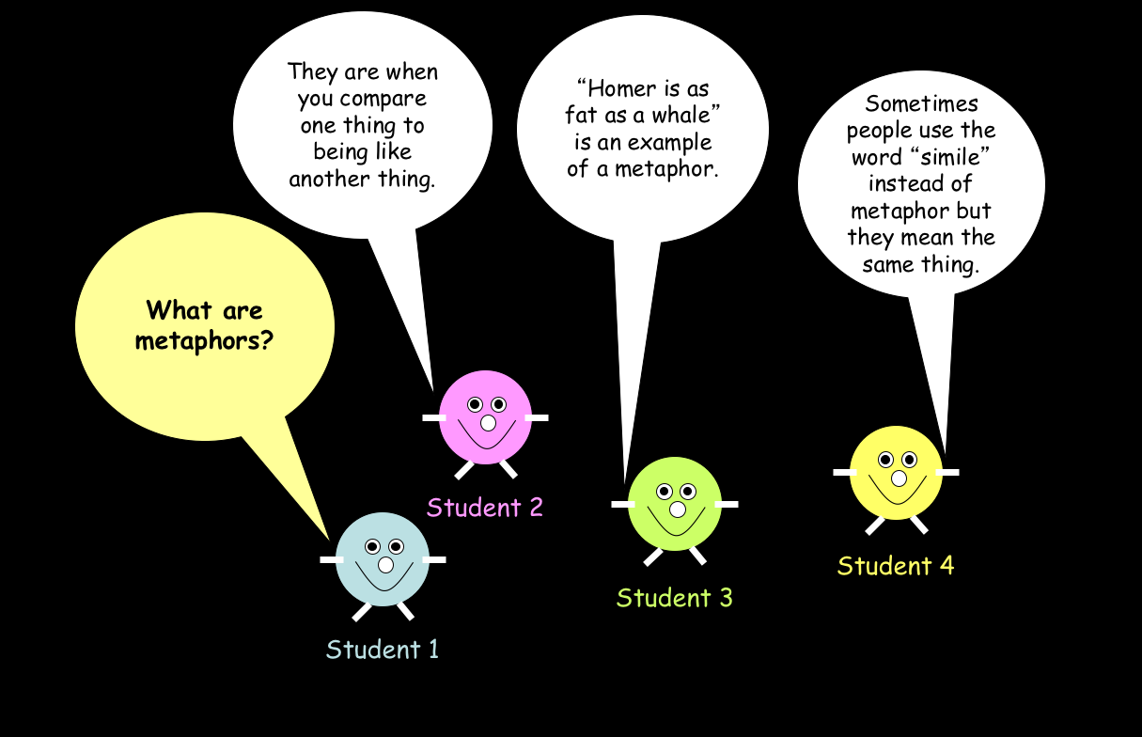

Slide 32
Common/different
On your show-me board, create a concept cartoon assessment that you could use with a Senior Phase class to assess prior knowledge.

Slide 33
Finishing the lesson:
“What have you learned today?”
Get students to write it down – it makes everyone think about something.
  Use a mini-whiteboard; get them to hold it up; have a look at them; use some of them as teaching points.
  Use post-it notes.
Most effective when the focus is brought back to the learning intention and success criteria of the lesson.
A variation might be to write down a question about something that a student’s not sure about.

Slide 34
Learning about oxygen
LI (WALT): Improve your knowledge about oxygen.
SC (WILF): You can list at least three facts about oxygen that you didn’t know when you entered the room.
OR
SC (WILF): You can:
  Write the symbol for an atom of oxygen
  Say if it is a metal or non-metal
  Say which group of the Periodic Table it appears in
  Say how many protons are in its nucleus
  Say what percentage of the air is made up of oxygen

Slide 35
Self-evaluation using traffic-lights
 | Green | Amber | Red
The chemical symbol for an atom of it
If it is a metal or a non-metal
The Group number in the Periodic Table where it can be found
The number of protons in its nucleus
The percentage of the air which is made up of it

Slide 36
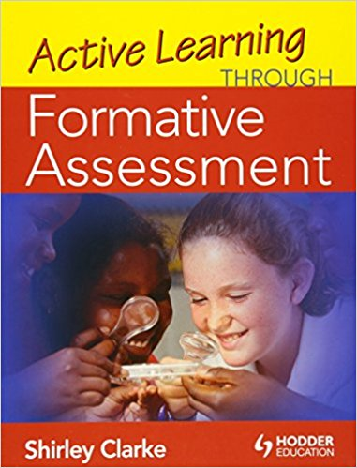
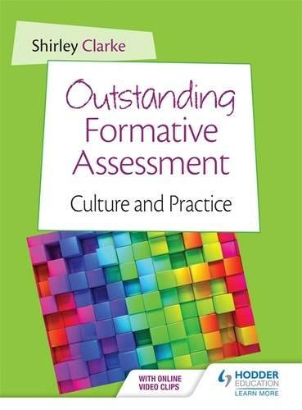
Recommended reading

Slide 37
Aims
Improve your understanding of what formative assessment is.
Improve your knowledge of formative assessment activities which could enhance your teaching and student learning.
10, 9, 8, 7, 6, 5, 4, 3, 2, 1

Slide 38
Next steps
What are they?

