Slide 1

Visible learning
Teachers as “activators of learning” and “evaluators of impact”:
PART 2

Slide 2
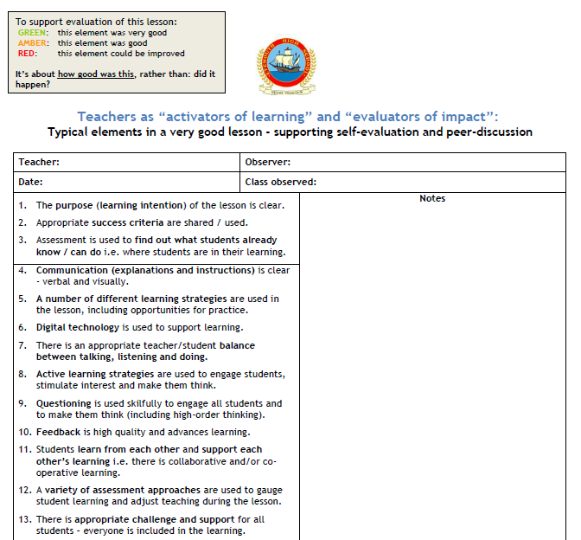
This session is really a “lesson”.
So I’d like you to use our Lesson Evaluation Toolkit (LET) to do an evaluation of the teaching and learning in this session.
  During OR
  At end OR
  After

Slide 3
Aims
This two-part presentation aims to pull together and build on themes and ideas from the 2016-17 session (active lesson conclusions, questioning, use of mini-whiteboards).
It will introduce key ideas from Visible Learning for Teachers by John Hattie
  All faculties have a copy of this book
  Our Professional Reading Group have been using this book
  We are purchasing additional copies for the staffroom
Two parts:
  Part 1: Teachers as “activators of learning” (was in August)
  Part 2: Teachers as “evaluators of impact”

Slide 4
PART 1:
TEACHERS AS ACTIVATORS OF LEARNING
Doing the things that research suggests have the biggest impact on learning

Slide 5
Learning intention & success criteria
Learning intention
  Develop a basic understanding of what effect sizes are.
Success criteria
  You can explain what an “effect size is”;
  You can state the value of Hattie’s recommended effect size baseline;
  You can use effect size information to discuss and reach judgements on the effectiveness of different pedagogical practices.

Slide 6
Activity
Q: What did you learn in Part 1?
  Discuss with a partner / in a small group (~2 minutes)
  Write one thing on your show-me board
  Show me

Slide 7
PART 2:
TEACHERS AS EVALUATORS OF IMPACT
Using evidence to assess the effect of a lesson of student learning

Slide 8
Learning intention & success criteria
Learning intention
  Understand the concept of “Teacher as Evaluator of Impact”.
Success criteria
  You can articulate what this concept means;
  You can list the 7 elements of our Lesson Evaluation Toolkit which relate to this concept;
  You feel confident that you know how you can go about starting to develop/improve this concept in lesson you teach.

Slide 9
Evaluating impact: the key question
What has changed as a result of this lesson?
To answer:
  Need to be clear about what is to be achieved and how you will know if it has been.
  Need to know where students are starting from.
  Need to know where they get to.
  In terms of the last two, you need strategies to find out.

Slide 10
In terms of our LET and SIP:
1
2
3
9
12
19
20

Slide 11
But one of the most important (and most challenging) principles in relation to this is the idea that it is about evaluating the learning of…
Everyone

Slide 12
We touched on some of this in Part 1
Without a clear focus, it can be difficult to focus on what really matters.
While it is possible to learn without knowing you’re learning (“tacit knowing”), for most people there needs to be a deliberate attempt to assimilate and accommodate new learning.
Which is why the learning intention and success criteria are so important – WALT and WILF.
“The critical part when evaluating the success of a lesson is a review against the learning intention and success criteria” (Chapter 8)
  The lesson conclusion needs to come back to these.

Slide 13
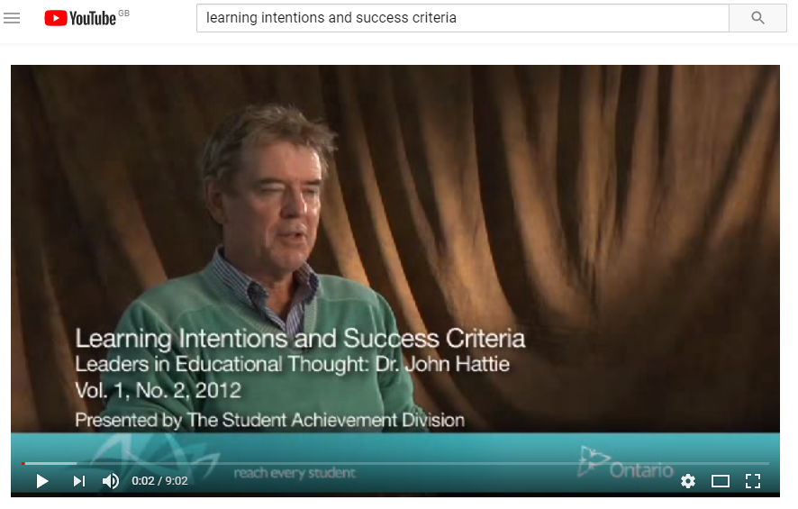
Video (On EHSTeaching website)
Considered showing this in this session.
BUT the “flipped-learning” principle is always good to keep in mind:
In lessons, spend as much time as you can on activities that need a teacher;
Other learning activities can be done at a different time.

Slide 14
David Bowie
A mock lesson to explore “Evaluator of Impact” principles
Notes:
I know that some people mind not be particularly interested in David Bowie, but we need to remember that that’s sometimes how students feel about some subjects and lessons

Slide 15
Learning intention
“We are learning about David Bowie.”
Activity
  Discuss: how good is this learning intention? (~2 minutes).
  Using G/A/R, show me what you think.
        This gives feedback to me
        It helps show you what other people in the session are thinking – which is important, because everyone should be involved in each other’s learning

Slide 16
Learning intention & success criteria
Learning intention (WALT) (Purpose)
Improve your knowledge of the music of David Bowie, in terms of his chart success.
Success criteria (WILF) (What we will evaluate against)
You can name all of his UK number one singles.

Slide 17
Where are we starting from? Show me
I feel very confident that I can name all of David Bowie’s number one singles.
I feel that I could name most/some of David Bowie’s number one singles, but not all of them.
I don’t feel that I could name many (or any!) of David Bowie’s number one singles.

Slide 18
Preparation for activities
Going to works in groups of 3 or 4.
Re-organise yourselves (if you need to) so that there is a mix of R/A/G people in your group
  Because you are going to be helping each other to learn in the activities and a mix should help with that

Slide 19
Activity 1 (Discuss: ~2 minutes)
Which of these David Bowie singles went to number one?
Let’s Dance
Ashes to Ashes
Fashion
China Girl
Rebel Rebel
Jean Genie
Ziggy Stardust
Space Oddity
Lazarus
Modern Love

Slide 20
Activity 1
Which of these David Bowie singles went to number one?
Let’s Dance
Ashes to Ashes
Fashion
China Girl
Rebel Rebel
Jean Genie
Ziggy Stardust
Space Oddity
Lazarus
Modern Love

Slide 21
Activity 2 (Discuss: ~2 minutes)
Did David Bowie have any more UK number one singles?
If so, with which songs?
How many did he have in total?

Slide 22
Activity 2 (Discuss: ~2 minutes)
Did David Bowie have any more UK number one singles? Yes
If so, with which songs? Under Pressure and Dancing in the Street
How many did he have in total? 5

Slide 23
Learning intention & success criteria
Learning intention (WALT) (Purpose)
Improve your knowledge of the music of David Bowie, in terms of his chart success.
Success criteria (WILF) (What we will evaluate against)
You can name all of his UK number one singles.
  On a show-me board, and ON YOUR OWN, write them down;
  Show me.

Slide 24
Where are we starting from? Show me
I feel very confident that I can name all of David Bowie’s number one singles.
I feel that I could name most/some of David Bowie’s number one singles, but not all of them.
I don’t feel that I could name many (or any!) of David Bowie’s number one singles.

Slide 25
Planners
A brief digression

Slide 26
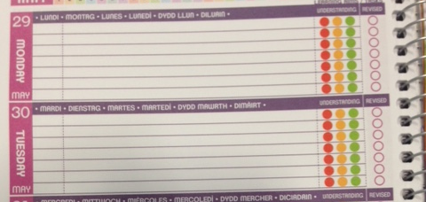
A “learning diary”
“It may be worth asking students to keep a work diary that details what they think they are learning, indicators of their progress, how confident they are that they will achieve these learning intentions, and their perceptions of their degree of success” (Chapter 8)

Slide 27
But it’s all about how we use it
We need to teach students how to be critical evaluators of their learning.
Discuss (~2 minutes):
  Something you do (or have seen someone else do) to support Planer use as a self-evaluation Learning Log .
Write down one thing on your show-me board.

Slide 28
A note of caution about where we are
When asked in Registration about what they were learning about in a subject last week, too many students (including Senior students) said: “I don’t know”.
  Which just isn’t good enough – they should know!
  And more than knowing what they were learning about, they should have an appreciation of how well they felt they learned it.
    They should be able to evaluate their own learning
    We all have a responsibility to show that we expect this of them and to teach them how to do it meaningfully

Slide 29
Back to Bowie

Slide 30
Some thoughts on the “lesson”
The intention was to build in discussion (not necessarily whole-class).
As much as possible, we were attempting to make learning (or thinking) visible – to me and to other participants.
The plan was for you to work harder than me.
A key role for me was to watch and listen, directing you to key points (including misconceptions and errors).
It was about everyone learning together and to draw on thinking from everyone.
My job was to activate that learning experience and evaluate its impact on your learning.

Slide 31
A personal thought
It was about surface knowledge.
But this surface knowledge is required to develop deeper knowledge
  e.g. success criteria might be “construct a reasoned argument as to whether or not you agree that David Bowie is a more successful artist than The Beatles”.
If we are to address the “attainment gap” and teach meaningful skills development, it is essential to teach core knowledge.

Slide 32
“Assessment”

Slide 33
“Assessment”
Think (~10 seconds):
  Should we be trying to reduce assessment?
Show of hands: Yes? No?

Slide 34
Should we be trying to reduce assessment?
No – we need more assessment!
We should be using assessment in every lesson – beginning, middle and end.
But using the right kind of assessment
  I’m not talking about 30-mark tests.
To evaluate impact, we need to be assessing learning constantly and relentlessly.

Slide 35
Activity
Discuss (~3 minutes):
  What strategies do you typically use to assess learning (including prior learning) in lessons?
Write down one strategy on a show-me board.

Slide 37
We explored some of these last August (in relation to lesson conclusions):
  Questioning
  Lists e.g. “write down five things that you know about…” / “write down three things you learned today”
  True/False statements
  Sorting / grouping / ranking
  Odd ones out
  Deliberate mistakes
  Matching
  Concept Cartoons

Slide 38
Odd one out
Changes
Space Oddity
Fashion
Hallo Spaceboy

Slide 39
Sorting / grouping / ranking
Rank these David Bowie songs in order of UK chart success:
Modern Love
Ashes to Ashes
Ziggy Stardust
Changes

Slide 40
Matching
Match these songs with their UK chart position:
Hallo Spaceboy
1
Let’s Dance
2
China Girl
5
Fashion
12

Slide 41
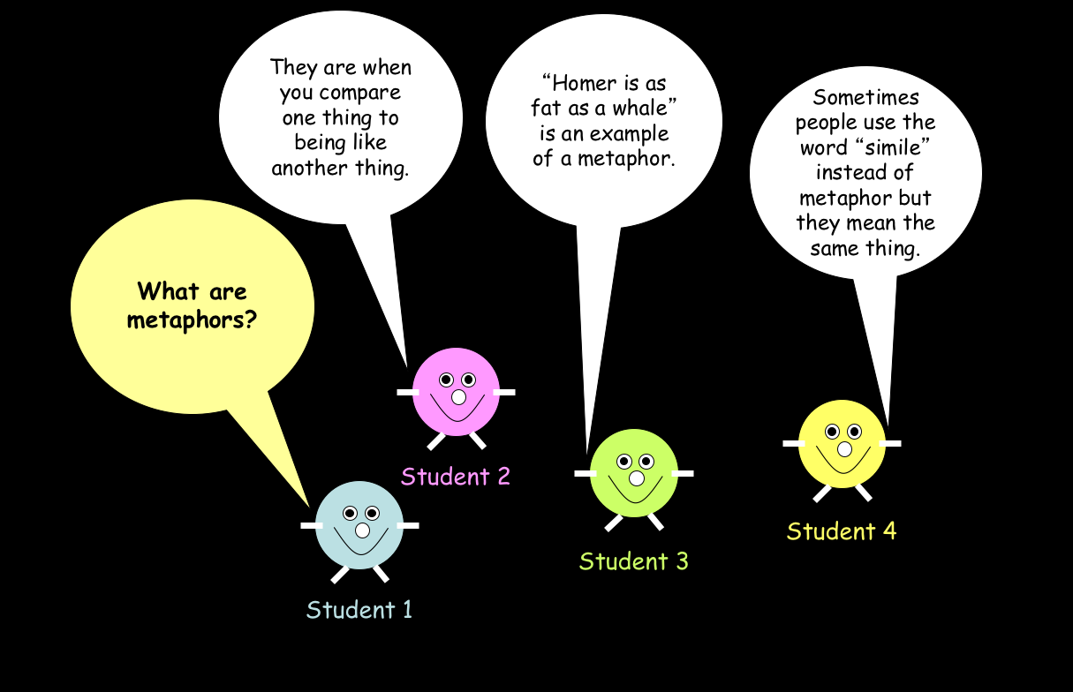
I know he’s had more than two.
I think they were all in the 1970s.
I think he’s had more number one singles than The Beatles.
What do you know about David Bowie’s UK number one singles?

Slide 42
Formative & summative assessment
One major mistake is to consider that the notions of “formative” and “summative” as to do with the type of assessment.
“Formative and summative refer to the nature of the interpretations made”:
  Formative: modify teaching while it is on-going
  Summative: get a measure of learning
All of the strategies looked at can be used formatively and/or summatively
  Because they tend to make students think, we are referring to them as Active Assessment strategies
“It is imperative that teachers have excellent summative evaluation in place in their classes”.

Slide 43
Purposes of assessment
Formative
Assessment
Assessment
Summative
Formative
Assessment
Summative

Slide 44
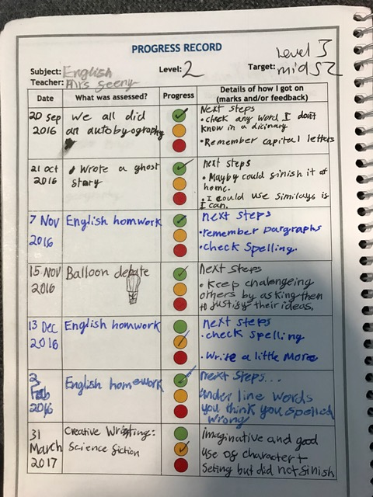

Slide 45
Conclusion

Slide 46
Critical evaluation: thoughts of Hattie
A key purpose of school is to develop critical evaluation skills in students:
  Examine, reflect, discuss, argue, think for one’s self;
  Includes in terms of their learning from lessons;
  But we can’t just expect them to be able to do this – it needs taught.
Similarly, teachers and school leaders need to become critical evaluators of the effect lessons are having on student learning:
  Not good enough to say things like “they all seemed to enjoy it” or “they all seemed engaged” – where is the evidence of the impact of the lesson on learning?
  Are you checking the learning of a few, some, most or all students?
  Teachers need strategies to find out what EVERYONE is learning.

Slide 47
In terms of our LET and SIP:
1
2
3
9
12
19
20

Slide 48
Next steps for developing these strategies
Read
Books
Observe
Other teachers
Do
& self-evaluate
Regular use of LET
Discuss
Faculty meetings
Get feedback
EHSTeaching
Articles
Peers
PT (faculty)
PT (L&T)
DHTs
HT
Practice
After observed lessons

Slide 49
Learning intention & success criteria
Learning intention
  Understand the concept of “Teacher as Evaluator of Impact”.
Success criteria
  You can articulate what this concept means;
  You can list the 7 elements of our Lesson Evaluation Toolkit which relate to this concept;
  You feel confident that you know how you can go about starting to develop/improve this concept in your lessons.

Slide 50
Complete an evaluation of this session.
Complete the LET and consider using a faculty meeting to discuss.

