Slide 1

Visible learning
Teachers as “Activators of Learning” and “Evaluators of Impact”

Slide 2
AIMS
This two-part presentation aims to pull together and build on themes from the 2016-17 (active lesson conclusions, questioning, use of mini-whiteboards)
It will introduce key ideas from “Visible Learning for Teachers” by John Hattie
  All faculties have a copy of this book
  Our Professional Reading Group have been using this book
  We are purchasing additional copies for the staffroom
Two parts:
  Part 1: Teachers as “Activators of Learning”
  Part 2: Teachers as “Evaluators of Impact” (October)

Slide 3
Visible learning
Is about making student learning visible to teachers
  Gathering evidence of the learning that is taking place by everyone in the class
Is about making teaching visible to students
  So that they can become their own teachers
In each case, there is a focus on critical evaluation skills
  Student: evaluating their learning from this lesson
  Teacher: evaluating the impact of the lesson on student learning

Slide 4
TEACHERS AS ACTIVATORS OF LEARNING

Slide 5
The practice of teaching
Hattie argues that there is a “practice of teaching”
  Not a fixed recipe
  Not a set of principles that apply to all students
  But practices that are particularly effective and practices which are not
  To be an “Activator of Learning” means to be doing the things that research suggests have the biggest impact on learning

Slide 6
Effect sizes

Slide 7
LEARNING INTENTIONS
& success criteria
Learning intention
  Develop a basic understanding of what effect sizes are.
Success criteria
  You can explain what an “effect size is”;
  You can state the value of Hattie’s recommended effect size baseline;
  You can use effect size information to discuss and reach judgements on the effectiveness of different pedagogical practices.

Slide 8
Effect sizes
A means to compare the effectiveness of different pedagogical practices.
Hattie presents “effect sizes” based on 800 meta-analyses of 50,000 research articles, involving around 240 million students.
Any effect size above zero means that the practice impacted positively on attainment
  Almost any practice can make a difference to student learning.
But Hattie argues that this isn’t good enough and that effect sizes of 0.4 and above (translating into one grade of difference) is what we should be focusing on.

Slide 9
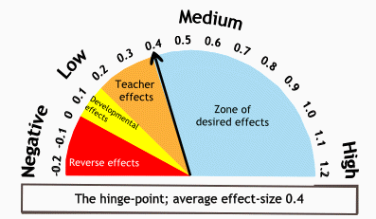

Slide 10
Card sort
Rank these pedagogical practices in order of effect size
Scaffolding (Worked examples)
Student control over their own learning
Inquiry-based teaching
Classroom discussion

Slide 11
Card sort
Rank these pedagogical practices in order of effect size
Classroom discussion
0.82
Scaffolding (Worked examples)
0.53
Inquiry-based teaching
0.35
Student control over their own learning
0.01

Slide 12
Odd one out
Homework
Web-based learning
Problem-based learning
Questioning

Slide 13
Odd one out
Homework
0.29
Web-based learning
0.18
Problem-based learning
0.12
Questioning
0.48

Slide 14
Handouts & discussion

Slide 15
Table 1
Pedagogical practices which teachers can have ownership of
- What stands out for you as particularly interesting / surprising?

Slide 16
Table 2
“Teacher as Activator” vs “Teacher as Facilitator”
- What are your thoughts on this?

Slide 17
Table 3
Specific programmes or whole-school activities
- What are your thoughts on this?

Slide 18
Table 4
Others factors which may be interesting to reflect on / discuss
- What stands out for you as particularly interesting / surprising?

Slide 19
Discussion of this
Too many open-ended tasks can make it difficult to direct students to what really matters.
While it is possible to learn without knowing you’re learning (“tacit knowing”), for most people there needs to be a deliberate attempt to assimilate and accommodate new learning.
This is why setting out the learning intention and success criteria is so important.
The critical part when evaluating the success of a lesson is a review against the learning intention and success criteria
  The lesson conclusion should come back to these.

Slide 20
ASSESSment of learning:
True or false?
“Peer tutoring” has a higher effect size than “mentoring”;
“Direct instruction” has a higher effect size than “co-operative learning”;
“Teacher-student relationships”, “homework” and “study skills” all have effect sizes greater than 0.4.
“Ability grouping (by class)” has a higher effect size than “within-in class grouping”.

Slide 21
ASSESSment of learning:
True or false?
“Peer tutoring” has a higher effect size than “mentoring”;
“Direct instruction” has a higher effect size than “co-operative learning”;
“Teacher-student relationships”, “homework” and “study skills” all have effect sizes greater than 0.4.
“Ability grouping (by class)” has a higher effect size than “within-in class grouping”.

Slide 22
LEARNING INTENTIONS
& success criteria
Learning intention
  Develop a basic understanding of what effect sizes are.
Success criteria
  You can explain what an “effect size is”;
  You can state the value of Hattie’s recommended effect size baseline;
  You can use effect size information to discuss and reach judgements on the effectiveness of different pedagogical practices.

Slide 23
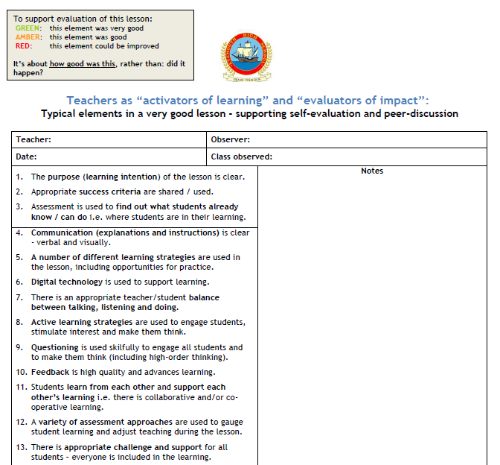
Our “practice of teaching”
We have updated elements to reflect principles from Visible Learning for Teachers
  e.g. Element 5, Element 7, Element 12
Handout shows how elements link to effect sizes
This year’s Improvement Plan has a particular focus on elements, which Part 2 will explore further:
  1-3
  9 & 12
  19 & 20

Slide 24
Suggested next steps
Review and discuss effect size information
Read Visible Learning for Teachers by John Hattie
  Copies in school
  GTCS website
PLPs
  Think about your focus in relation to effect sizes
Peer Observation Week
PT Learning & Teaching
EHSTeaching website

Slide 25

Ehsteaching.wordpress.com

Slide 26
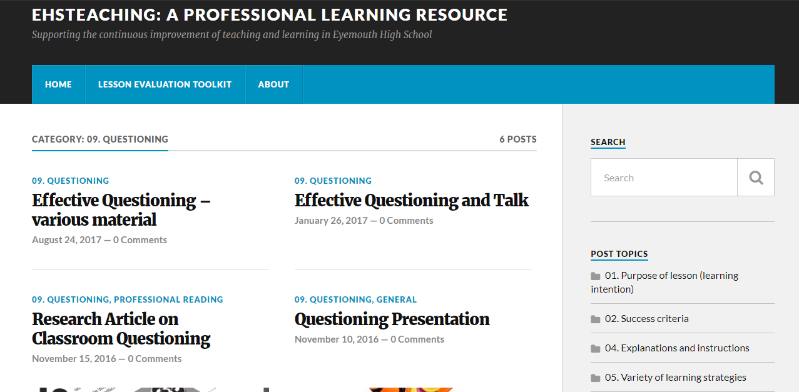

Slide 27
Ehsteaching.wordpress.com

Slide 28
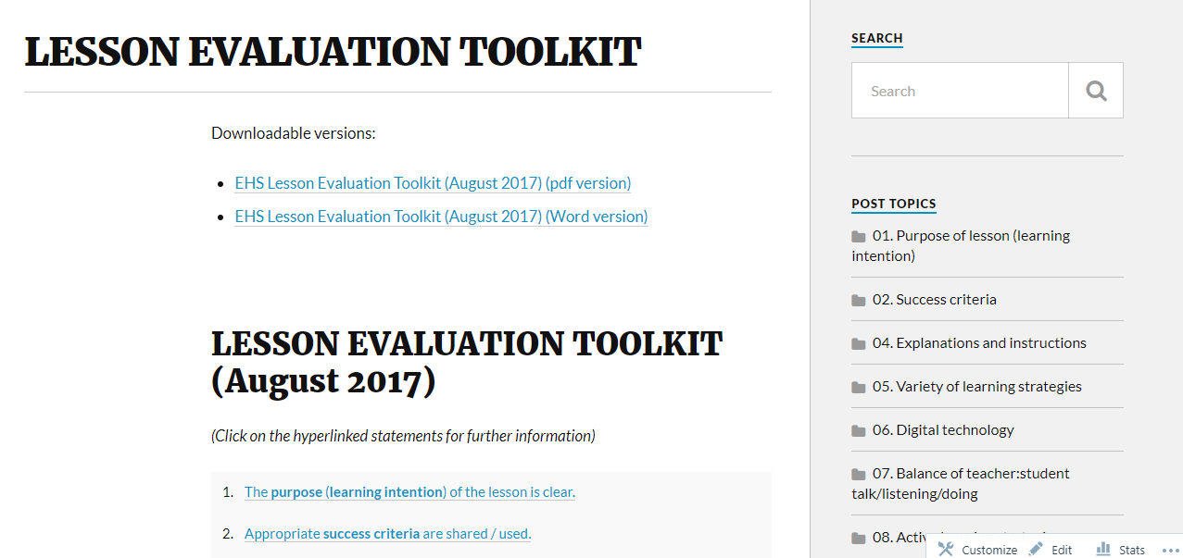

Slide 29
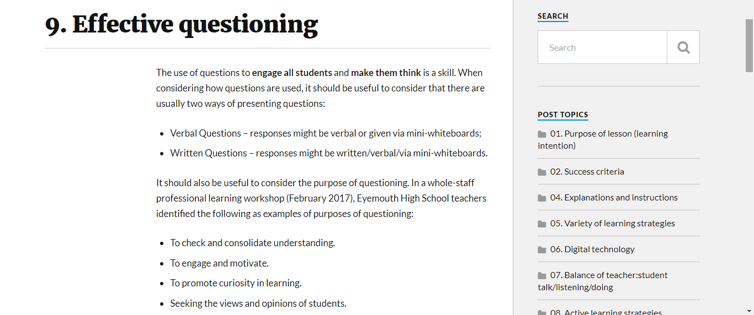

Slide 30
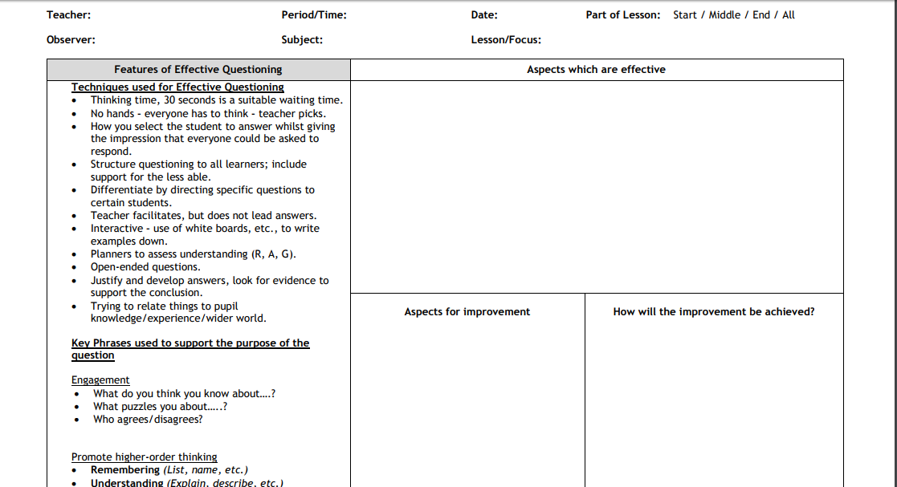

Slide 31
Evaluation
Very useful
Useful
Not very useful

