Slide 1
Active lesson conclusions
Ideas to develop practice across Eyemouth High School

Slide 2
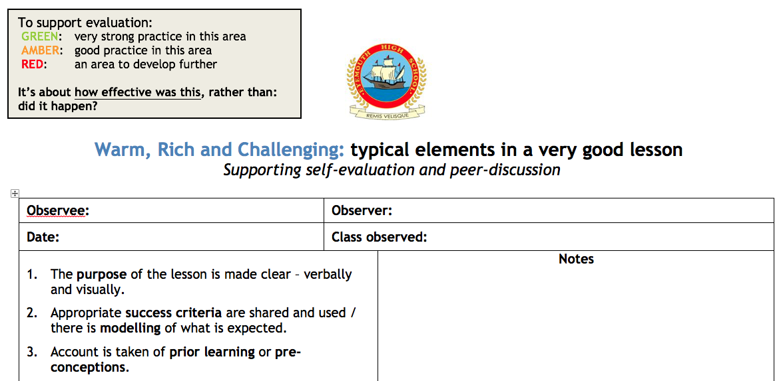
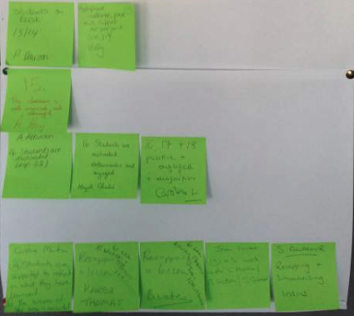
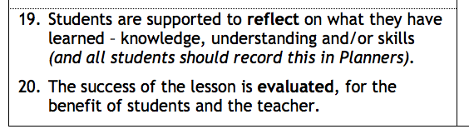
Rationale

Slide 3
purpose & success criteria
Purpose
  To present a selection of different “active lesson conclusions” which could be used to focus students to reflect on their learning and to help teachers to evaluate the success of the lesson based on student learning.
Success criteria
  You thought at least one of the methodologies was useful and something that you will focus on developing in your teaching.

Slide 4
Active assessment
By active learning, we mean actively engaged
  Getting students to really think about something
Assessment is essential to learning, and we should be assessing student learning and progress constantly
    Summative and formative
This presentation is about active assessment towards the ends of lessons, supporting self-evaluation records in Planners
  But many of the methodologies could be used as lesson starters or activities during lessons

Slide 5
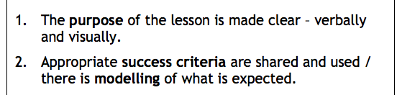
Lesson purpose & success criteria
Every lesson should have a clear purpose, whether that’s to learn something new, to be able to do something new, or to consolidate or improve on something.
If we’re going to focus students on what they’ve learned or achieved at the ends of lessons, then the PURPOSE needs to be made clear at some point.
We also need clear CRITERIA to gauge how successfully students have learned something – this is important for students in terms of their learning and for teachers in terms of getting feedback on teaching.

Slide 6
Useful tools
Mini-whiteboards / Show-Me boards (in Planners)
Traffic-light cards (in Planners)
Post-it notes
They all help to give feedback to a teacher about how individual students, groups of students, or the class as a whole have got on

Slide 7
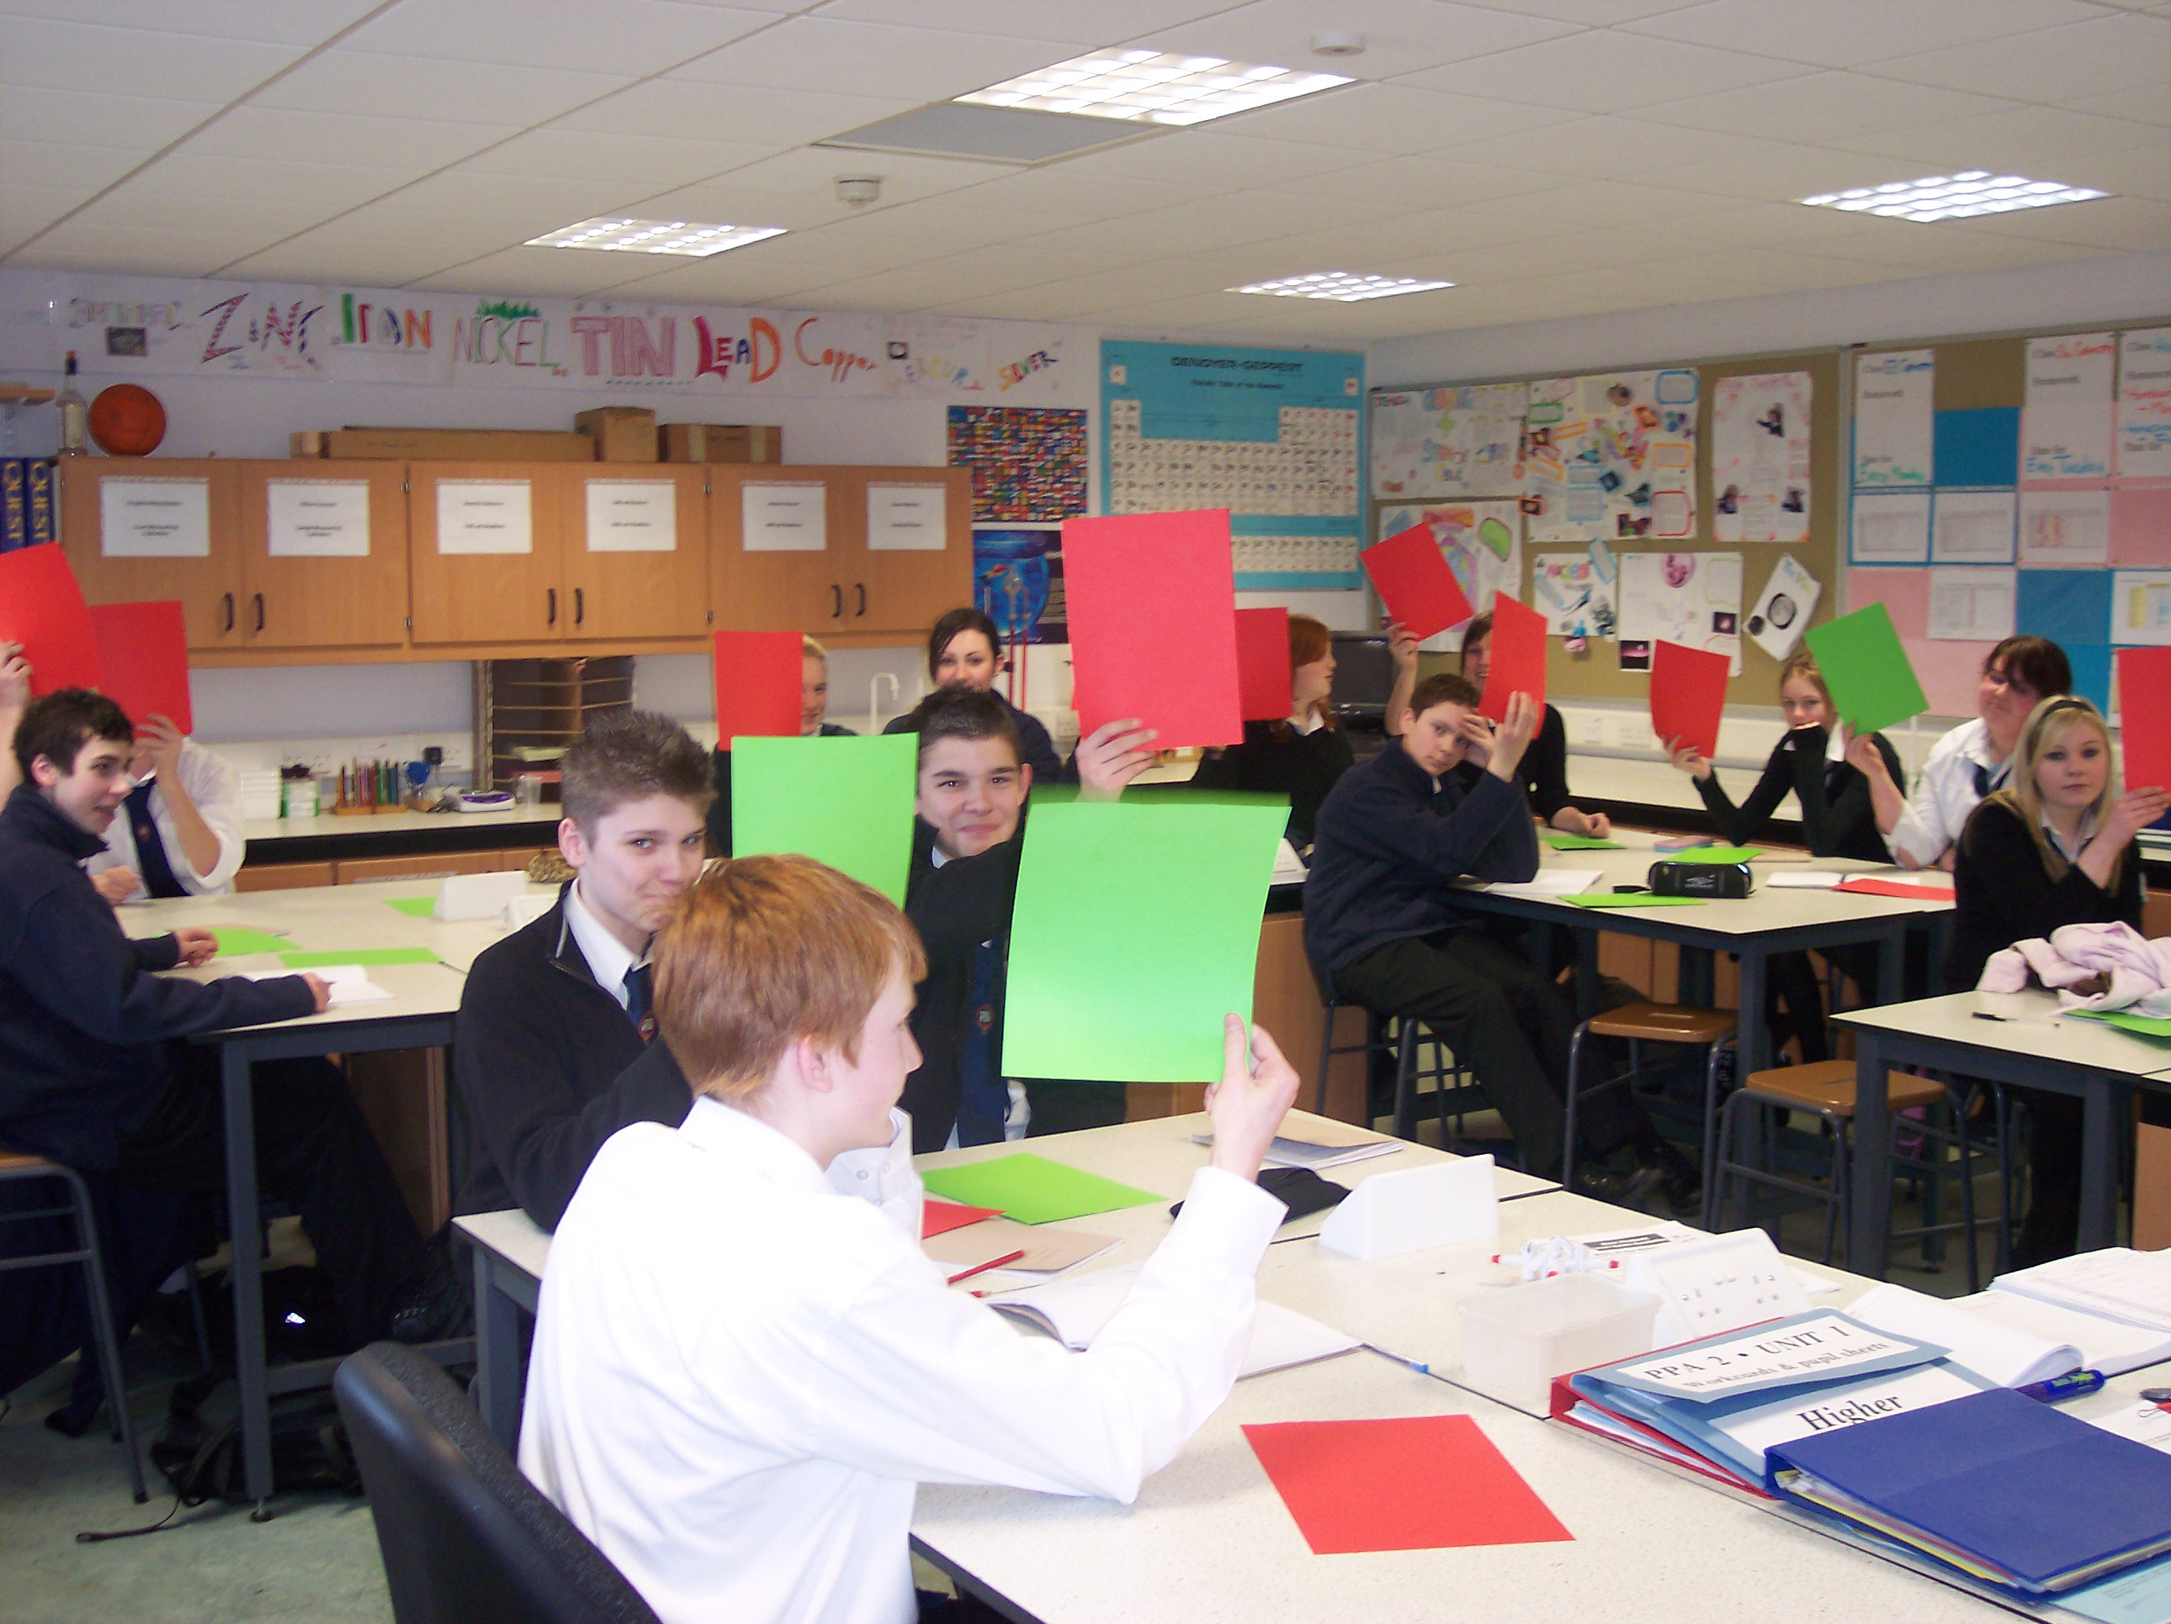
S4

Slide 8
1.
“what have you learned today?” question
Simple, but effective

Slide 9
“What have you learned today?”
Get students to write it down – it makes everyone think about something.
  Use a mini-whiteboard; get them to hold it up; have a look at them; use some of them as teaching points.
  Use post-it notes.
Most effective when the focus is brought back to the purpose or success criteria of the lesson.
A variation might be to write down a question about something that a student’s not sure about.

Slide 11
2.
Odd one out

Slide 12
Learning Intention
  Understand what elements and compounds are.
Success Criteria
  You can write definitions for both terms.
  You can name at least three examples of elements and three examples of compounds.
  Given information about a chemical, you can identify whether it is an element or a compound.

Slide 13
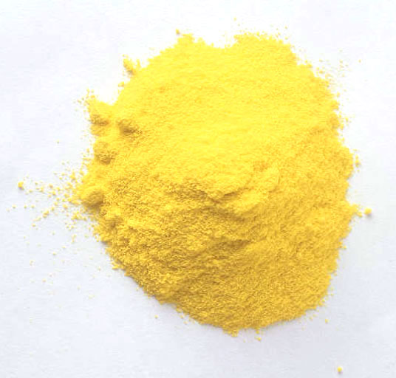
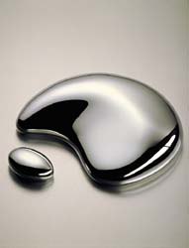
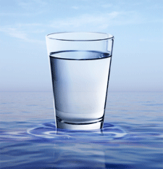

Notes:
Which is the odd one out?
The water is the odd one out. It is the only one which is not an element.

Slide 14
Self-evaluation
I feel very confident about being able to identify something as an element or compound.
I feel quite confident about being able to identify something as an element or compound.
I don’t feel very confident about being able to identify something as an element or compound.

Slide 15
3. classifying/grouping

Slide 16
Learning Intention
  Understand the difference between compounds and mixtures.
Success Criteria
  You can write definitions for both terms.
  Given the name of a substance, you can state whether it is a compound or a mixture.

Slide 17
Element, compound or mixture?
Mercury
Krypton
Water
Salt
Sea water
Air
Sugar
Carbon dioxide

Slide 18
Verb | Adverb | Adjective | None of these | It depends
hot
blue
run
car
slowly
fast
bright
girl
again
she

Slide 19
Self-evaluation
I got all of these correct.
I got all of these correct except for one or two.
I got more than two of these wrong.

Slide 20
4. deliberate mistakes

Slide 21
Deliberate mistakes: melting and freezing
Melting and freezing are opposites of each other. To freeze a substance you heat it up and the liquid turns into a solid. This means that the particles become more spread out.
Water freezes at 0ºC and all substances freeze at this temperature. Because of this, whenever a substance freezes it will feel cold.

Slide 22
Deliberate mistakes: melting and freezing
Melting and freezing are opposites of each other. To freeze a substance you heat it up and the liquid turns into a solid. This means that the particles become more spread out.
Water freezes at 0ºC and all substances freeze at this temperature. Because of this, whenever a substance freezes it will feel cold.

Slide 23
Self-evaluation
I spotted all of the mistakes – I feel very confident about it.
I spotted some of the mistakes – I’m getting there with this.
I didn’t spot many of the mistakes – I found this quite difficult.

Slide 24
5. true or false?

Slide 25
True or false?
Adjectives always come before a noun.
An adjective helps describe a noun.
An adjective can describe a verb.
An adjective can be made from more than one word.
Adjectives never begin with a capital letter.
Some adjectives end in ‘ly’

Slide 26
Self-evaluation
6 correct
4 or 5 correct
Less than 4 correct

Slide 27
6.
Matching

Slide 28
Match the indicator with what gives a positive result to a test.
Indicator | Used to test for?
Benedict’s Reagent | Carbon dioxide
Iodine solution | Acids and alkalis
Universal indicator | Sugars (but not sucrose)
Ferroxyl indicator | Starch
Lime water | Iron(II) ions

Slide 29
Self-evaluation
All correct
1 mistake only
More than one mistake

Slide 30
7. concept cartoons

Slide 31
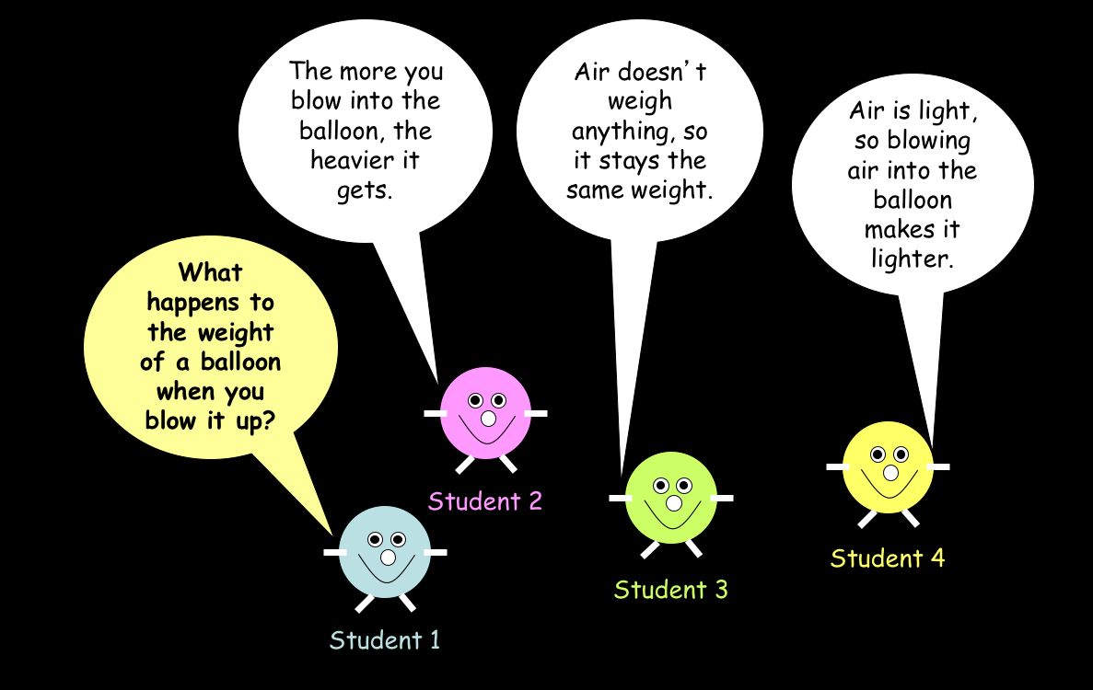

Slide 32
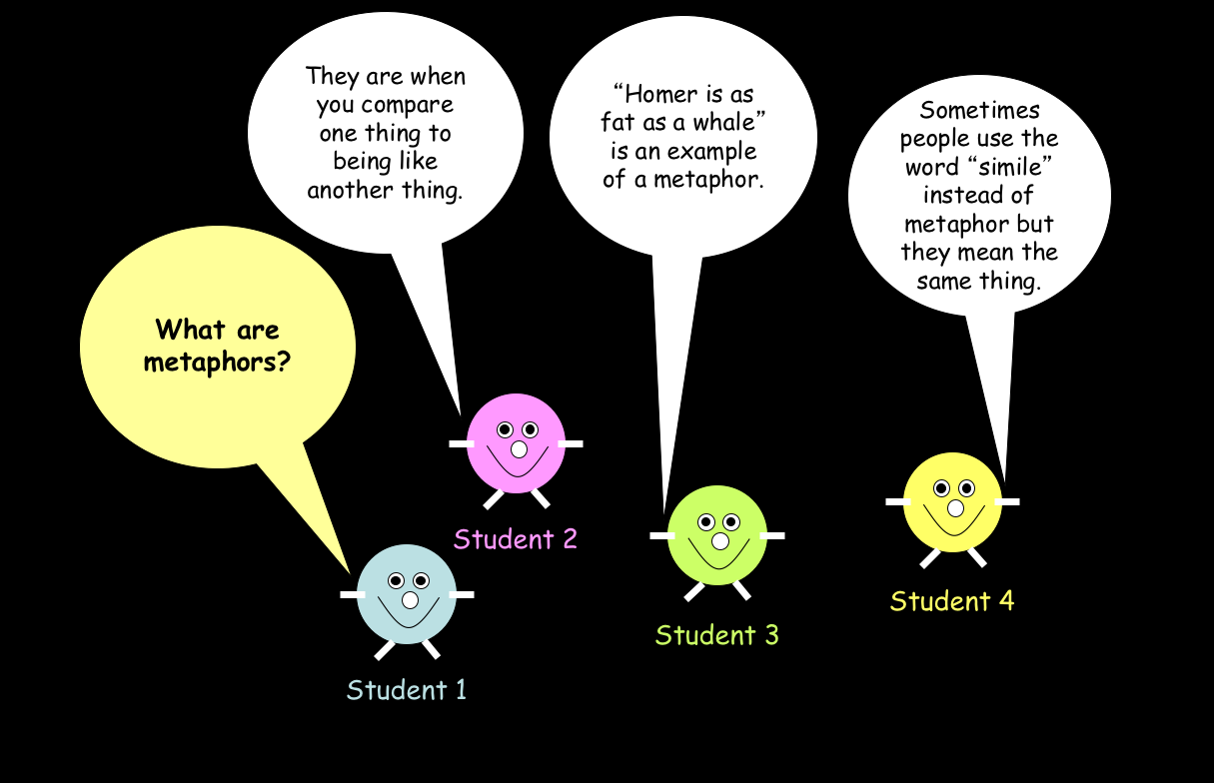

Slide 33
Self-evaluation
I think I really understand this.
I understand a lot of this but I need to do some more work on it to get it fully,
There’s quite a bit of this that I don’t understand yet.

Slide 35
Next steps
For individuals and faculties

Slide 36
Over the next month…
Revisit this presentation in faculties.
Discuss how some of these active lesson conclusions might work for your subject / curricular area.
Discuss and agree your own faculty criteria for features of effective lesson conclusions.

Slide 37
Peer observation week
It’s next week.
We’d like everyone to be taking part.
Please try to pair-up with someone from out-with your faculty.
Put your name onto a post-it and put it onto the staffroom board – you could do this before you leave this afternoon.
In addition to any particular focus you want feedback on from your lesson, please could everyone also focus on elements 19 and 20 from our toolkit.

Slide 38
Ehsteaching website
EHSTeaching.wordpress.com

Slide 39
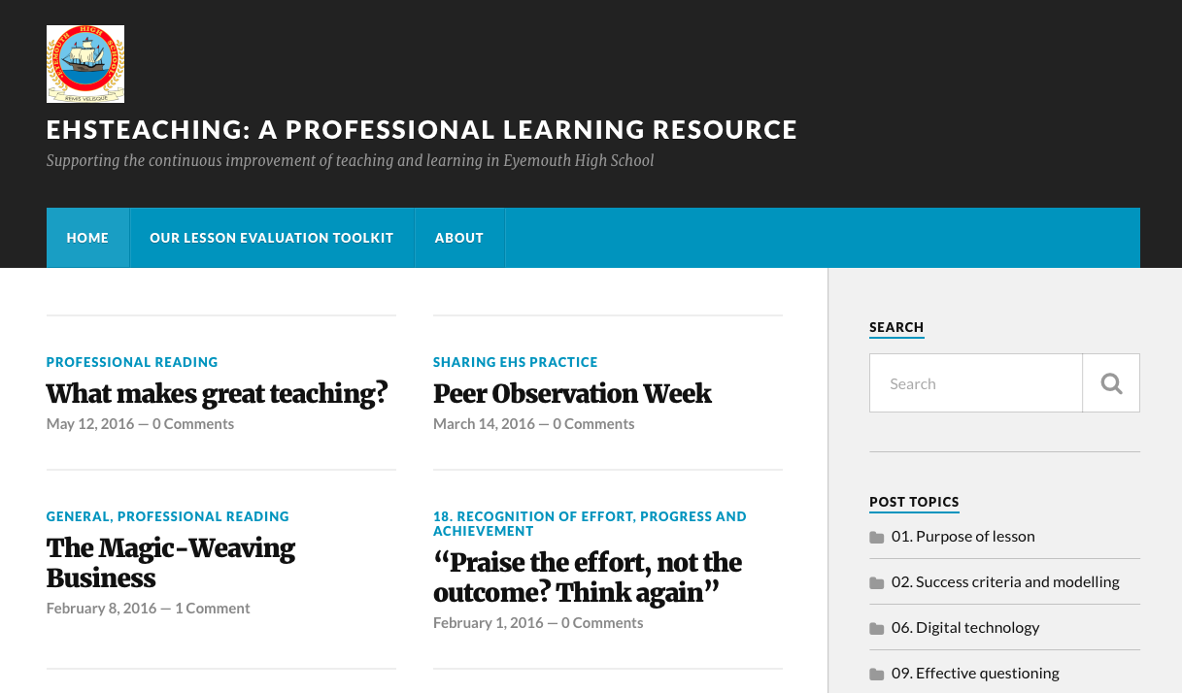
EHSTeaching.wordpress.com

Slide 40
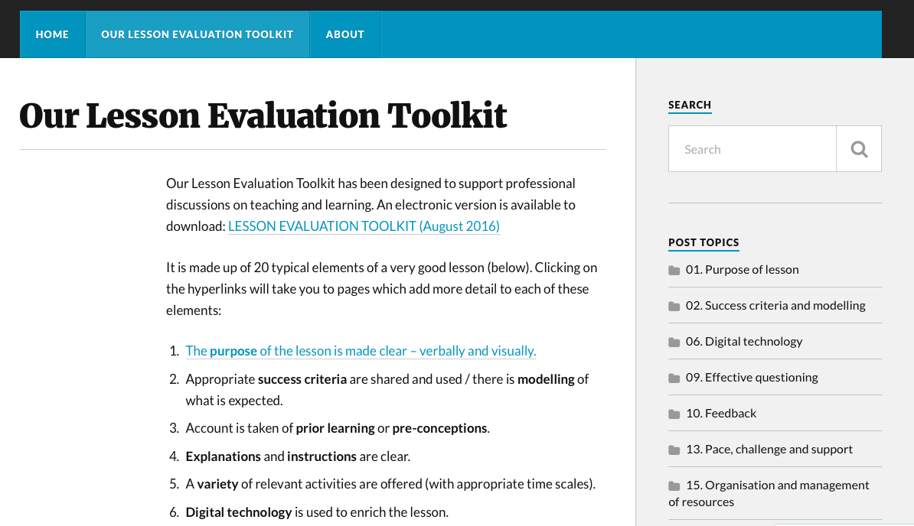

Slide 41
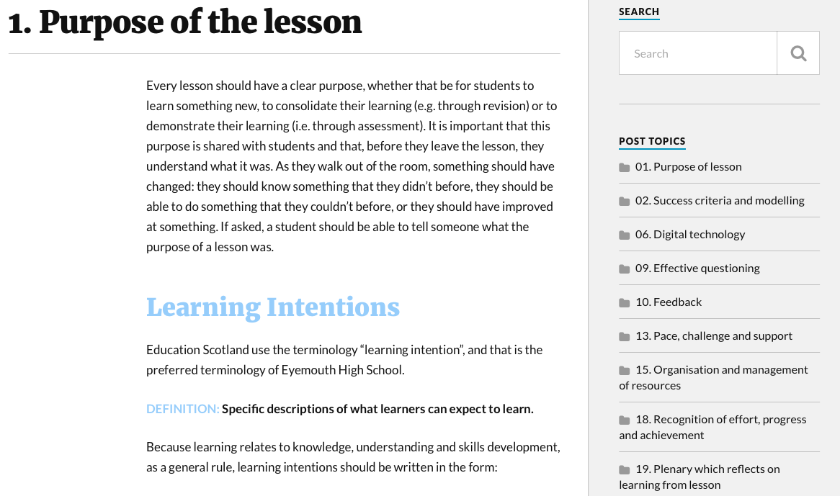

Slide 42
purpose & success criteria
Purpose
  To present a selection of different “active lesson conclusions” which could be used to focus students to reflect on their learning and to help teachers to evaluate the success of the lesson based on student learning.
Success criteria
  You thought at least one of the methodologies was useful and something that you will focus on developing in your teaching.

Slide 43
Evaluation of this session
Please GREEN/AMBER/RED the usefulness of this session
Please also add a comment
Please include your name
Leave it on the front table before you leave

