Slide 1

The continuous improvement of learning and teaching
In-Service Day, 2017

Slide 2
Learning and teaching is at the heart of what we do.
As a school, we should be focused on the relentless pursuit of excellence in the classroom, evaluating this against the quality of student experiences and outcomes.
Guiding our work should be a simple principle: no matter how good our learning and teaching is, we should always be trying to make it better.

Slide 3

A model for continuous improvement

Slide 4
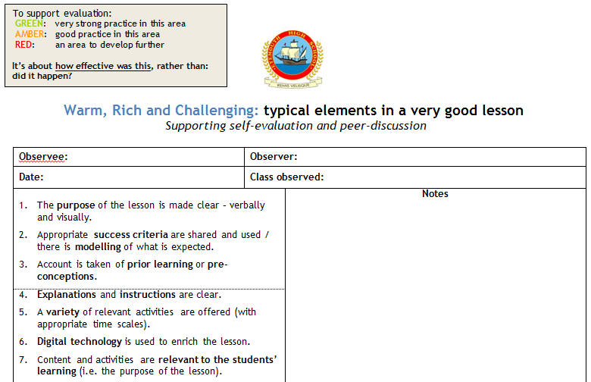
Lesson Evaluation Toolkit

Slide 5
Whole-school Learning and Teaching Improvement Group
  Representation
Whole-school Peer Observation Weeks
Learning and Teaching workshops
Professional Learning library
EHS Learning and Teaching website
Faculty learning and teaching improvement programmes
  set out in faculty Learning and Teaching Calendars

Slide 6
2016-17 Improvement Plan
1. The Teaching and Learning Improvement Group should be expanded to have wider faculty representation. Ideally, there will be representation from all faculties.

Slide 7
Progress and evidence
Membership of 13.
Meetings every 4-6 weeks.
Plans and evaluates collaborative professional learning opportunities.
Minutes being shared with all staff.
Group members taking a “Leader of Learning” role in faculties, encouraging the sharing of practice and bringing back to share with this group.

Slide 8
2016-17 Improvement Plan
2. The school Teaching and Learning Website will be re-designed so that it aligns to our whole-school Lesson Evaluation Toolkit. It will be designed to function in a similar way to the How2s website, but with a school-specific spin.
The idea of having “specialist” lesson evaluation toolkits (e.g. one which drills down into the key features of effective questioning) will be incorporated into the re-designed website.

Slide 9
Progress and evidence
EHSTeaching website launched in August.
1951 visits since then.
20 “posts” to the website.
LTIG members given training on how to add posts.
PTs / LTIG members encouraged to lead discussion of posts at faculty meetings.
“Library/reference” area has started to develop.
“Effective Questioning Framework” developed.

Slide 10
2016-17 Improvement Plan
3. Three Peer Observation Weeks will feature in the school calendar.
Two “Post-It Boards” (trialed in 2015/16 session) should be considered to support each Peer Observation Week – one to identify a focus and the other to highlight effective practice – but there should be evaluation of their usefulness first (based on the work from the 2015-16 session).

Slide 11
Progress and evidence
First Peer Observation Week in September had 33 teachers taking part.
The two Post-Its boards have been successfully used.
Second Peer Observation Week has been moved from November 2016 to January 2017, after feedback from staff suggesting that this would be better.
Third Peer Observation Week is w/b 8th May.

Slide 12
2016-17 Improvement Plan
4. We will use Collegiate Meeting (CM) sessions to offer a selection of in-house Professional Learning Workshops, planned and organised by the Learning and Teaching Improvement Group.
We should aim to align these to specific elements from our Lesson Evaluation Toolkit.

Slide 13
Progress and evidence
Workshop on “Active Lesson Conclusions” (covering Elements 19 and 20 of the LET) received very positive feedback in evaluations. Follow-up action has been discussed with Principal Teachers. Majority of teachers attended.
Workshops on “Mini-White Boards”, “Effective Questioning” (Element 9) and “Differentiation” (Element 13) received very positive feedback in evaluations. Majority of teachers attended.
Workshop setting up the development of an “Effective Questioning Framework” (Element 9) received very positive feedback. Majority of teachers attended.

Slide 14
2016-17 improvement plan
5. The GTCS website now has a “Research” area where books and journal articles are available for online access. A Professiomal Reading Group should be established for any teachers who are interested in discussing the pedagogical research available via this site.
Similarly, we should consider a core middle leadership and management text for our new Principal Teachers and look to create opportunities for them to meet and discuss elements from this.

Slide 15
Progress and evidence
KF leading a Professional Reading Group. The first book was “Professional Capital” (Hargreaves and Fullan). Six teachers have joined the group.
Learning and Teaching books have been moved from library to staffroom – feedback from LTIG was they are more likely to be used in this area.
“Visible Learning for Teachers” (John Hattie) has been purchased as a core text for members of the EMT.
“Visible Learning for Teachers” being purchased as second text for the Professional Reading Group.
A voluntary research reading group is due to meet next week.

Slide 16
Other
S1-3 Learner Experiences Survey.
Faculty “Learning and Teaching Calendars” and Improvement Plans with L&T focus.
Programme of SMT lesson observations and follow-up discussion (25 between August and October 2016 – “faculty fortnight programme”).
Programme of PT L&T (C. Richardson) lesson observations and follow-up discussion.

Slide 17
Self-Evaluation of learning and teaching and leadership of learning and teaching

Slide 18


Slide 19
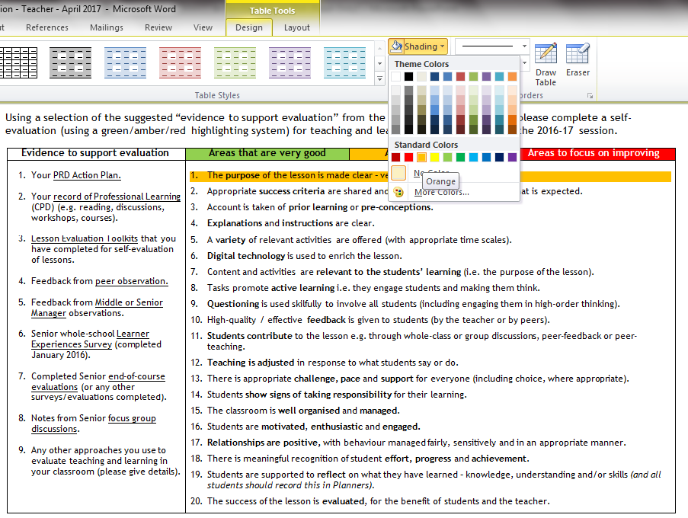

Slide 20
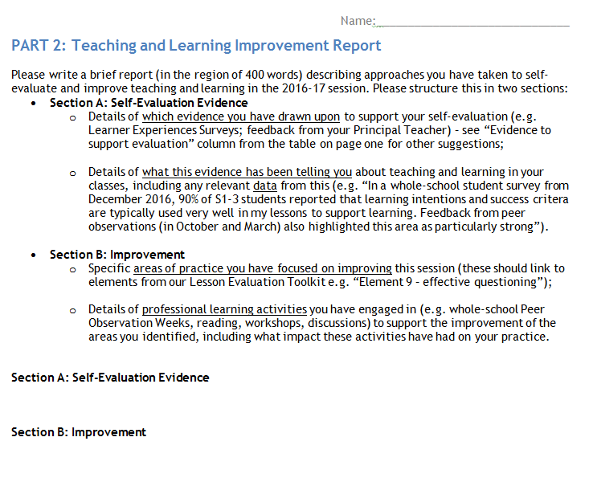

Slide 21


Slide 22
Please use time available for this activity today.
Forward completed versions of parts 1-3 to your Principal Teacher and B. Robertson by end of the day, Monday 8th May.

Slide 23
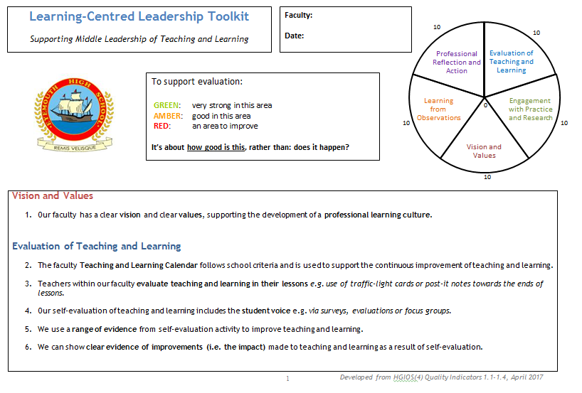

Slide 24
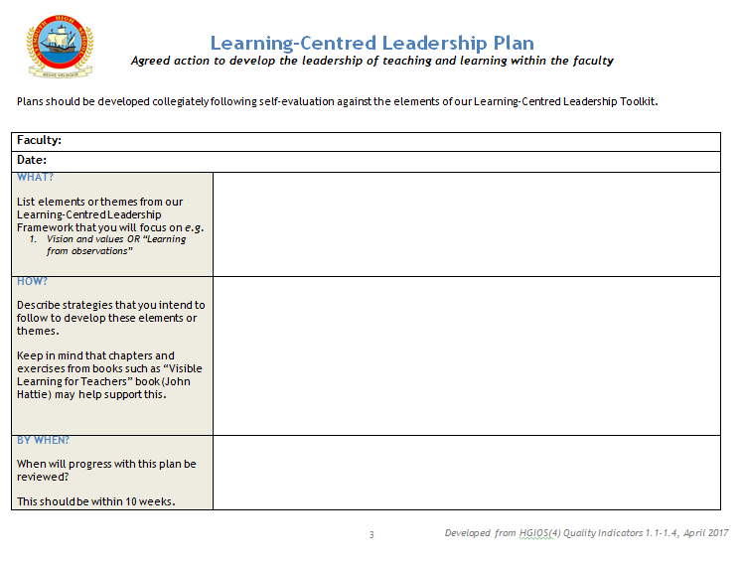

Slide 25
Please use time available for this activity today.
Forward completed versions of parts 1-3 to B. Robertson by end of the day, Monday 8th May.

