Slide 1

The continuous improvement of learning and teaching
Framework overview

Slide 2
Learning and teaching is at the heart of what we do.
As a school, we should be focused on the relentless pursuit of excellence in the classroom, evaluating this against the quality of student experiences and outcomes.
Guiding our work should be a simple principle: no matter how good our learning and teaching is, we should always be trying to make it better.

Slide 3

A model for continuous improvement

Slide 4
PRD meetings
  to be completed by Friday 16th September
Faculty learning and teaching improvement programmes
  set out in faculty Learning and Teaching Calendars
Whole-school Learning and Teaching Improvement Group
  Representation
Whole-school Peer Observation Weeks
Learning and Teaching workshops
Professional Learning library
  subscription to TESS magazine
EHS Learning and Teaching website

Slide 5
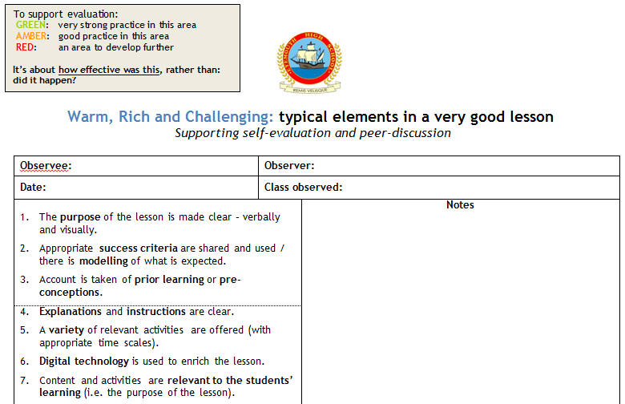
Lesson Evaluation Toolkit

Slide 6
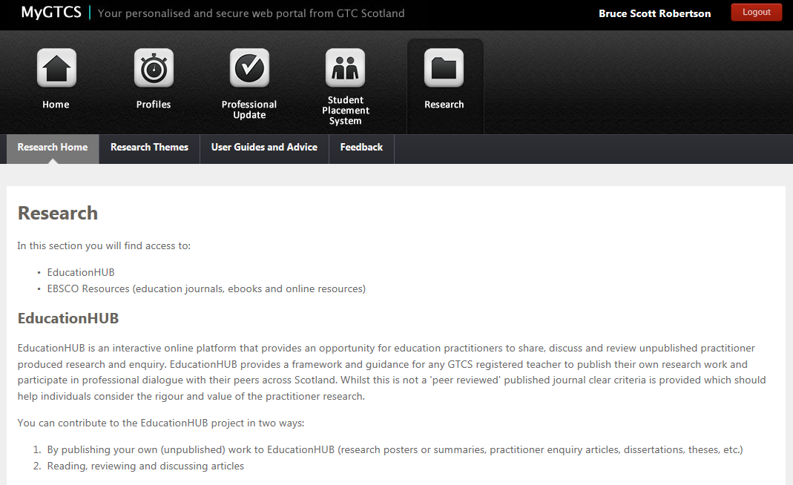

Slide 7
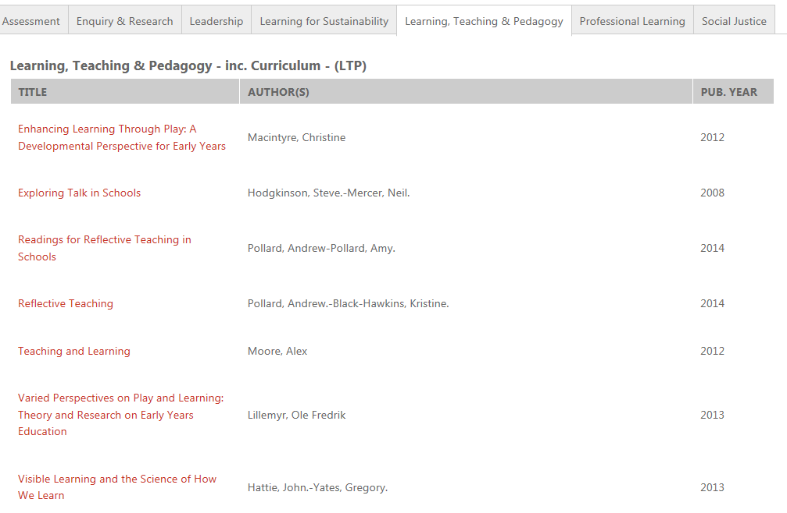

Slide 8
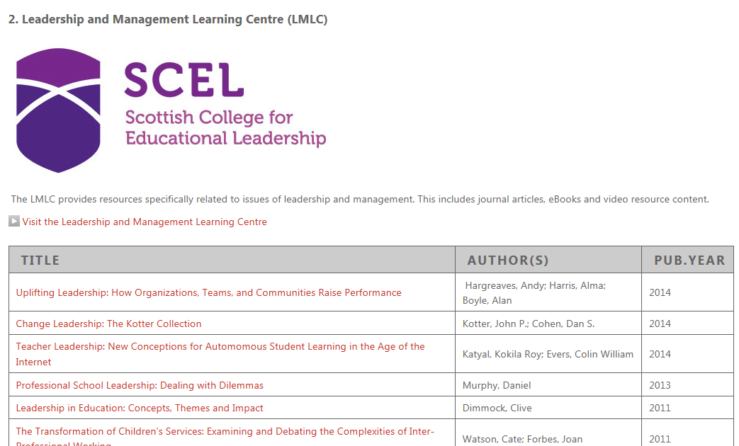

Slide 9
Student Planners
Key messages

Slide 10

We use Planners to support your learning, and it’s important that they’re used properly.
We expect every student to:
Bring it into school every day.
Take it out at the start of every lesson.
Keep it up-to-date.
Keep it neat and tidy.
S1-3: Get it signed at the end of every week.
You will need this Planner for the whole year, so look after it.
If you forget it, you should get a photocopied sheet from your Registration teacher, complete that through the day, and copy it into your Planner before the next day.
.

Slide 11



Slide 12

Do…
Take your self-evaluation seriously – it’s important to think about what you were meant to be learning every period, and how well you did with this.
Don’t…
Just tick greens and ambers – it’s important to be honest with yourself when you don’t think you learned what you were meant to, or if you don’t feel you made much progress.

Slide 13
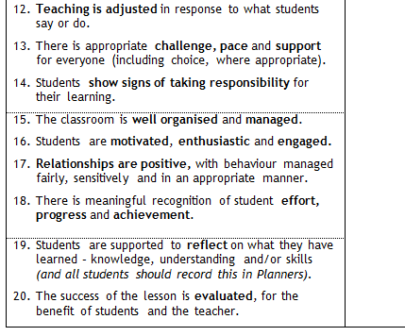

Slide 14
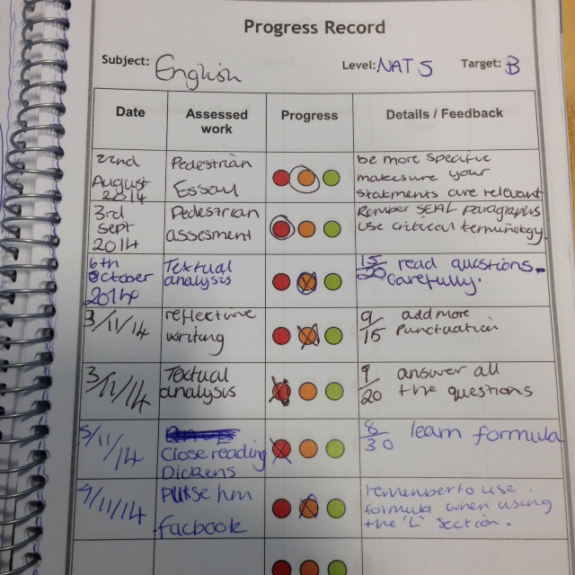
In this year’s Planners, the Progress Record looks a bit different, but you’ll still be putting the same information into it.
KEY MESSAGES
You should be keeping a Progress Record for EVERY subject.
You should be recording something in it AT LEAST once a month for every subject.
Things that can go in include assessment results (feedback or marks) and homework results (feedback or marks).
Make sure that you complete all sections:
  Date
  What was assessed
  Progress
  Details of how I got on

Slide 15
This is an example of what your Progress Record should start to look like.
In subjects (not just now), your teachers will help you to record:
the LEVEL that you’re working at (1st, 2nd, 3rd or 4th);
your TARGET – this will be the date that you’re aiming to achieve the Level by.
An example is shown to the left.

Slide 16
Targets in Planners
S2 & S3: should be in now. If not, please discuss as a faculty and have these in by the end of the week.
S1; S4-6: please discuss with students over the next fortnight and have these in by 31st August.

Slide 17


