Slide 1
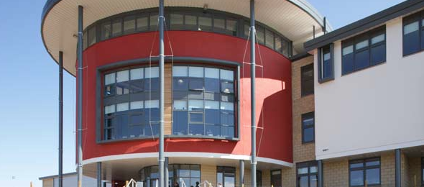
Professional Review & Development (PRD) and Professional Learning (PL)

Slide 2
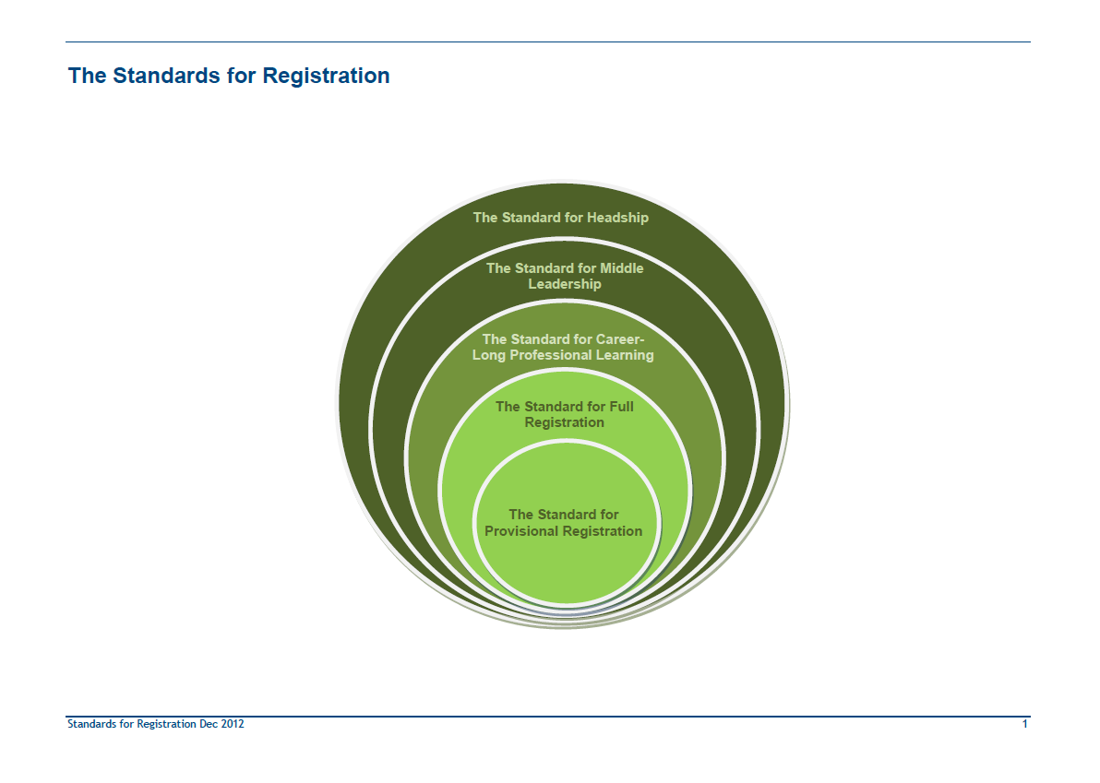

Slide 3


Slide 4
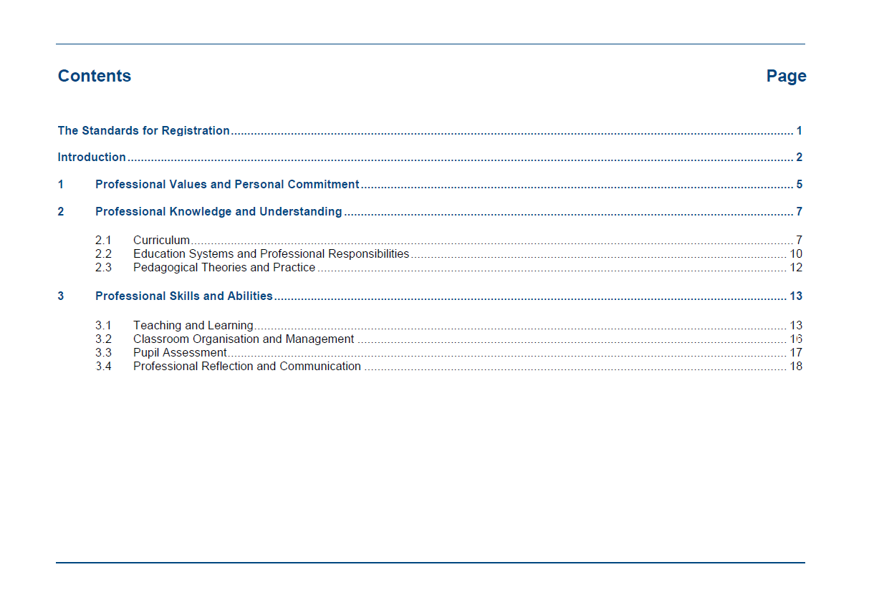

Slide 5
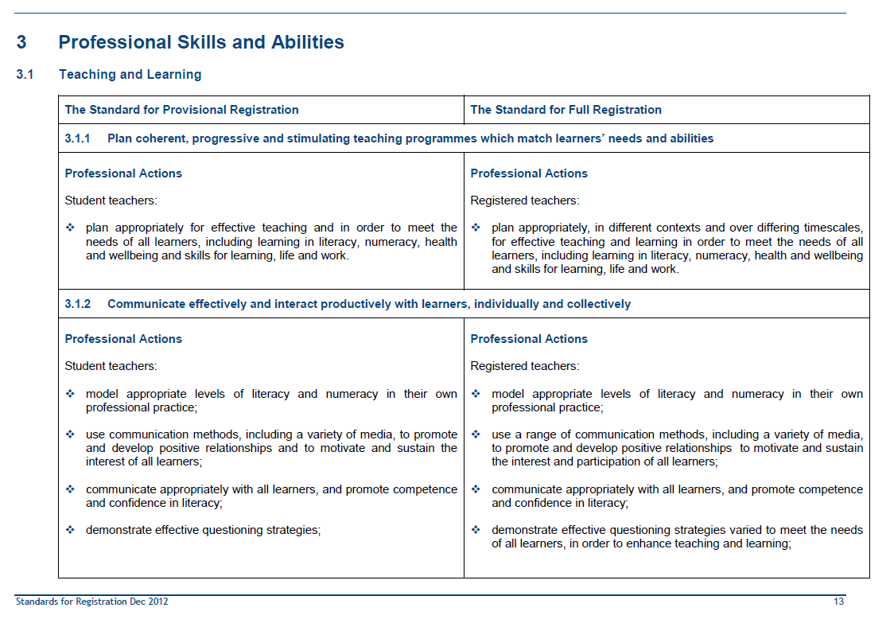

Slide 6
The principles
No matter how good you are, you can always improve.
The key questions are:
  WHAT will you be working to improve?
  HOW will you go about improving it?
  HOW will you know that you’ve made improvement?

Slide 7
The PRD process
Preparing for your meeting
On-going self-evaluation
The meeting
Professional Learning
Agreeing an action plan

Slide 8
Preparing for your PRD
Takes time.
Requires reflection against the GTCS Professional Standards.
Requires you to consider evidence e.g. feedback from observations, focus groups, one-to-ones, learner surveys.
Requires you to consider impact on experiences and outcomes for learners.

Slide 9

An effective action plan
What?
  GTCS Professional Standards
  Improvement Plans
How?
  Professional Learning model
When?

Slide 10
Example
What?
  SR 3.1.2: demonstrate effective questioning strategies varied to meet the needs of all learners, in order to enhance teaching and learning
How?
  Reading e.g. “Talk less teaching” book, EHS Learning & Teaching website.
  Observation – I should observe colleagues from within and outwith team;
  Try out different questioning techniques and get feedback from students and peers observing (including PT and SMT).
When?
  Review progress with line manager in December.

Slide 11
Some examples of “what?”
Skills in using Progress Records of Planners to give effective feedback;
Skills in supporting students to self-evaluate at the ends of lessons;
Understanding of how to track student progress using “Significant Aspects of Learning”;
Understanding of how to reach reliable judgements about Achievement of a Level in the BGE;
Skills in using success criteria to support student learning;
Knowledge of different active learning methodologies and skills in using these.

Slide 12
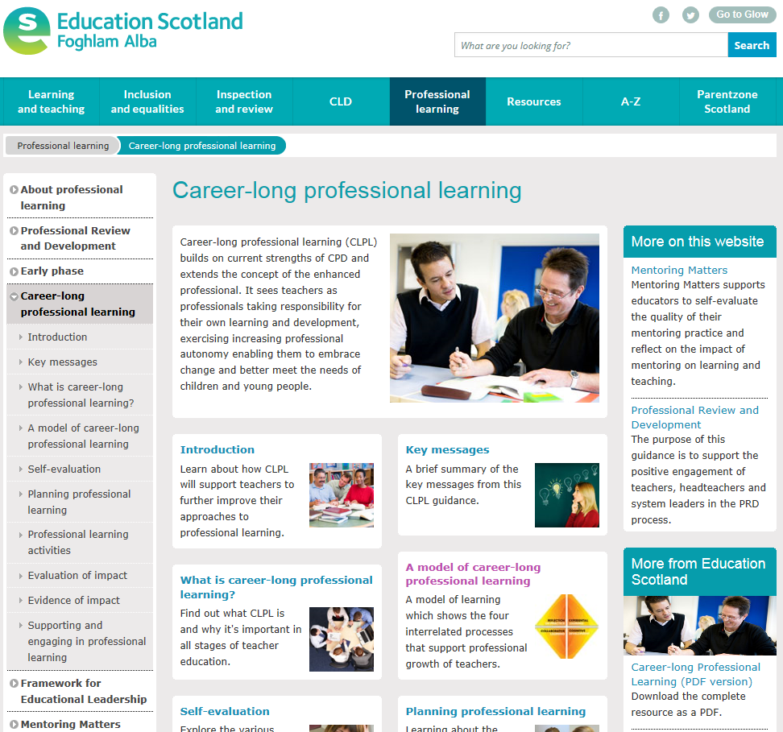

Slide 13
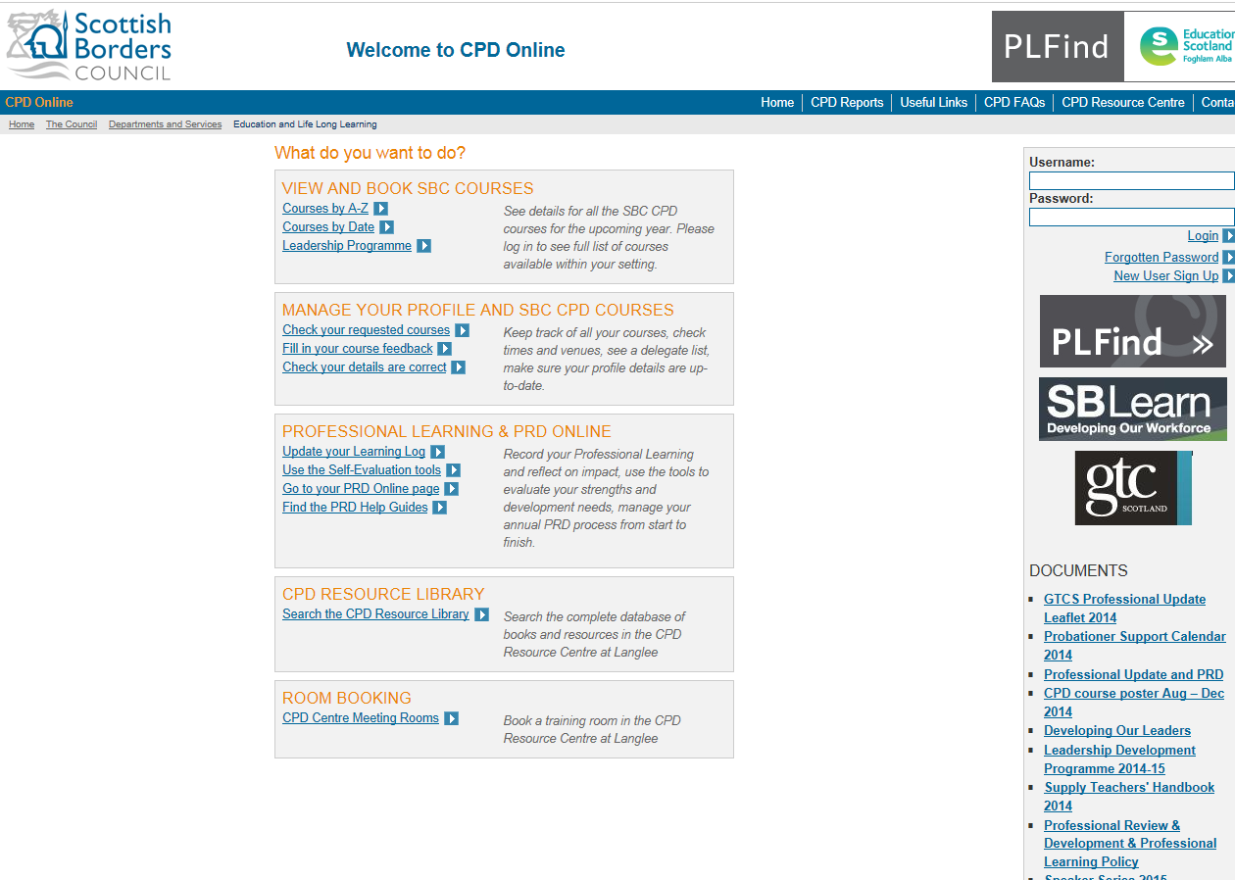

Slide 14


Slide 15


Slide 16
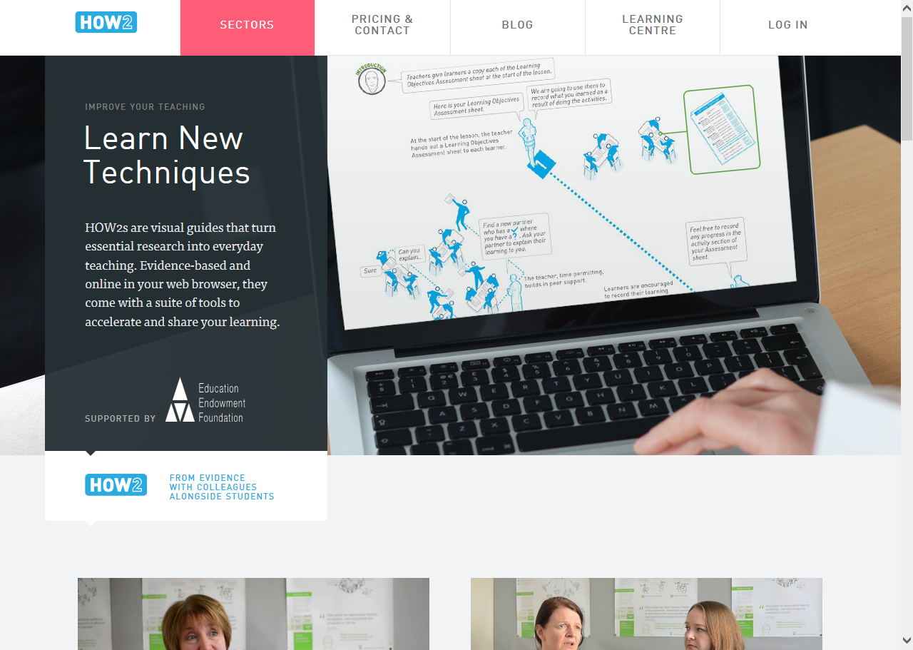

Slide 17
Self-evaluating lessons & Peer observation
Continuous improvements in learning and teaching

Slide 18
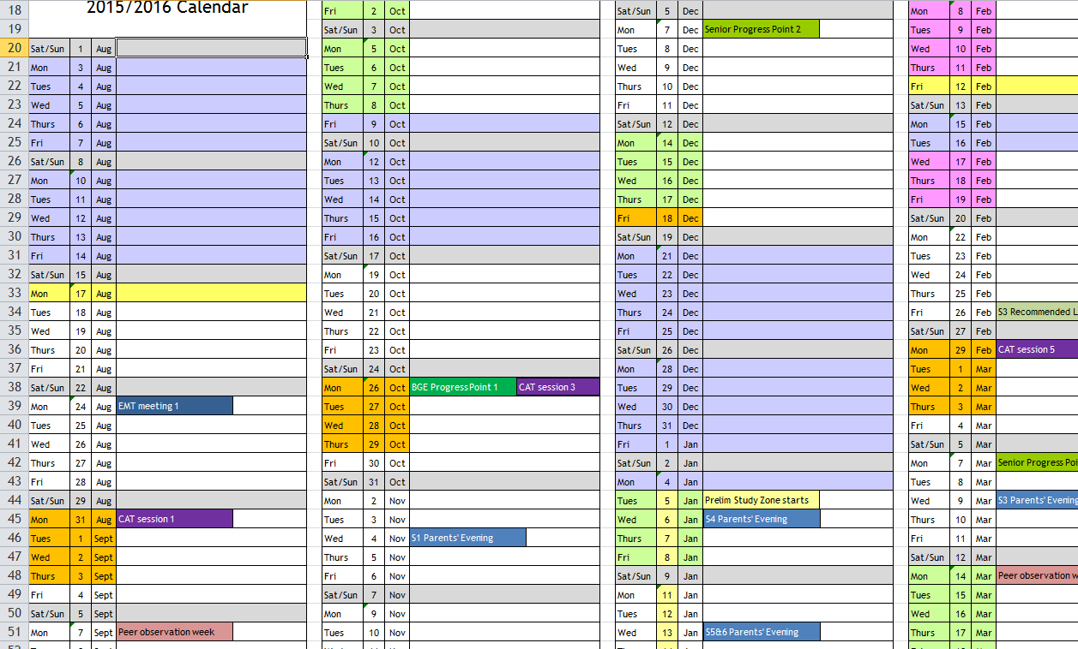

Slide 19
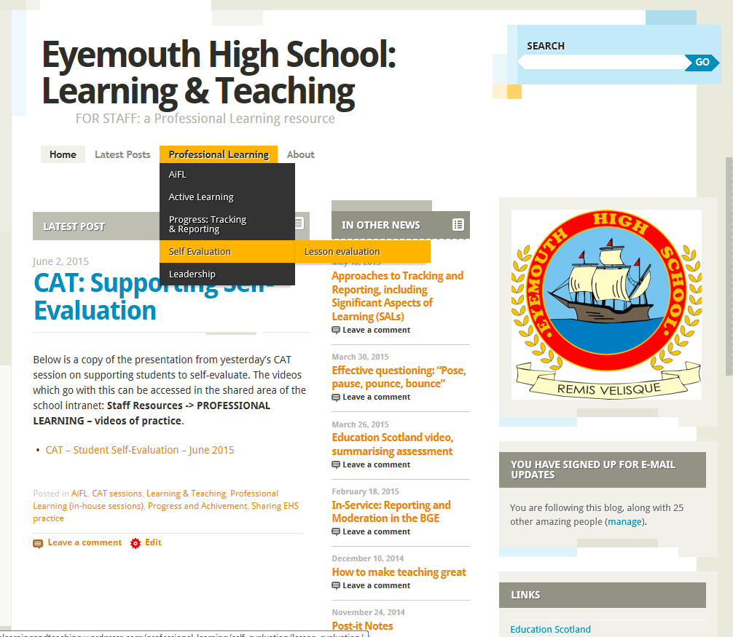

Slide 20
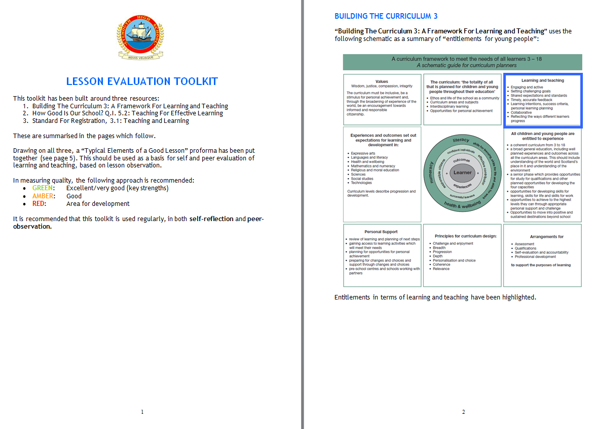

Slide 21
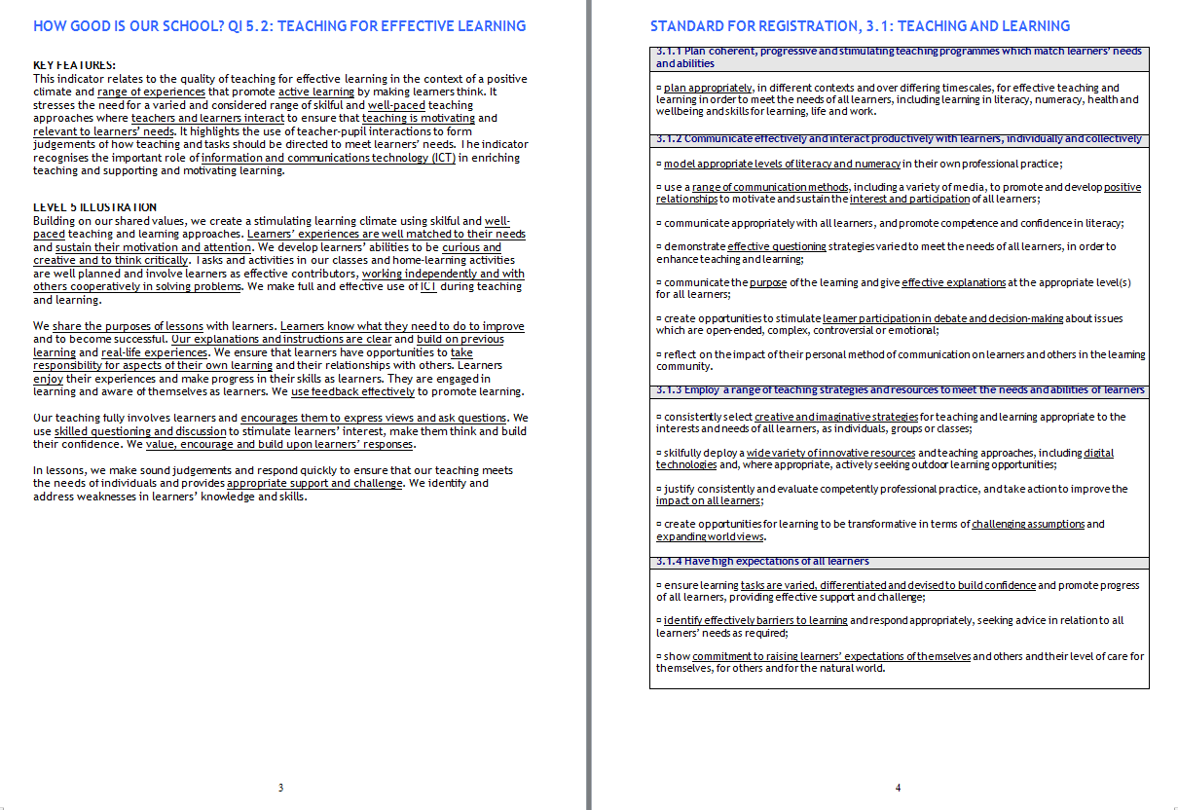

Slide 22
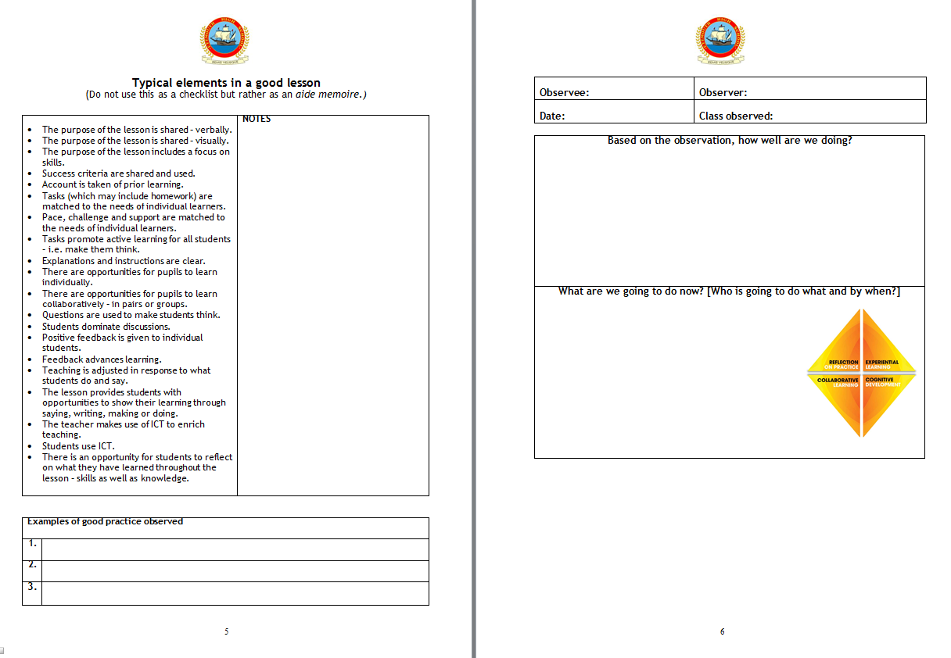

Slide 23
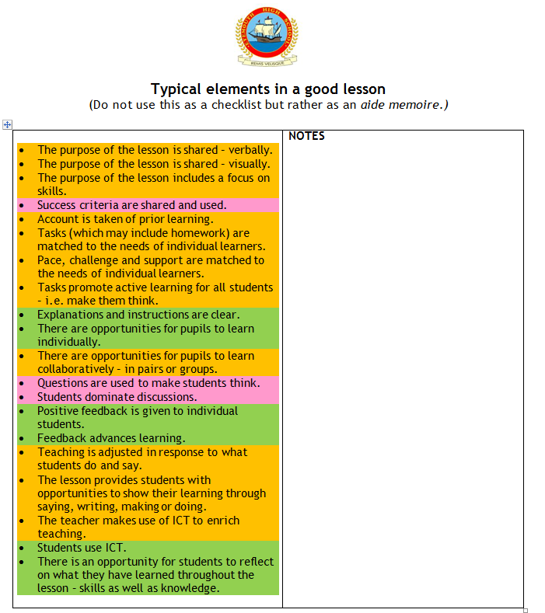

Slide 24
Expectations
Use the toolkit regularly as part of your continuous self-evaluation.
Use the toolkit in peer observation to support professional discussions.
  “Peer Observation Weeks”
All Middle and Senior Leaders should use the toolkit when carrying out observations, with teachers using it to self-evaluate before meeting for discussion and feedback.

Slide 25
Leadership development

Slide 26


Slide 27


Slide 28
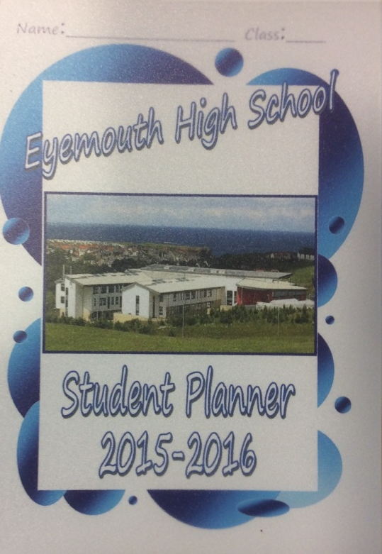
Planners
Progress Records and Self-evaluation

Slide 29
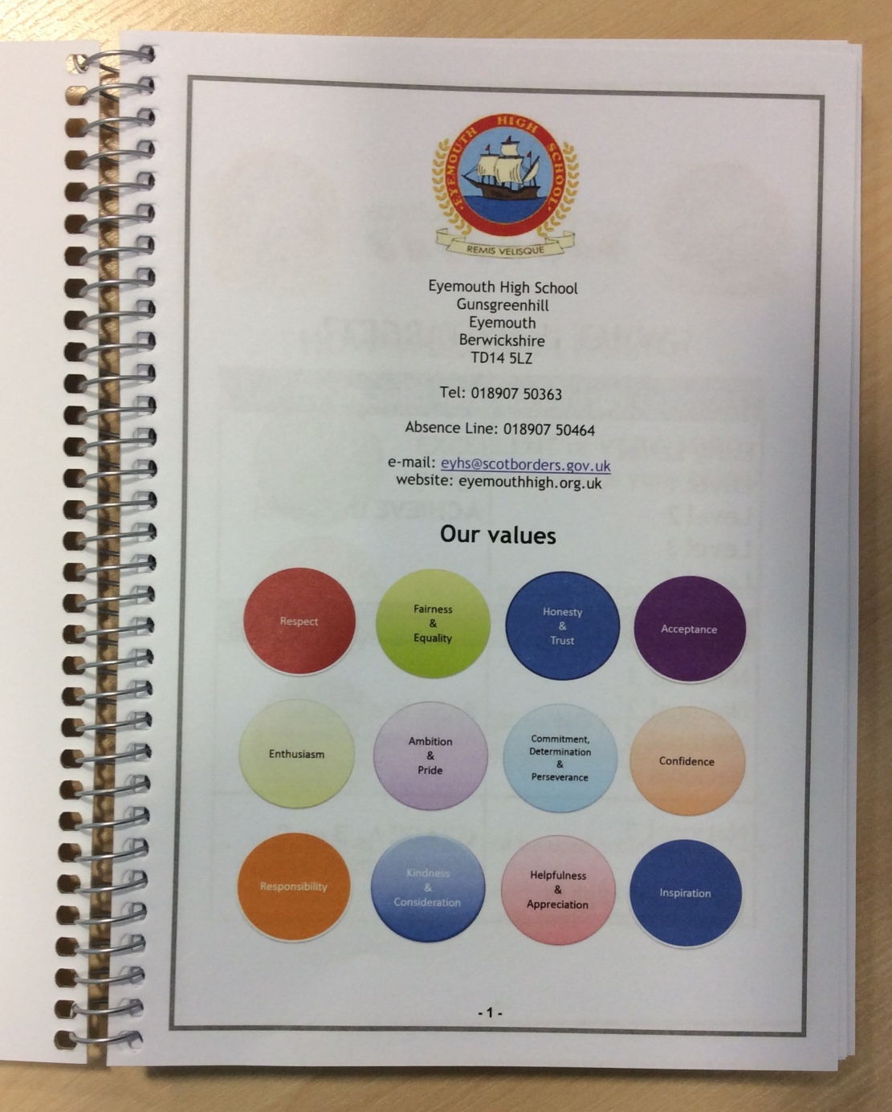

Slide 30
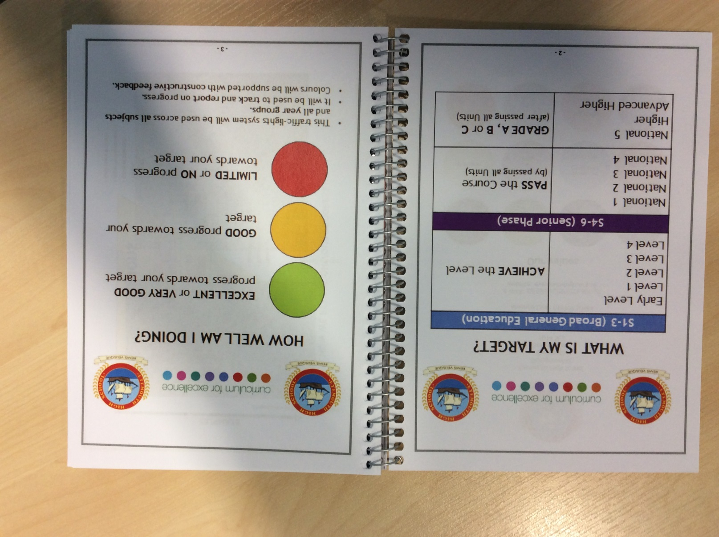

Slide 31
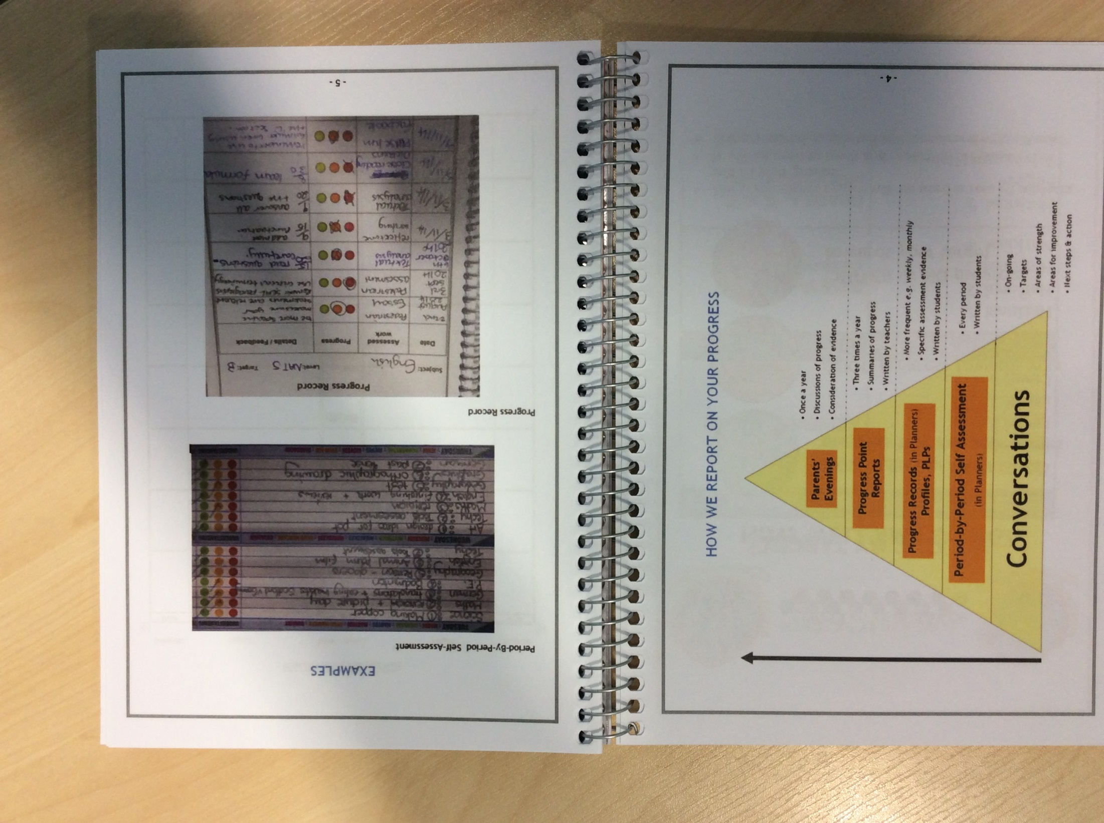

Slide 33
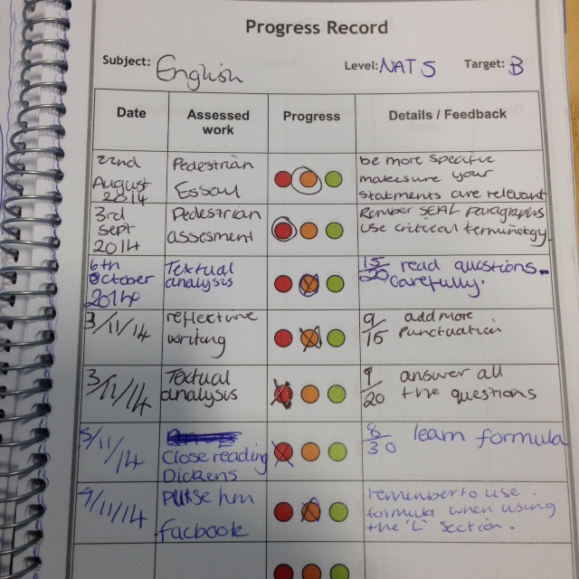

Slide 34
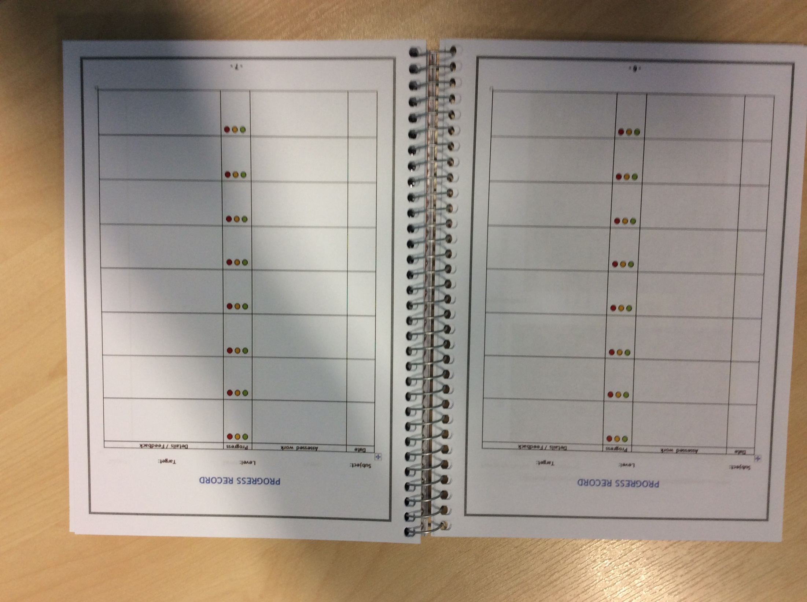
PROGRESS RECORDS
BGE (S1-3):
Levels (the target is to “achieve” the Level;
Senior Phase (S4-6):
grades (A-C) or “pass”
All year groups:
Assessment info
Includes homework
As a rule, at least one entry per month

Slide 35
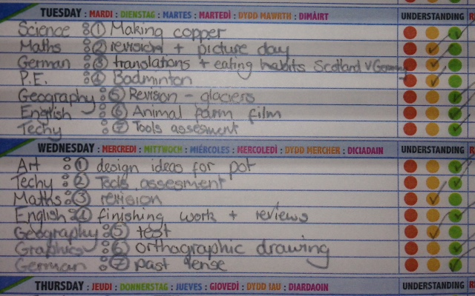
SELF-EVALUATION
BGE (S1-3): applies to everyone
Senior Phase (S4-6): use of Planners as a self-evaluation record is a choice – by the question remains: why wouldn’t you do it?
Several teachers have indicated that they want all Senior students to do this – let me know who you are and I will support it;
Three-year plan to move all Senior students to using this record.

Slide 36
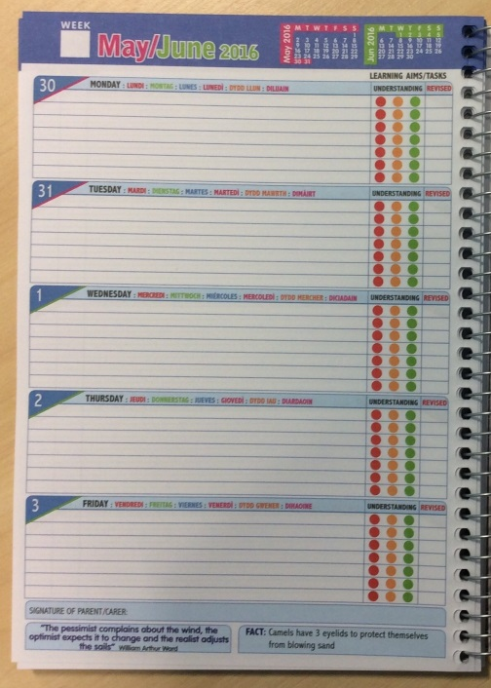
Registration
Planners on desks
Opened to self-evaluation / diary section
Subjects written in for the day
Teacher to check (helpful to also look back at previous day)
Home
Revise learning and tick off
Check diary
Complete homework
Lessons
Planners on desks
Opened to self-evaluation / diary section
Learning summary written in by end
Progress colour “ticked”

Slide 37

(Towards the back)
Notes pages (seven of them).

Slide 38
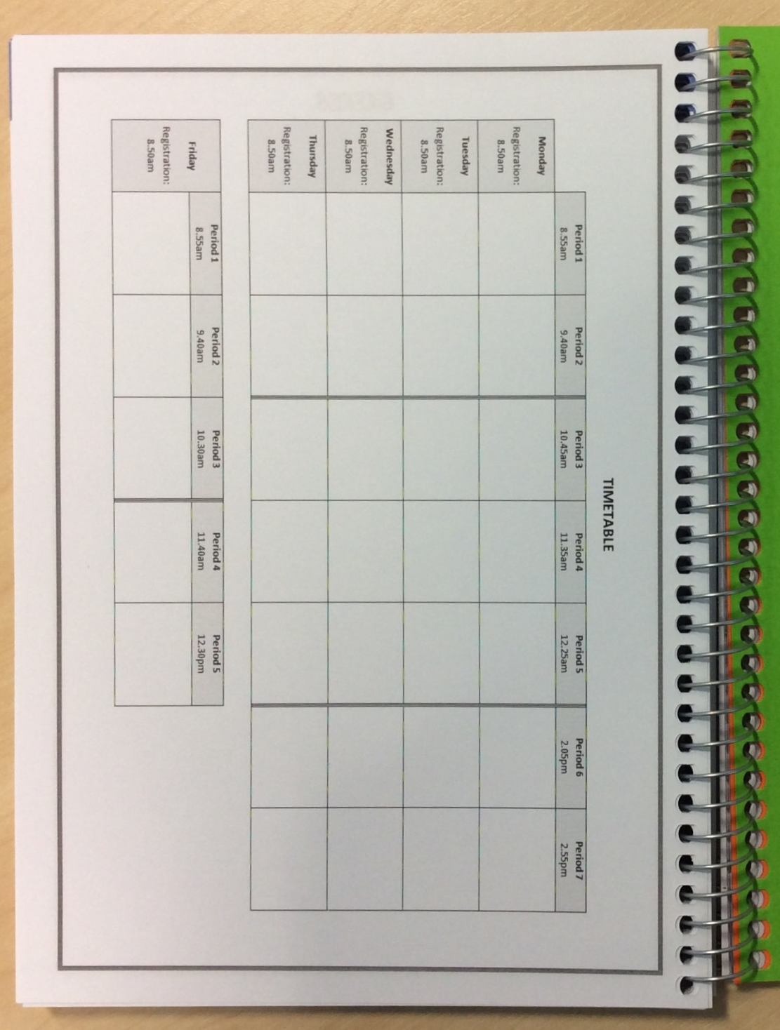
(Towards the back)
Timetable

Slide 39
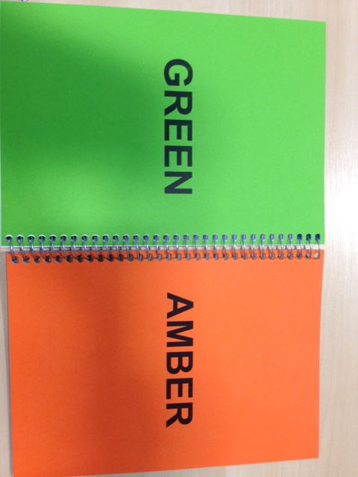
(Towards the back)
Traffic-light cards

Slide 40

(Towards the back)
Polythene wallet, to keep bits of paper in e.g. letters home, written homework exercises etc.

Slide 41
Signatures
Pilot with new S1
  review after 1 month
Weekly signatures
  parents
  Registration teacher

