Slide 1
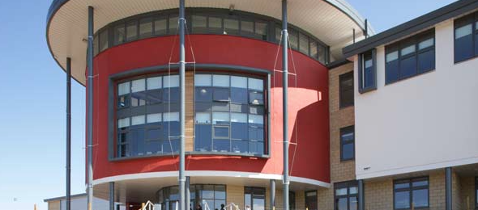
In-Service,
13th February 2015
Eyemouth High School
Moderation of judgements around student progress and achievement of a Level in the Broad General Education

Slide 2
Programme
8.50 am: Staff briefing (staffroom)
9.15 am: Collaborative working in Curricular Teams (including completion of a staff reporting survey – by 10am)
11.00 am: Break
11.20 am: Collaborative working in Curricular Teams
12.20 am: Staff meeting (staffroom)

Slide 3
Significant Aspects of Learning: Curricular Areas
Significant Aspects of Learning: sharing practice
CAT
CAT
In-set
CAT
CAT
Significant Aspects of Learning: the big picture
Significant Aspects of Learning: achievement of a Level

Slide 4
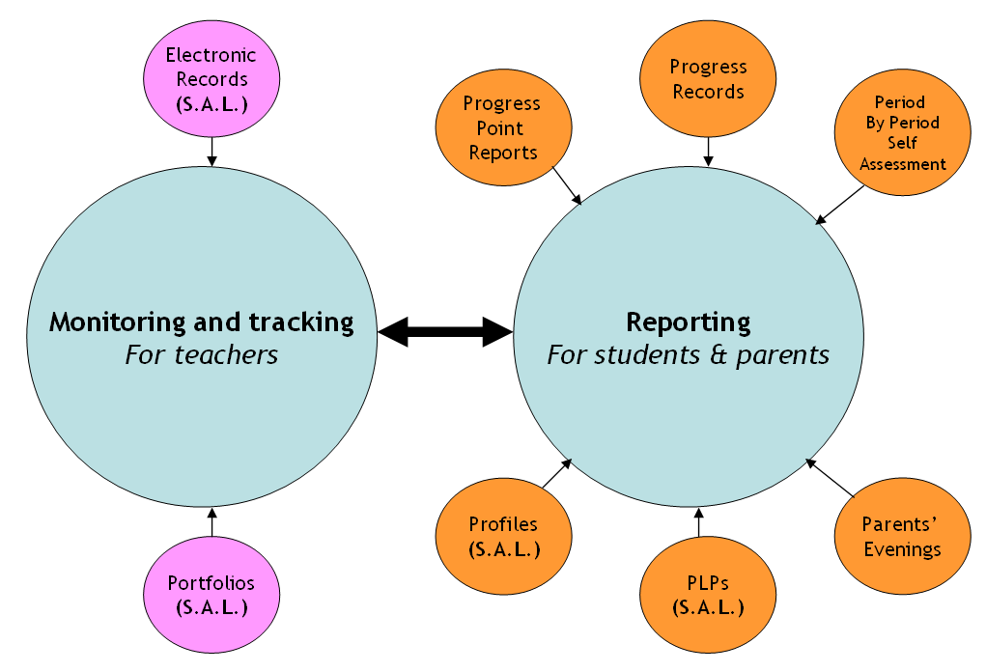

Slide 5
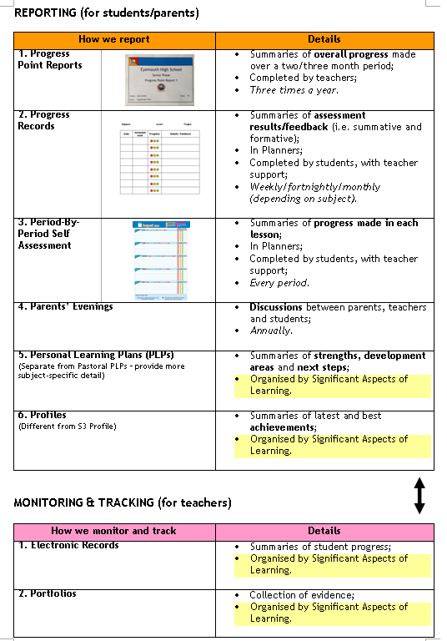

Slide 6
Aims
If a teacher is asked how any student is progressing in their subject, they should be able to describe this and back it up with evidence. This evidence will come from a combination of that used in monitoring & tracking and reporting. In the Broad General Education (S1-3), this should include evidence relating to the Significant Aspects of Learning (S.A.L.).
If a student is asked how they are progressing in any of their subjects, they should be able to describe this and back it up with evidence. This evidence will come from the 6-point reporting model. In the Broad General Education (S1-3), this should include evidence relating to the Significant Aspects of Learning (S.A.L.).

Slide 7
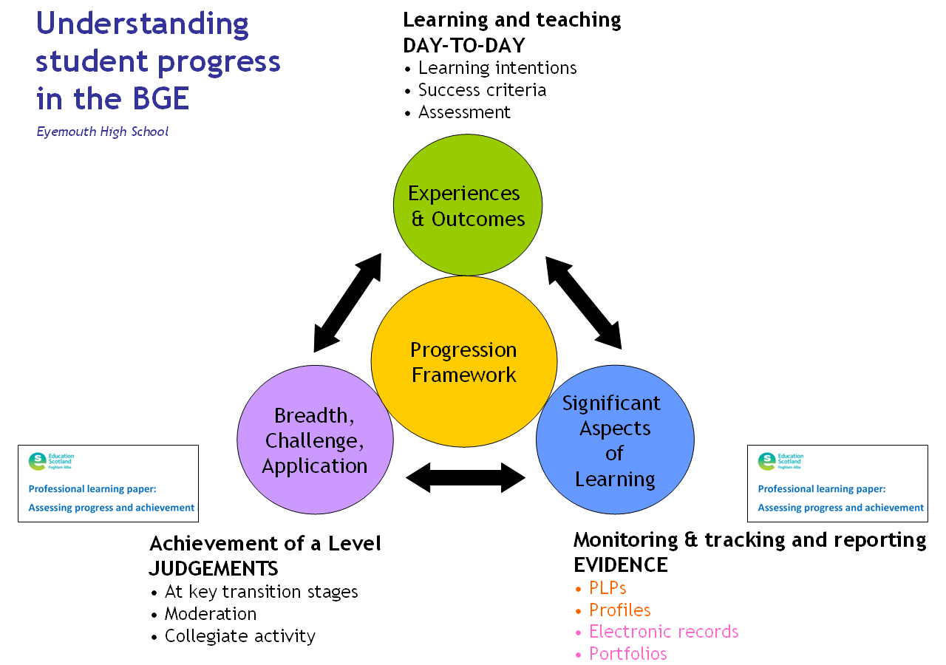

Slide 8
 |  | Used to… | Further details
Experiences and Outcomes | Progression Framework | Inform day-to-day learning and teaching | Learning intentions and success criteria should be derived from these; assessments should be planned from these.
Significant Aspects of Learning |  | Organise/categorise assessment evidence | Assessment evidence should be collected and organised to cover each of these in a particular Curricular Area. This should be via electronic records, portfolios, PLPs and/or profiles.
Breadth, challenge and application |  | Make judgements about achievement of a Level | Curricular Area specific guidance about the sorts of questions to ask when considering assessment evidence is available in the relevant “Professional Learning Paper” and “Progression Framework”.

Slide 9
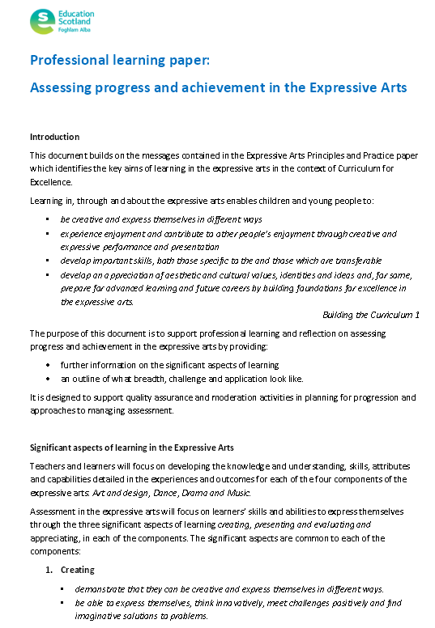
KEY RESOURCE 1: professional learning paper
Notes:
Refer to this briefly – staff will be engaging with it later

Slide 10
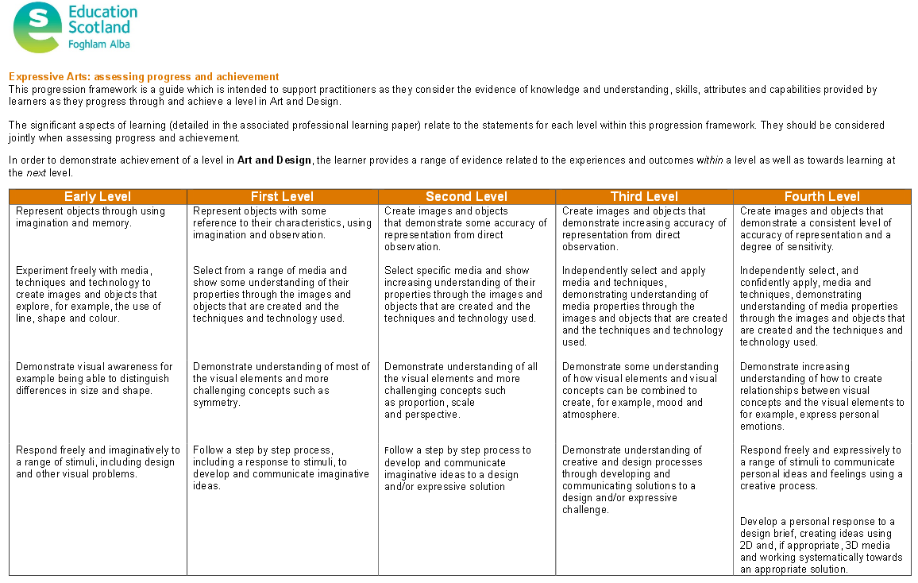
KEY RESOURCE 2: progression framework
Notes:
Refer to this briefly – staff will be engaging with it later

Slide 11
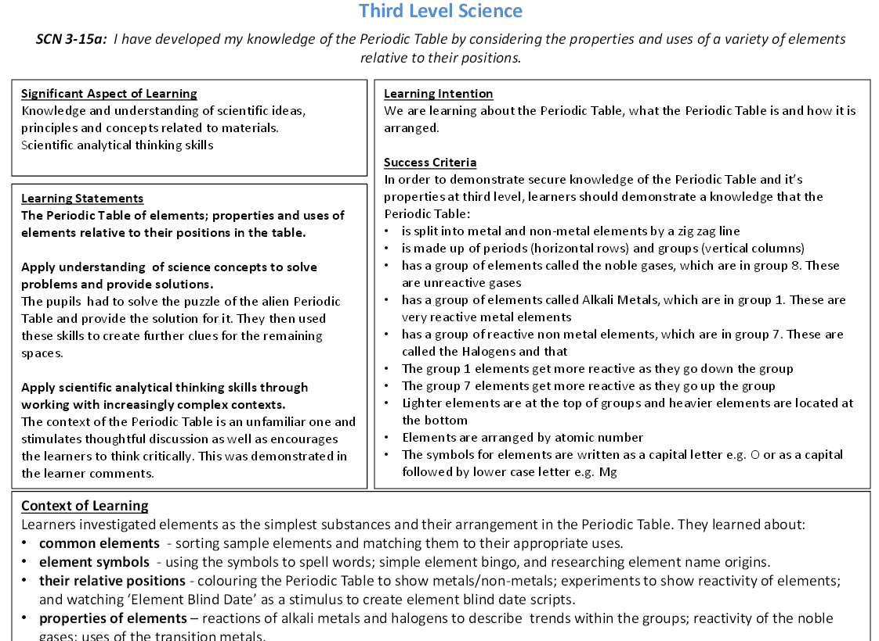
KEY RESOURCE 3: annotated exemplars
Notes:
Refer to this briefly – staff will be engaging with it later

Slide 12
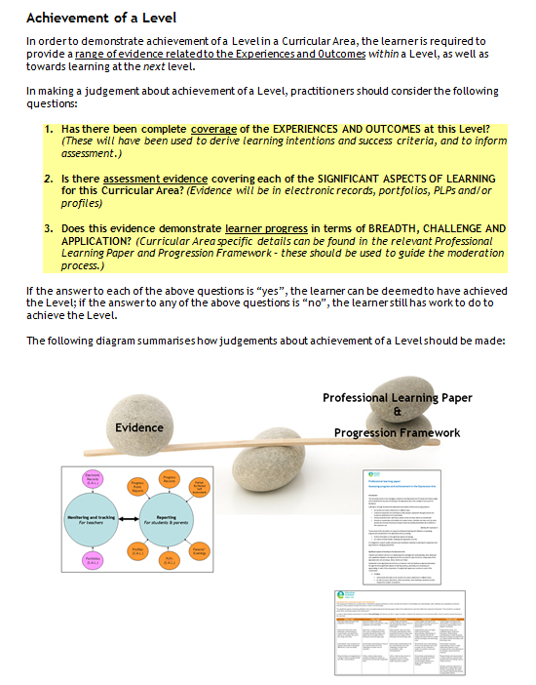

Slide 13
In-Team Working
The purpose of work during this time should be to ensure that assessment evidence is used effectively to reach reliable judgements of student progress and achievement of a Level in the Broad General Education (using the information from the relevant Professional Learning Papers and Progression Frameworks as a steer for benchmarks).

Slide 14
In-Team Working
Teams should base their discussions around the following questions, using examples of specific students where possible:
  If a teacher is making a judgement about student progress (e.g. “GREEN”, “AMBER” or “RED” in a Progress Point Report) or achievement of a Level (e.g. has now achieved Level 3) for any given student:
    Is the judgement backed up by a robust evidence-base?
    Would another member of the team make the same judgement, given the same evidence?
In considering the evidence-base, staff should aim to ensure that it…
  is holistic (in line with the above model);
  includes: PLPs, Profiles, Portfolios and/or electronic records;
  incorporates the relevant Significant Aspects of Learning.

Slide 15
In-Service,
13th February 2015
Eyemouth High School
Reporting and Planners surveys: students and teachers

Slide 16
S3 Aspirational Targets

Slide 17
Senior Reports: Prelims

Slide 18
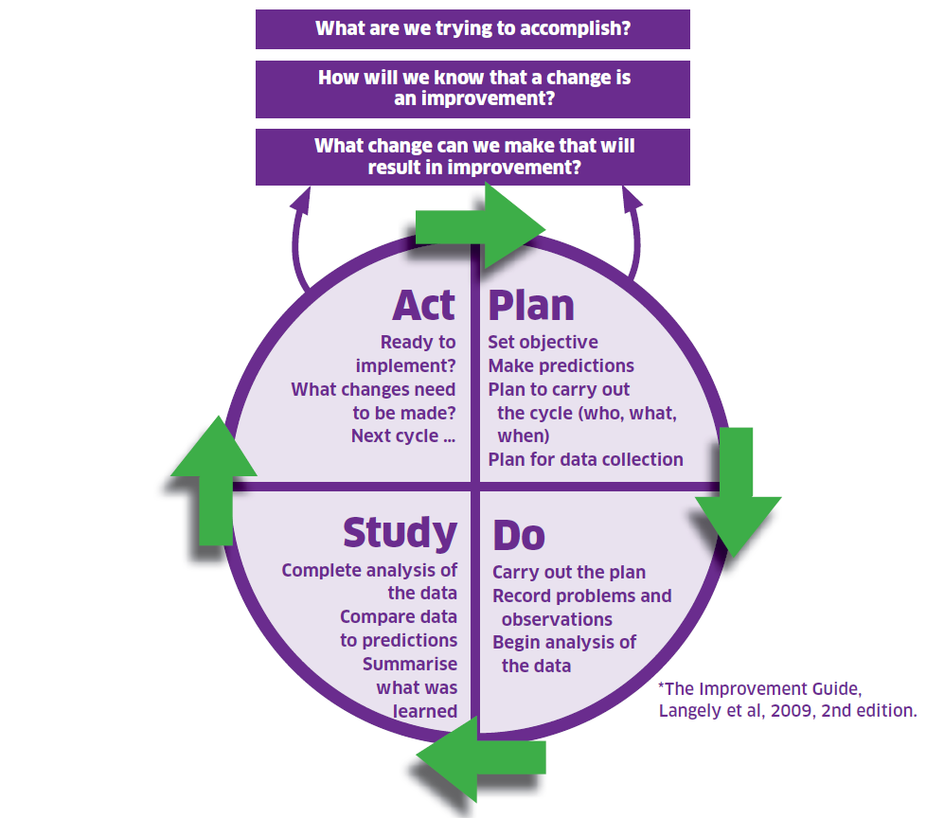

Slide 19
Student and Teacher Survey Results
Take a few minutes to read through and reflect on the results yourself.
In groups of up to 4, over a period of about 15 minutes, discuss:
  What do you feel are the key messages?
  What action(s) do you think should be taken to improve our reporting system (including the role of Planners)?
Whole-staff discussion (about 15 minutes).
Individually, write a summary of your thoughts in relation to the two questions asked (about 5 minutes).

Slide 20
Expectations
Planners should be out and on desks during all lessons, including Registration;
Period-By-Period Self-Assessment (S1-6)
  During Registration, subjects for the day should be written in (unless already done);
  Towards the end of lessons, students should be supported to reflect on their learning – they should tick a progress colour and write a brief summary of the learning from that period;
Progress Records (S1-6)
  Should be completed on a regular basis for all subjects, including in relation to homework.

