Slide 1
Teaching & Learning
Session 2018-19
Bruce Robertson, Depute Headteacher
August 2018

Slide 2
2018-19 Improvement Priority
“Continue to improve the quality of teaching and learning across the school.”
  Formative assessment
  Homework
  Knowledge Organisers
  Assessment Calendars
  School Website
  Student Planners

Slide 3
Student Planners

Slide 4
S1-3
Registration | Subjects written into Daily Self- Evaluation section
During lessons | Start: Purpose written into Daily Self- Evaluation section End: Traffic-light Daily Self-Evaluation
Weekends | Parental Signature
Monthly | Progress Record entry

Slide 5
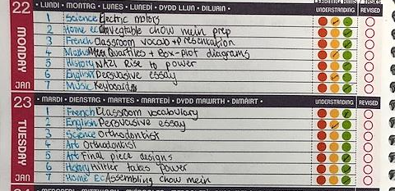
Example

Slide 6
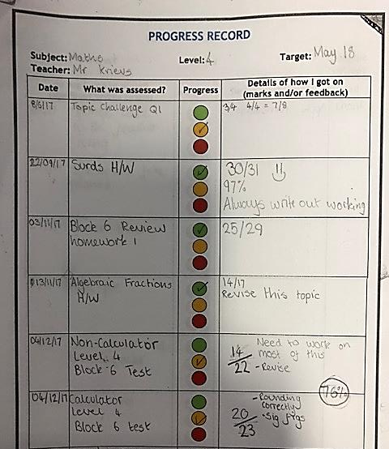
Example

Slide 7
Tomorrow (Tuesday 21st August)
Registration extended by 5 minutes, to 9am
S1
  Registration Teacher issues Planners and timetables
  Period 1 Teacher will support students to complete specific sections
S2 & S3
  Registration Teacher returns Planners to students and reminds students of basic Planner expectations
S4-6
  Registration Teacher issues new Planners
  Students begin to complete timetable (page 1) and told that they are expected to finish this process in their own time

Slide 8
S1 Period 1
Students should write their timetable into the timetable section in their Planner (page 1);
On a scrap piece of paper, students should write all of their subjects out in alphabetical order – this is to support them filling in their Progress Record properly;
The Progress Record starts on page 20. Students should write their subjects and teachers into this in the following way:
  Page 20 – English
  Page 23 – Maths
  Page 26 – Science
  Page 29 – Art (or if they don’t study Art, the next subject that comes first alphabetically)
  Page 32 onwards (on the even numbered pages i.e. page 34, 36, 38 etc.) – write subjects alphabetically

Slide 9
New S4-6 Planners
Action for subject teachers by the end of next week:
  Page 9: Course Targets Summary
  Page 11 - 12: June / August self-evaluation
  Page 14 – 41: Progress Record
  Page 53: Study Support

Slide 10
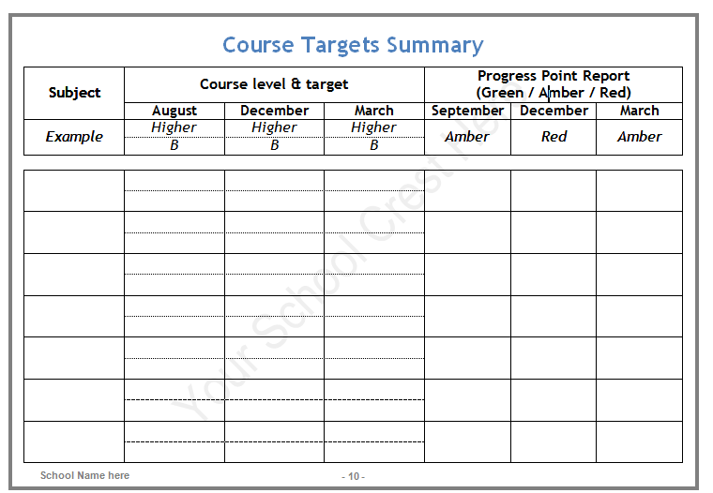
Page 9

Slide 11
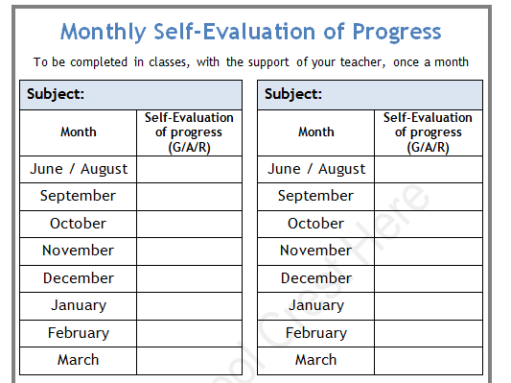
Page 11-12

Slide 12
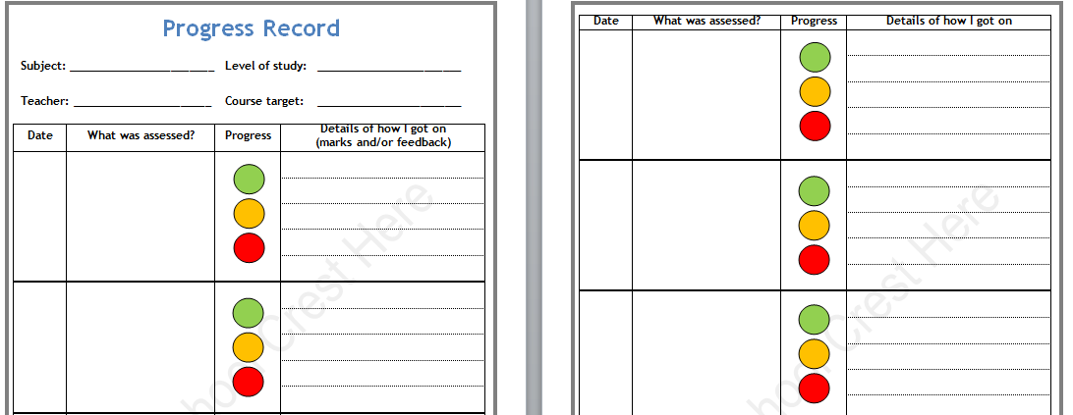
Page 14-41

Slide 13
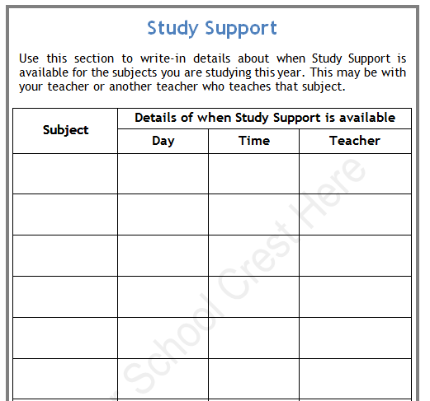
Page 53

Slide 14
Other features
Action Plans (see page 43-48)
  We will discuss these at a future time
Revision/Study Check-list (see page 49)
  You may wish to make use of this with students
Weekly Study Timetable (see pages 50-51)
  Students should complete this in Registration (or their own time) over the next week
Wider Achievement Record (see page 54-56)
Notes (see pages 57-68)
Traffic Light Cards
Diary

Slide 15
2018-19 Improvement Priority
“Continue to improve the quality of teaching and learning across the school.”
  Formative assessment
  Homework
  Knowledge Organisers
  Assessment Calendars
  School Website
  Student Planners

Slide 16
Formative assessment

Slide 17
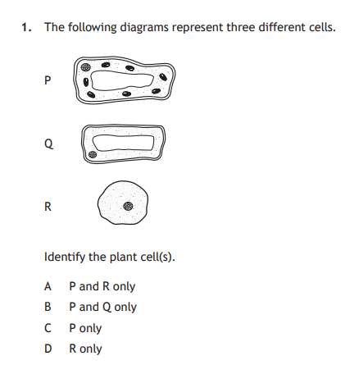
Formative assessment?
You start a lesson off with this Past Paper question (National 5 Biology, 2017 paper)
– is this formative assessment?

Slide 18
Formative assessment?
You set weekly homework consisting of answering 20 marks worth of SQA Past Paper questions (like the one shown)
– is this formative assessment?

Slide 19
Formative assessment?
You set an end of unit test, comprising a mixture of short-answer and extended response questions
– is this formative assessment?

Slide 20
Formative assessment: a definition
“A strategy to find out what students know or don’t know (or can or can’t do), informing teaching”.

Slide 21
Dylan Wiliam
Formative assessment is all about:
  Ensuring students know what they are meant to be learning (LET 1 & 2);
  Finding out what students have learned – from this lesson, a previous lesson or learning out-with lessons (LET 3, 9, 12 & 20);
  Providing feedback that improves student learning (LET 10);
  Having students help each other learn (LET 9 & 11);
  Developing students’ ability to monitor and assess their own learning (LET 12 & 19).

Slide 22
LET priority areas
1, 2, 3, 4, 5, 6, 7, 8, 9, 10,
11, 12, 13, 14, 15, 16, 17, 18, 19, 20

Slide 23
When?
Teachers should think about formative assessment in terms of taking place at the following points:
  Minute-by-minute e.g. via questioning, show-me boards and ‘active assessment’ methodologies (such as true/false statements, odd-ones-out and deliberate mistakes);
  Lesson-by-lesson e.g. via show-me boards, traffic-light colours and exit passes;
  Week-by-week e.g. via in-class quizzes and homework;
  Topic-by-topic e.g. via end of topic assessments and examinations (including Prelims), used formatively.

Slide 24
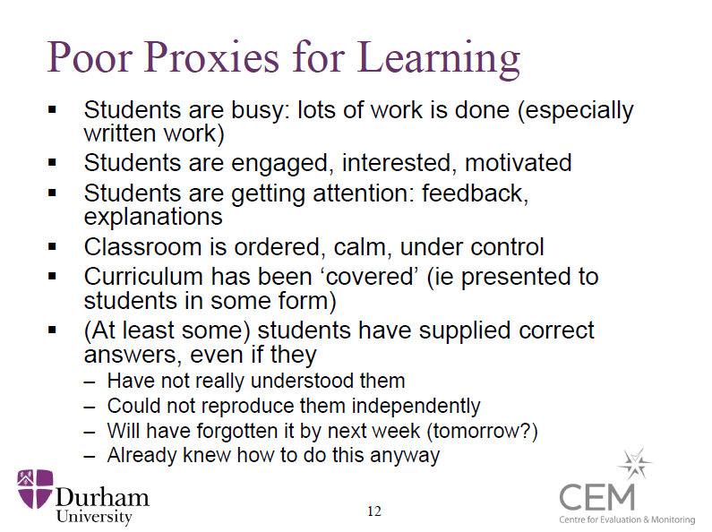

Slide 25
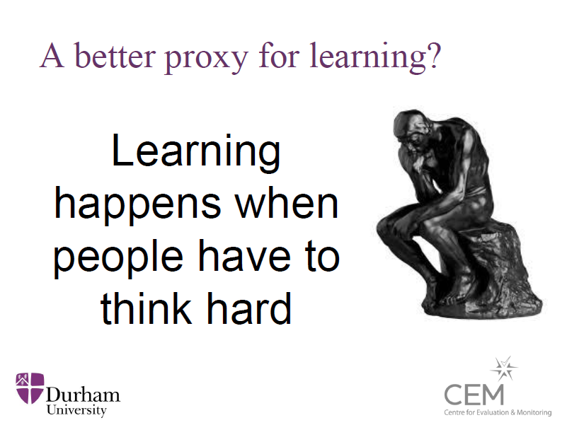

Slide 26
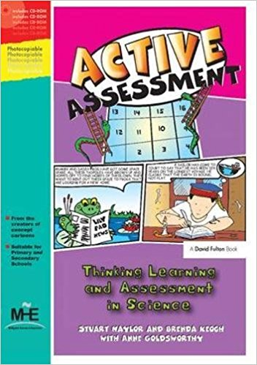
Active Assessment activities: get students to think
True or False?
Odd-one-out
Card sorts
Matching
Concept cartoons
KWL grids
Balloon debates
Deliberate mistakes
Rumours
Diamond nines
Graphic organisers
Compare and contrasts

Slide 27
Key ingredients of formative assessment
Learning intention
(WALT)
Success criteria
(WILF)
Traffic-light colours
Exit passes
Formative assessment
Pose, pause, pounce, bounce
Active Assessment activities
Show-me boards
“Chat to a partner”

Slide 28
Learning about calcium
LI (WALT): Improve your knowledge of calcium.
SC (WILF): You can list at least three facts about calcium that you didn’t know when you entered the room.
OR
SC (WILF): You can:
  Write the symbol for an atom of calcium
  Say if it is a metal or non-metal
  Say which group of the Periodic Table it appears in
  Describe at least one use for it

Slide 29
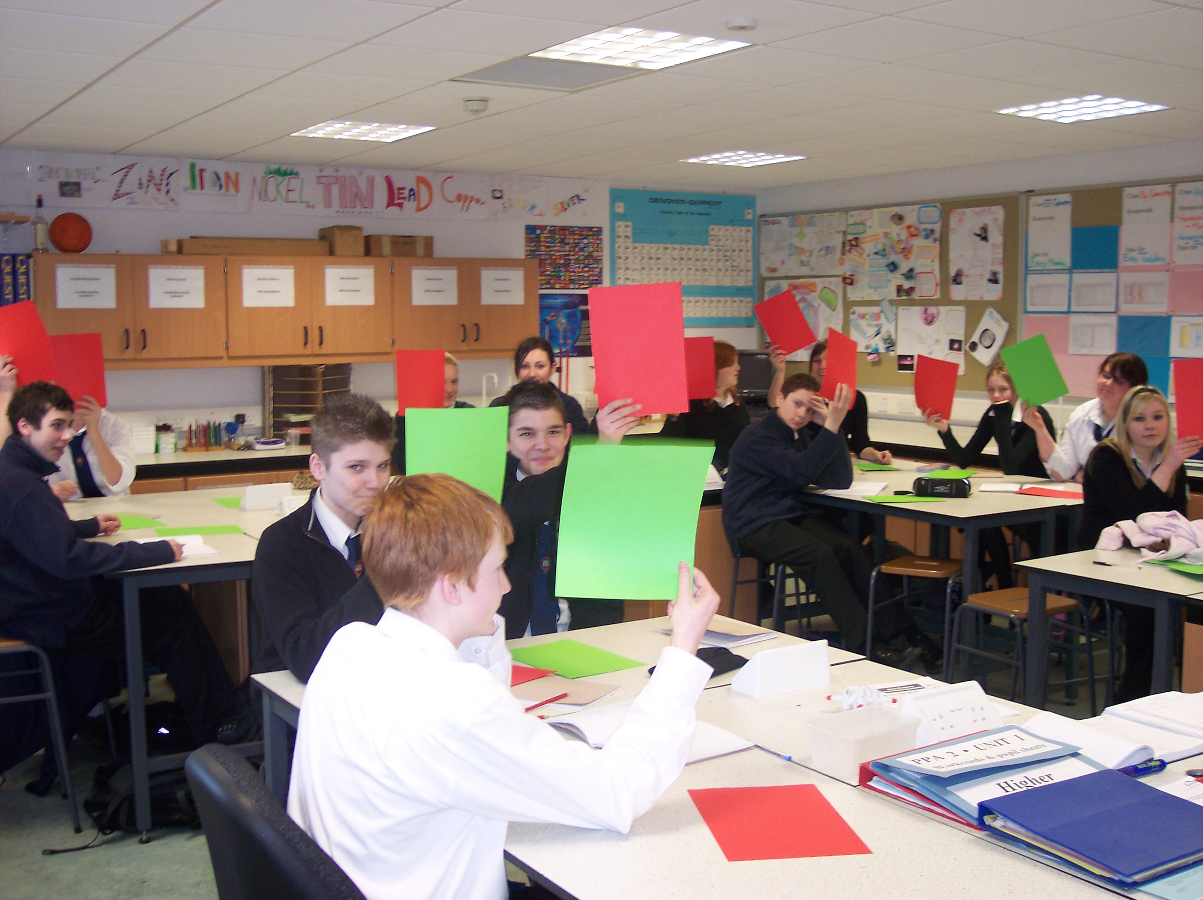
Traffic-light colours
Find out where they are at the start, and find out why they think that.
Find out where they are at the end, and find out why they think that.
Helps you to evaluate the impact of the lesson.
But best when students have evidence to be drawing on to support their evaluation, rather than it just being an impression.

Slide 30
Finishing the lesson:
“What have you learned today?”
Get students to write it down – it makes everyone think about something.
  Use a mini-whiteboard; get them to hold it up; have a look at them; use some of them as teaching points.
  Use post-it notes.
Most effective when the focus is brought back to the learning intention and success criteria of the lesson.
A variation might be to write down a question about something that a student’s not sure about.

Slide 31


Recommended reading

Slide 32
Odd one out?
Student control over learning
Enquiry-based learning
Within-class grouping
Discussion

Slide 33
Reminder: effect sizes
Discussion
0.82
Spaced vs mass practise
0.60
Teacher clarity
0.75
Co-operative learning
0.55
Feedback
0.73
Scaffolding (worked examples)
0.53
‘Graded’ homework
0.64
Mega-cognition
0.53
Direct instruction
0.60
Goal setting
0.53

Slide 34
Reminder: effect sizes
Frequency of testing
0.52
Web-based learning
0.18
Questioning
0.52
Within-class grouping
0.18
Enquiry-based teaching
0.35
Problem-based learning
0.12
Simulations & gaming
0.32
Ability grouping (by class – “setting”)
0.10
Individualised instruction
0.20
Student control over learning
0.01

Slide 35
Teacher & Learning Framework (Policy)
Started to develop last session; will finalise this term.
But at its heart will be an emphasis on ensuring day-to-day teaching practices which research shows to have the biggest impact on student learning.
  And a reduction in practices which have lower impact.

Slide 36
Formative assessment focus
  Minute-by-minute e.g. via questioning, show-me boards and ‘active assessment’ methodologies (such as true/false statements, odd-ones-out and deliberate mistakes);
  Lesson-by-lesson e.g. via show-me boards, traffic-light colours and exit passes;
  Week-by-week e.g. via in-class quizzes and homework;
  Topic-by-topic e.g. via end of topic assessments and examinations (including Prelims), used formatively.

Slide 37
Questions?

Slide 38
Good routines and good order

Slide 39
Reminders
Uniform – all times while in the building (after 8:50am)
Planners – on desks for all lessons (including Registration)
Mobile phones – teacher decision; not during transitions
“Free” time – used for study or volunteering

Slide 40
Requests
All teachers: please be outside your classroom door after each lesson / just before a lesson starts.
All teachers: we now have a warning bell towards the end of interval and lunchtime – please be at your classroom by the time the second bell goes.
All teachers: please do not dismiss classes (including S6) early for any reason (e.g. to get a slightly earlier lunch).

Slide 41
Requests
Principal Teachers: please could you take drop into Registration classes in your faculty, periodically, to help enforce good morning routines.
Volunteers: if you would be willing to help supervise the school at break and lunchtimes, please send me an e-mail later today to let me know which day(s) you would be prepared to do.

