Slide 1
Teaching & Learning Policy
Supporting the continuous improvement
of teaching and learning in our school

Slide 2
Where are we starting from?
I believe it is important that we have a school Teaching & Learning Policy.
I believe there could be some value in having a school Teaching and Learning Policy.
I don’t believe we need a school Teaching & Learning Policy.

Slide 3
Aims
Summarise our recent teaching- and learning-focused improvement work.
Start to make the case for why we need a school Teaching and Learning Policy.
Explain why I believe there is a need to focus on particular teaching practices, depending on what we are aiming to teach.

Slide 4
Part 1
A great school

Slide 5
For discussion (and show-me boards)
To what extent would you say that Eyemouth High School is ‘a great school’?
What, specifically, would make it ‘a great school’ (or make it an ‘even greater school’)?
What would you say is your single-most important contribution in helping to make our school ‘a great school’?

Slide 6
Thoughts related to this
Attainment is important – very important – but it isn’t the key measure of greatness.
  I doubt if our attainment statistics will top national league tables any time soon
  But, regardless, we can still be a great school
The key measure of greatness is the quality of teaching and learning
  Every teacher can directly influence this
  Supported by great leadership, relationships, curriculum and support

Slide 7
EHS
Climate & Culture
Successful Learners; Confident Individuals;
Effective Contributors; Responsible Citizens
KEY
Engagement
Enjoyment
Achievement
Climate & Culture – what it’s like to be part of our school
Curriculum
Pedagogy
Support
Outputs – what we are aiming to achieve
Measures – what we gather data on
Drivers – what we should focus on
Leadership
Foundations– what everything is built upon
Relationships
Vision
Aims
Values

Slide 8
Another thought related to this
Attainment is important – very important – but it isn’t the key measure of greatness.
  I doubt if our attainment statistics will top national league tables any time soon
  But, regardless, we can still be a great school
The key measure of greatness is the quality of teaching and learning
  Every teacher can directly influence this
  Supported by great leadership, relationships, curriculum and support.
There is nothing to stop the quality of teaching and learning in Eyemouth High School being the best in the Borders, or indeed, the best in the country.
  But how do we do that?

Slide 9
By ensuring that teaching and learning is ‘the thing’ – that we are always thinking about it and always talking about it.
By ensuring that we have a shared understanding of what we mean by great teaching and learning.
    A Teaching and Learning Policy is designed to support this
By ensuring that we have a culture of professional learning (or learning).
    Not seeing classrooms as discrete and autonomous – rather, we steep ourselves in collaboration.
By ensuring that we think about barriers and do something to address these.
    Not seeing the idea of ‘continuous improvement’ as being about criticism that we aren’t good enough – we value learning and we value learning from each other.
    Accepting that time will always be an issue but to strive to make time for our own learning every week – otherwise we are just busy ‘doing’, not ‘improving’.

Slide 10
The word ‘improvement’
We need to embrace this word.
We need to overcome anxieties or tensions we have about it meaning ‘not good enough’ and see it as ‘let’s all get better and better – together’.
We need to encourage feedback – from other teachers, the Extended Management Team, and students.
We need to make time to learn through reading, watching others and discussing.

Slide 11
Our professional learning model
Read
Books
Observe
Other teachers
Do
& self-evaluate
Regular use of LET
Discuss
Faculty meetings
Get feedback
EHSTeaching
Articles
Peers
PT (faculty)
PT (L&T)
DHTs
HT
Practise
After observed lessons

Slide 12
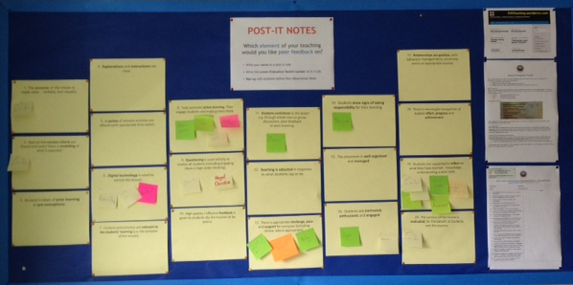

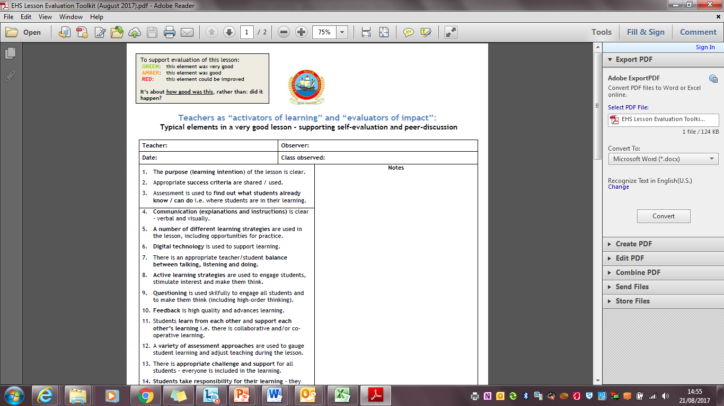

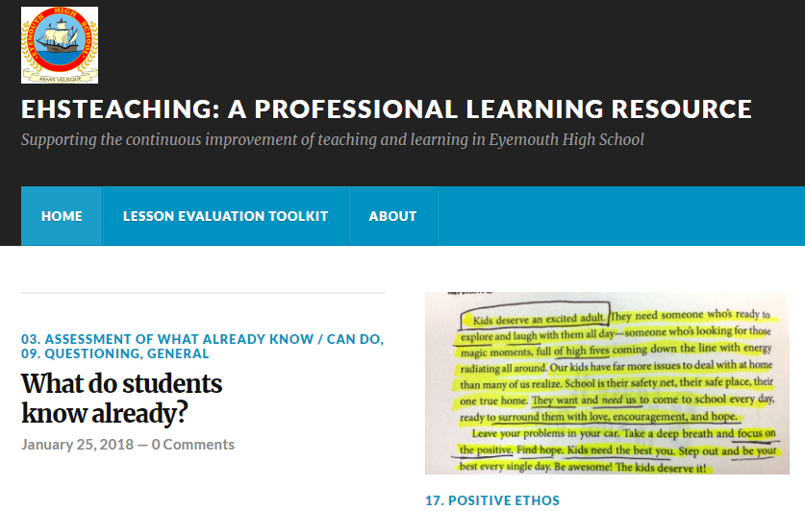
Lesson Evaluation Toolkit
Workshops
Peer Observation Fortnights
In-faculty peer observation
EHSTeaching website
Sharing practice discussions at faculty meetings
Sharing Practice Boards
Professional Reading Group
Faculty Fortnight Review Programme
Learning Walk Programme
Teacher Professional Learning Plans
Annual PRD
Learning & Teaching Group

Slide 13
Where are we now?
Our learning culture has really developed.
Our shared understanding of very good teaching & learning has really improved.
We are more collaborative.
Teaching and learning has improved.
Our attainment has improved.

Slide 14
Part 2
Let’s make teaching & learning even better

Slide 16
Our areas for focus
1
2
3
9
12
19
20

Slide 17
So what are we really talking about?
Learning intentions & success criteria
Formative assessment
    Start of lesson
    During the lesson
    End of lesson
      Questioning – thinking time; ‘chat to a partner’; show-me boards
      ‘Active assessment’ strategies
With the aim being to engage and evaluate the learning of EVERYONE

Slide 18
‘Activators of Learning’ & ‘Evaluators of Impact’
What do those terms mean?
  Chat to a partner – take 30 seconds
‘Activators of learning’
  Focusing on the use of practices which have the largest effect sizes
  Workshop in August 2017
‘Evaluators of impact’
  Using formative assessment evidence from a lesson to find out what difference the lesson made to the learning of everyone
  Workshop in October 2017

Slide 19
Effect Sizes: where are you now?
Discuss with a partner – what were the top 10? (1 minute).
List the three that you are most certain of on a show-me board.

Slide 20
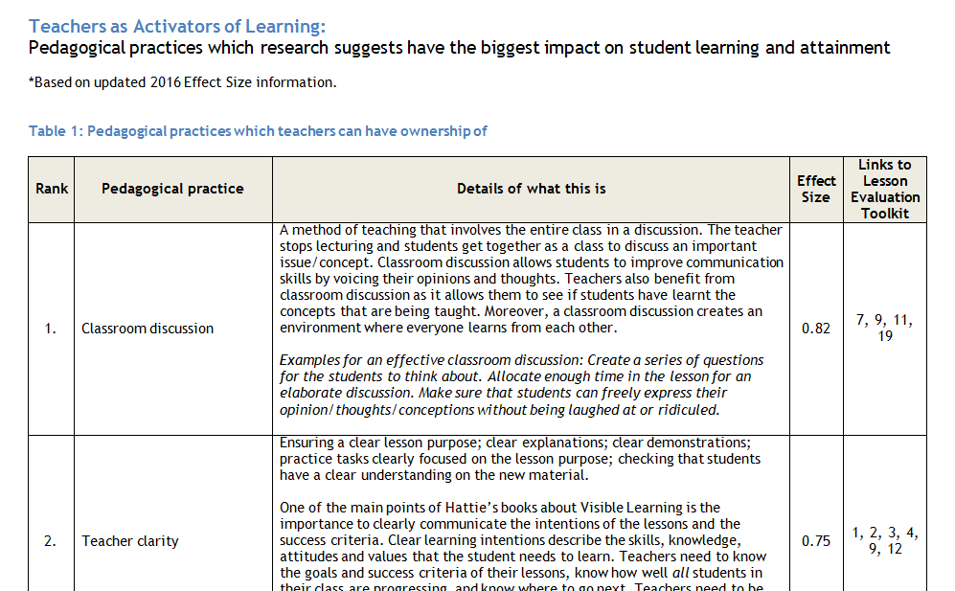
Activators of Learning

Slide 21
Effect Sizes: the top 10
Discussion
Teacher clarity
Feedback
Concept mapping
Behaviour
Time on task
Direct instruction
Spaced vs mass practise
Teaching strategies
Study skills

Slide 22
“Teacher clarity” (0.75)
Ensuring a clear lesson purpose; clear explanations; clear demonstrations; practice tasks clearly focused on the lesson purpose; checking that students have a clear understanding on the new material.
One of the main points of Hattie’s books about Visible Learning is the importance to clearly communicate the learning intentions of the lessons and the success criteria. Clear learning intentions describe the knowledge, understanding and skills that the student needs to learn. Teachers need to know the goals and success criteria of their lessons, know how well all students in their class are progressing, and know where to go next. Teachers need to be clear what the starting point is in terms of what students already know/can do and build on this.

Slide 23
“Direct instruction” (0.75)
Setting out the learning intentions and success criteria for the lesson; reviewing prior learning; present new content; use of formative assessment to check understanding; allowing time for independent practise, with opportunities for teacher support and feedback; review learning from the lesson, including how well it was learned and next steps.

Slide 24
“Spaced vs mass practice” (0.6)
Frequency of different learning opportunities; three to four exposures to learning over several days before learning occurs. Spacing the practice of skills or applying knowledge over a long period of time.

Slide 25
“Teaching strategies” (0.6)
Using a variety of different strategies to teach something; coming at the learning from different angles; adjusting teaching in response to what appears to be working or not.

Slide 26
“Feedback” (0.73)
Feedback can be one of the most powerful influences on learning and achievement, but this impact can be either positive or negative. Feedback on task, process and self-regulation level is far more effective than on the self-level (e.g. praise which contains no learning information). Descriptive feedback is closely related to providing formative assessment.
Hattie has also emphasised that the most powerful feedback can be that given from the student to the teacher –this feedback allows teachers to see learning through the eyes of their students. It makes learning visible and supports the planning of next steps. The feedback that students receive from their teachers is also vital. It enables students to progress towards challenging learning intentions and goals.

Slide 27
Our areas for focus
1
2
3
9
12
19
20

Slide 28
Part 3
Drawing on research to deliver better and better teaching & learning

Slide 29
For reflection/discussion:
If students are ‘busy’ in lessons i.e. on task and engaged, does that mean that we can say the teaching and learning is very good?
To what extent should a teacher be autonomous within their classroom?
  In other words, to what extent should a teacher be able to use the teaching practices which they deem to be the most appropriate?

Slide 30
Some recent quotes:
“First it’s co-operative learning, then it’s active learning, then it’s AiFL, then it’s independent learning – it just keeps changing!”
“It used to be Dylan Wiliam, now it seems to be John Hattie.”
“I’m the teacher – I should be able to teach how I want to.”
“A Teaching and Learning Policy is just a stick to beat us with, telling us we’re not good enough.”
“A Teaching and Learning Policy is just going to turn us all into robots, doing exactly the same thing.”
Is there a ‘best way’ to teach?

Slide 31
Content vs Core Skills
‘Content’: knowledge, understanding, subject-specific skills
‘Skills’: ‘soft skills’ / ‘transferable skills’(?) / ‘core skills’ e.g.
  Critical thinking
  Problem solving
  Creativity
  Leadership
Should they be taught in different ways?

Slide 32




Recommended reading

Slide 33
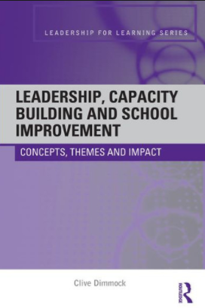
Recommended reading

Slide 34
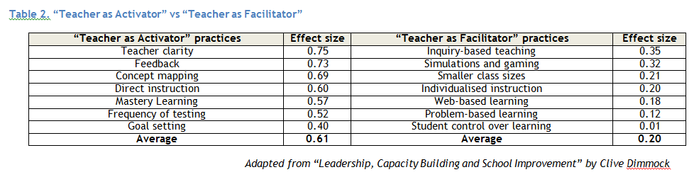
‘Activator’ vs ‘facilitator’

Slide 35
Teacher as ACTIVATOR of learning
Teaching ‘content’

Slide 36
Learning intention (WALT) is clear
Summary in Planner
Success criteria
(WILF) shared & used
Re-cap previous lesson
Assess what students know, understand or can do already, including misconceptions
Clear exposition, with visuals
Modelling, with examples & non-examples
Stimulate interest and thinking in everyone
Scaffold support
Supported by self- or peer- assessment
Continue via homework
Revisit learning intention & success criteria
Evaluate impact of lesson using G/A/R
Record in Planner
(1) Introduction
(2) Prior learning
(3) Direct, interactive teaching
(4) Focused practise
(5) Plenary
Formative assessment: specific; assesses prior learning or learning from lesson; ‘active assessment’ methodologies
Questioning: “Pose, Pause, Pounce, Bounce” – thinking time; show-me boards; getting students to explain their thinking
Discussion: pairs, small group (e.g. “chat to a partner”; “think/pair/share”) or whole-class; can link to questioning
Feedback: specific; link to success criteria or formative assessment; encourage self-evaluation; clear next steps
Support and challenge: everyone is engaged and learning in the lesson
Relationships and recognition of effort as well as achievement

Slide 37
Teacher as FACILITATOR of learning
Teaching ‘core skills’

Slide 38
Learning intention (WALT)
Success criteria
(WILF)
Summary in Planner
Re-cap previous lesson
Assess what do students know, understand or can they do already, including misconceptions
Revisit learning intention & success criteria
Evaluate impact of lesson using G/A/R
Record in Planner
(1) Introduction
(2) Prior learning
(3) Problem-based, inquiry-based or web-based teaching; co-operative or collaborative learning
(4) Plenary
Formative assessment: specific; assesses prior learning or learning from lesson; ‘active assessment’ methodologies
Questioning: “Pose, Pause, Pounce, Bounce” – thinking time; show-me boards; getting students to explain their thinking
Discussion: pairs, small group (e.g. “chat to a partner”; “think/pair/share”) or whole-class; can link to questioning
Feedback: specific; link to success criteria or formative assessment; encourage self-evaluation; clear next steps
Support and challenge: everyone is engaged and learning in the lesson
Relationships and recognition of effort as well as achievement

Slide 39
What does this mean for us?
Continue with our focus on the continuous improvement of teaching and learning, but with a specific focus on ensuring that the practices used in every classroom, every lesson, are the best practices for achieving the outcomes that we are aiming for.
  Distinction between ‘content’ and ‘core skills’.
  A focus on ‘content’ (before ‘core skills’).
This means a relentless and collaborative focus on specific teaching practices.
  Our Lesson Evaluation Toolkit can be applied to either the ‘activator’ or the ‘facilitator’ model of teaching.
  The ‘Teacher as Activator’ model should be seen as the principal model for us as a school.

Slide 40
Learning intention (WALT) is clear
Summary in Planner
Success criteria
(WILF) shared & used
Re-cap previous lesson
Assess what students know, understand or can do already, including misconceptions
Clear exposition, with visuals
Modelling, with examples & non-examples
Stimulate interest and thinking in everyone
Scaffold support
Supported by self- or peer- assessment
Continue via homework
Revisit learning intention & success criteria
Evaluate impact of lesson using G/A/R
Record in Planner
(1) Introduction
(2) Prior learning
(3) Direct, interactive teaching
(4) Focused practise
(5) Plenary
Formative assessment: specific; assesses prior learning or learning from lesson; ‘active assessment’ methodologies
Questioning: “Pose, Pause, Pounce, Bounce” – thinking time; show-me boards; getting students to explain their thinking
Discussion: pairs, small group (e.g. “chat to a partner”; “think/pair/share”) or whole-class; can link to questioning
Feedback: specific; link to success criteria or formative assessment; encourage self-evaluation; clear next steps
Support and challenge: everyone is engaged and learning in the lesson
Relationships and recognition of effort as well as achievement

Slide 41
Follow-up activity (in faculties)
Discuss and re-visit this presentation, including:
  Your initial thoughts
  Implications for your faculty
  Implications for the school
  Next steps for you
Read the extracts from Battle Hymn For The Tiger Teachers
  Discuss in faculty
Continue your discussions regarding the first 10 pages of the policy.
Complete an individual or group return.
Forward returns to me by Friday 9th March 2018.

Slide 42
Aims
Summarise our recent teaching- and learning-focused improvement work.
Start to make the case for why we need a school Teaching and Learning Policy.
Explain why I believe there is a need to focus on particular teaching practices, depending on what we are aiming to teach.

Slide 43
Where are we starting from?
I believe it is important that we have a school Teaching & Learning Policy.
I believe there could be some value in having a school Teaching and Learning Policy.
I don’t believe we need a school Teaching & Learning Policy.

