Slide 1
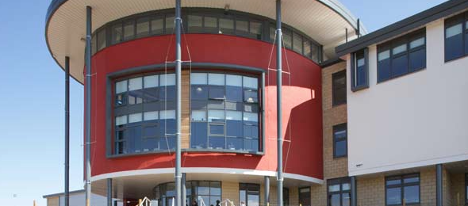
Inspection and Self-evaluation
Eyemouth High School
Extended Management Team
9th February 2015

Slide 2
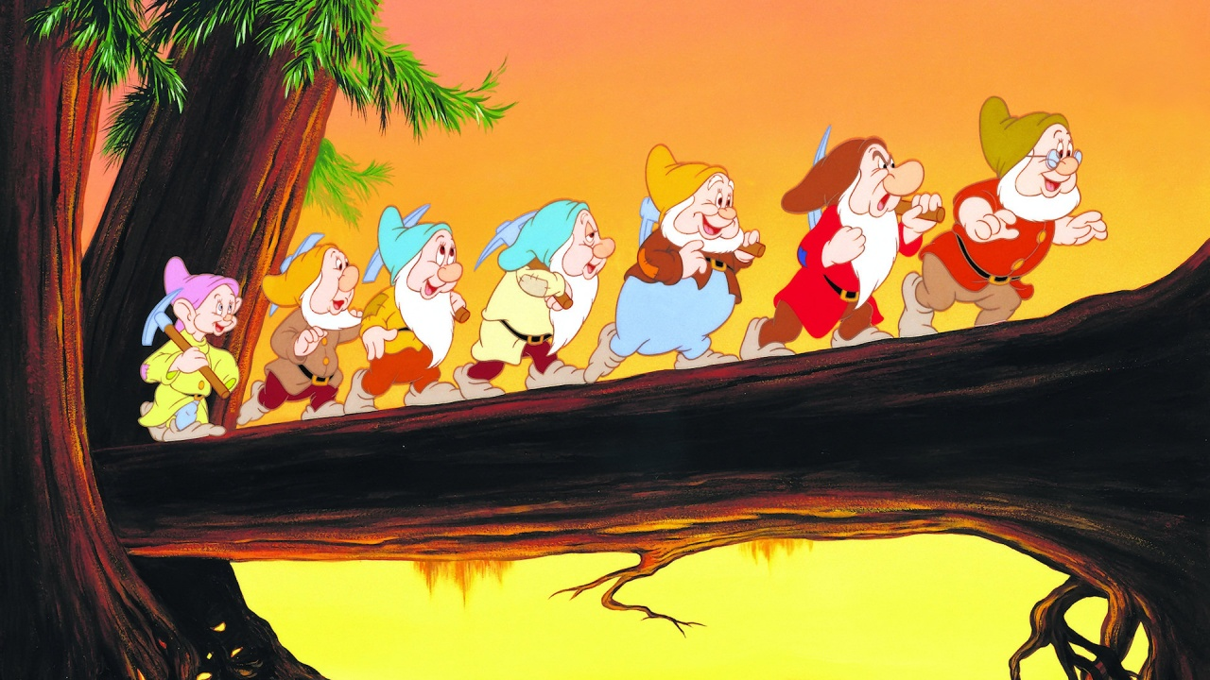
I don’t know and, frankly, I don’t really care because I’ve got plenty of other things to be worrying about.
It’s something that needs to happen annually.
It’s something that SMT need to do.
What is self-evaluation?
It’s about finding out how good we are at something.

Slide 3
Purposes
Outline the key messages from an Education Scotland “Preparing For Inspection” conference;
Develop our understanding of what effective self-evaluation looks like;
Develop our understanding of how we can improve self-evaluation at every level in the school.

Slide 4
Link to the Professional Standards:
Leadership and Management

Slide 5
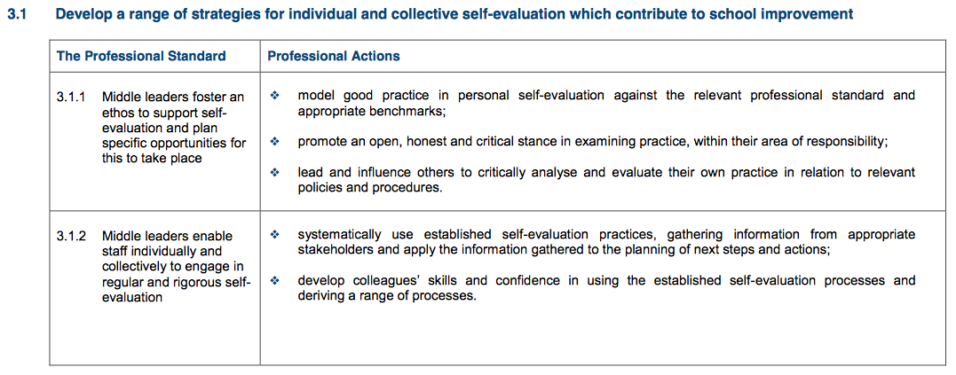
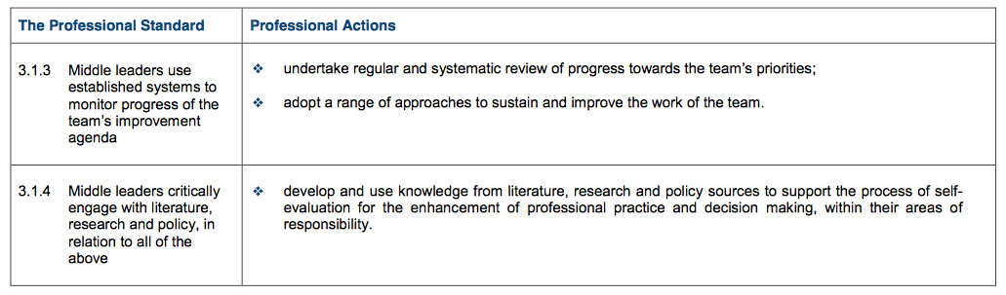

Slide 6


Slide 7


Slide 8


Slide 9


Slide 10


Slide 11
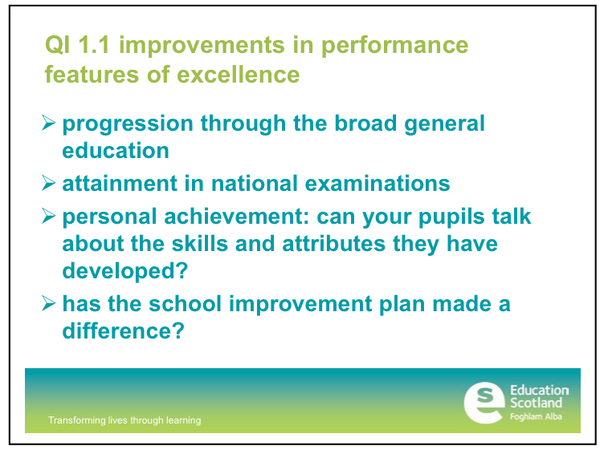

Slide 12
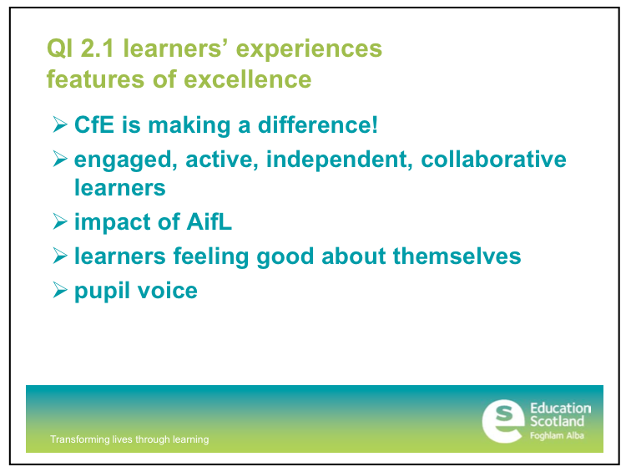

Slide 13
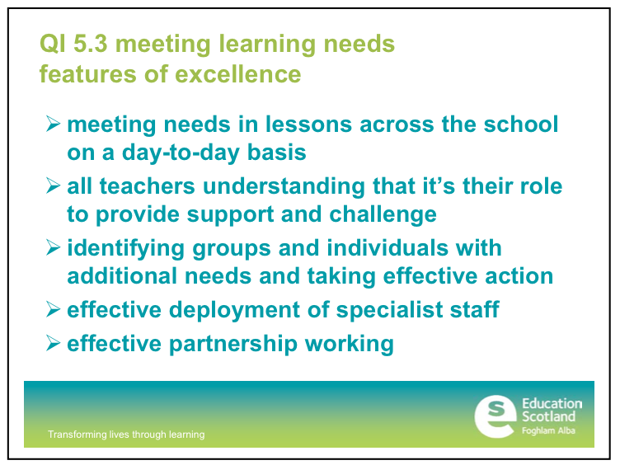

Slide 14
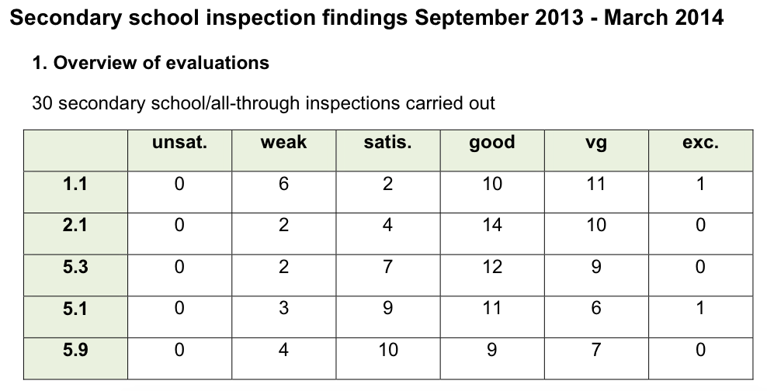

Slide 15
Self-evaluation
How do we improve i.e. to move from “satisfactory” towards “excellent”?

Slide 16
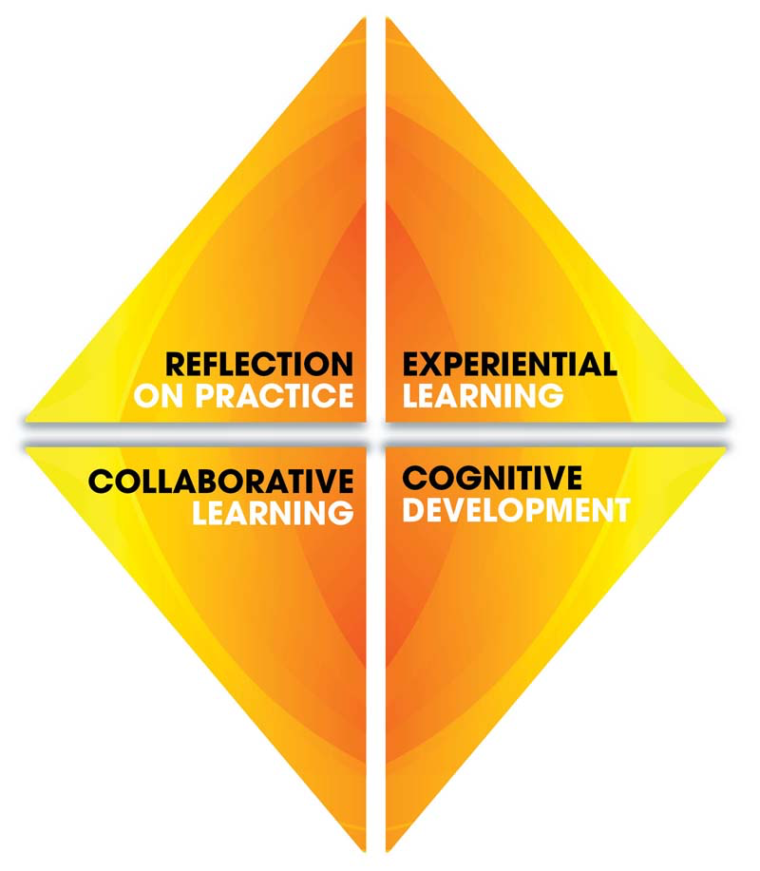
How do we learn to self-evaluate effectively?

Slide 17

Notes:
Useful starting point

Slide 18


Slide 19
Task
5.9 Improvement through self-evaluation
  Read (5 minutes)
  Thinking and discuss: what are the key messages for YOU and YOUR TEAM? (10 minutes)
Examples of highly effective practice
  Read (5 minutes)
  Thinking and discuss: what are the key messages for YOU and YOUR TEAM? (10 minutes)

Slide 20


Slide 21
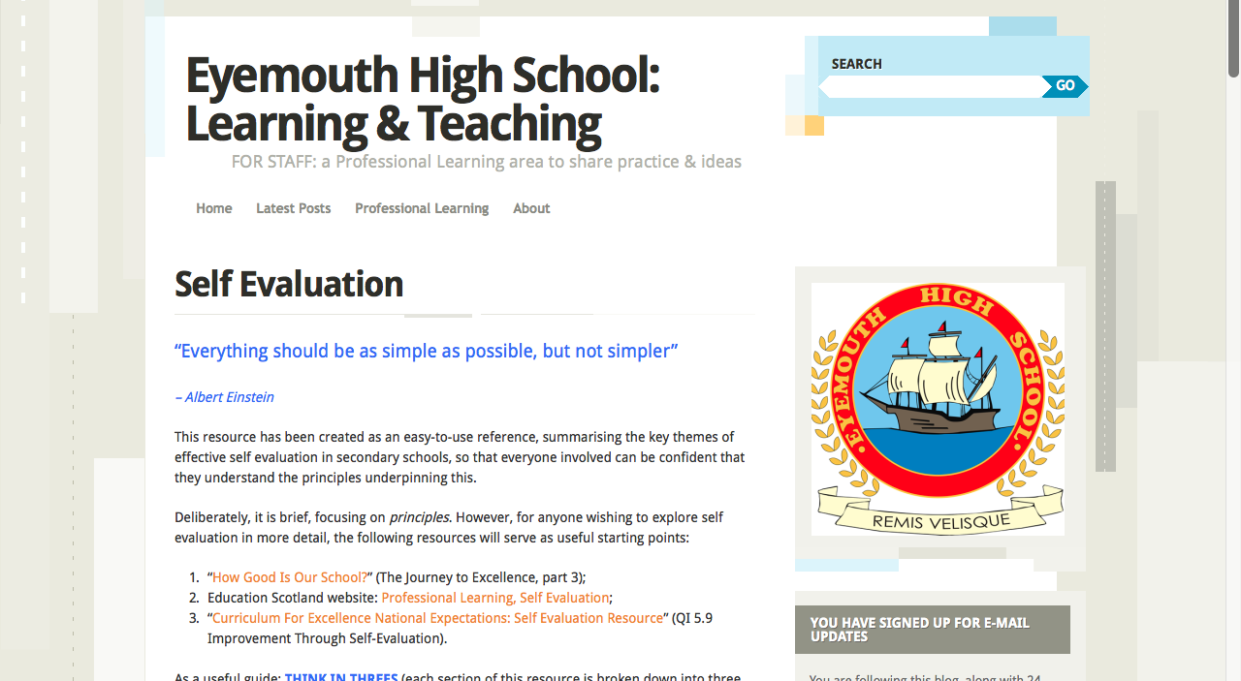

Slide 22
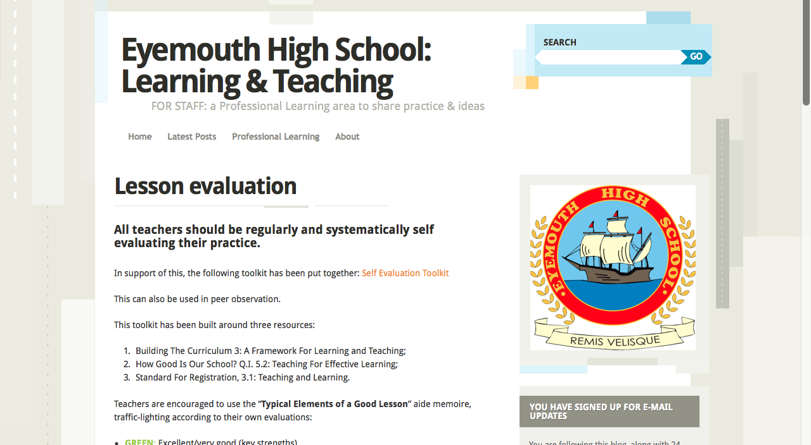

Slide 23
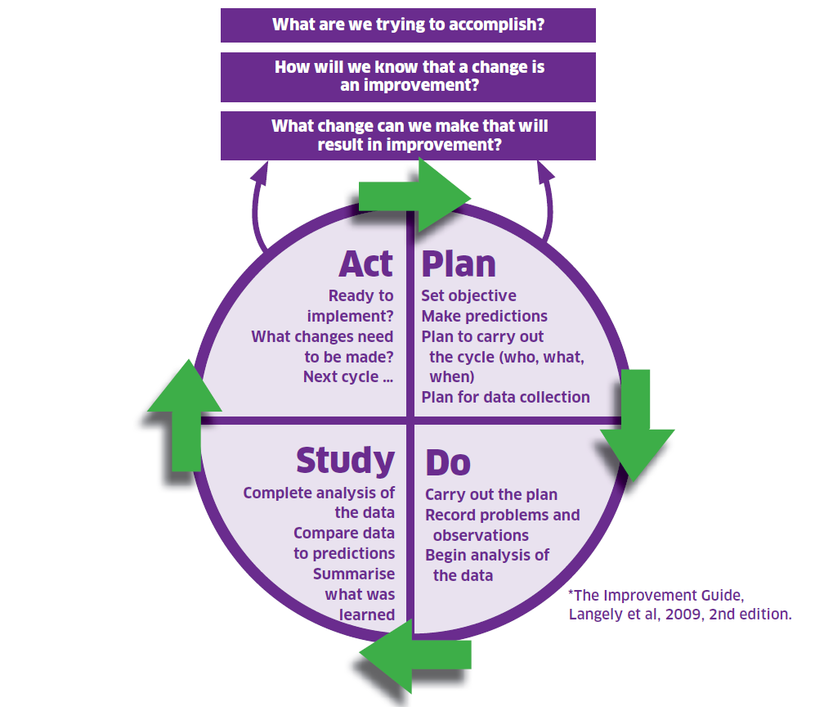

Slide 24
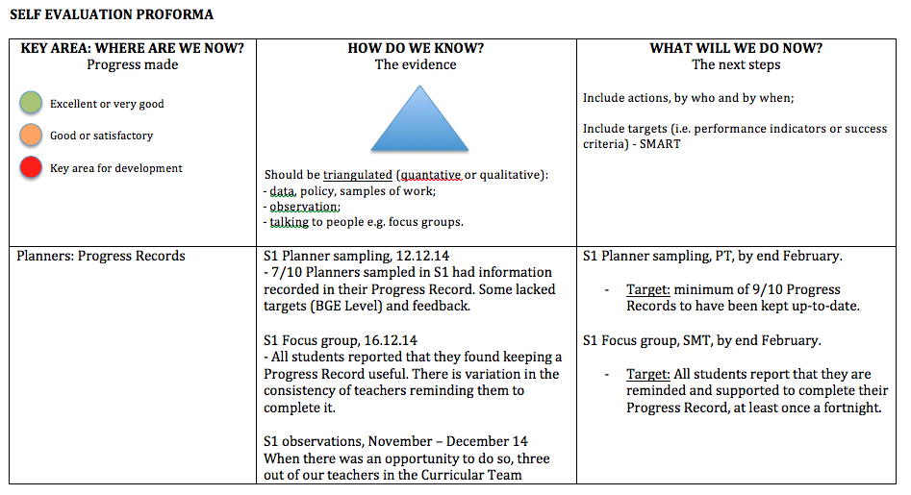

Slide 25
What next?
You and your team
Where are you now?
How do you know?
What will you do next?

Slide 26
Purposes
Outline the key messages from an Education Scotland “Preparing For Inspection” conference;
Develop our understanding of what effective self-evaluation looks like;
Develop our understanding of how we can improve self-evaluation at every level in the school.

Slide 27
I don’t know and, frankly, I don’t really care because I’ve got plenty of other things to be worrying about.
It’s something that needs to happen annually.
It’s something that SMT need to do.
What is self-evaluation?
It’s about finding out how good we are at something.

