Slide 1
Towards great teaching
Part 2: From good to very good
February 2019

Slide 2
Session outline
Presentation (30 minutes)
Task (60 minutes)

Slide 3
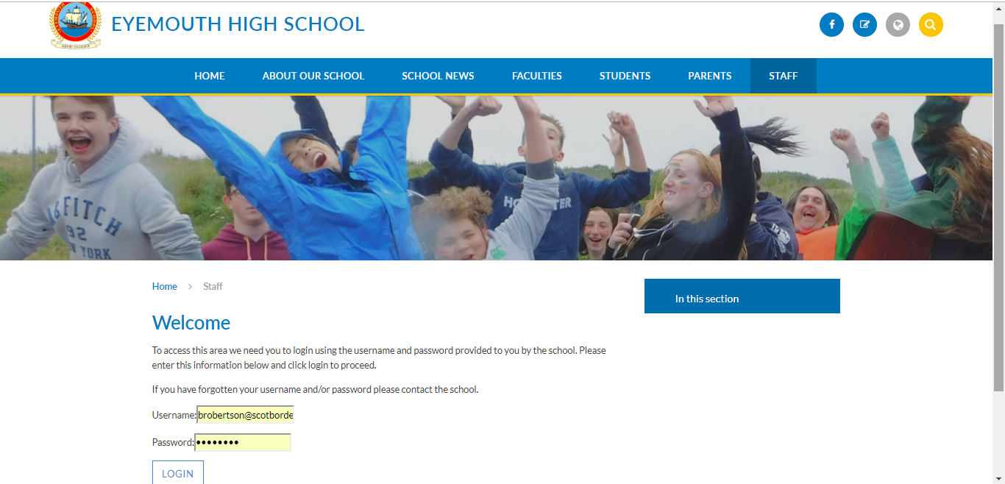

Slide 4
Inspection
Very positive
To move to the next level, we must continue to develop greater consistency in practice – across the whole school
Which means ensuring that certain features of lessons:
  Are happening
  Are high quality

Slide 5
Inspection
For example…
  Sharing learning intentions
    Happening in most lessons (let’s move this to all)
    The quality is good (let’s move this to very good)
  Questioning
    Happening in almost all lessons
    “Skilful” (let’s move to “very skilful”)

Slide 6
If we do this:
  The quality of teaching and learning across the whole school will improve further
  Our attainment will improve

Slide 7
What we have been doing
Developing a culture of professional learning
  Reading
  Workshops
  Watching other teachers teach
  Discussing
Time is always going to be a barrier, but we must make time for these things

Slide 8
Reading is key
“Mind-expanding”
Your teaching will get better
You’ll enjoy your job more
You’ll become more confident at challenging others
But you need to make time for it
  Suggestion: block 30 minutes each week for professional reading

Slide 9
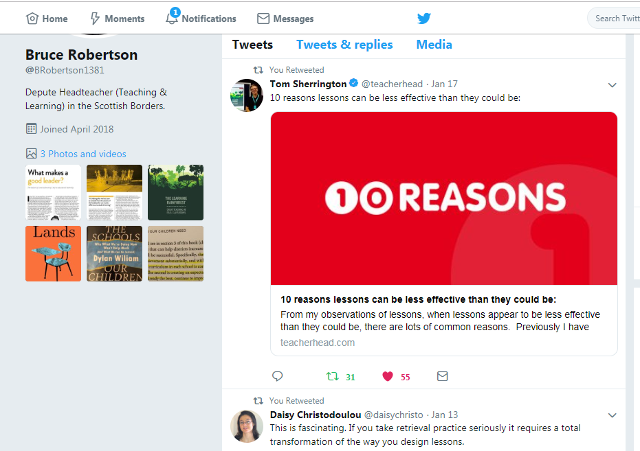
Twitter

Slide 10
Twitter
Asking all teachers to set up a professional Twitter account
Offer of training
Start following each other and others (e.g. Tom Sherrington, Doug Lemov, Daisy Christodoulou, Retrieval Practice)

Slide 11
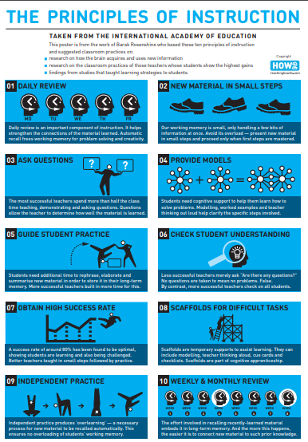
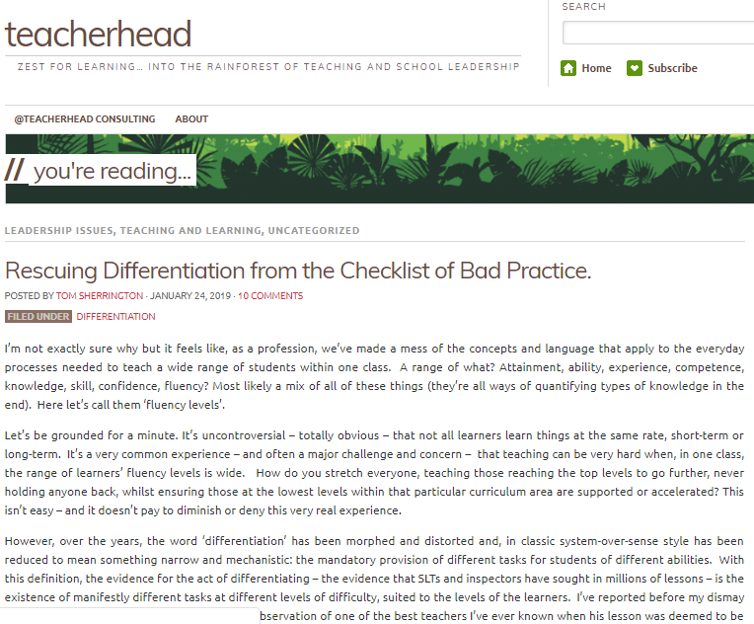

Slide 12
Learning from previous session
On your show-me board, write down one thing that you learned from Towards Great Teaching (Part 1).

Slide 13
Definition of learning?
A change in long-term memory

Slide 14
Students forget things quickly, so we need regular review to boost long-term memory retention and guard against forgetting.

Slide 15
Remember
Re-call

Slide 16

Assessment
(re-call)
Teaching
Learning

Slide 17
Assessment (“checking”, “quizzing”, “testing”)
A key theme through educational research is the importance of regular and frequent assessment
  Minute-by-minute, lesson-by-lesson, week-by-week, month-by-month
  Formal / informal
  Formative / summative

Slide 18
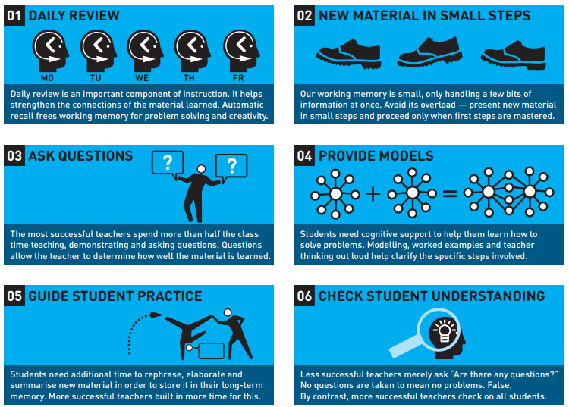

Slide 19
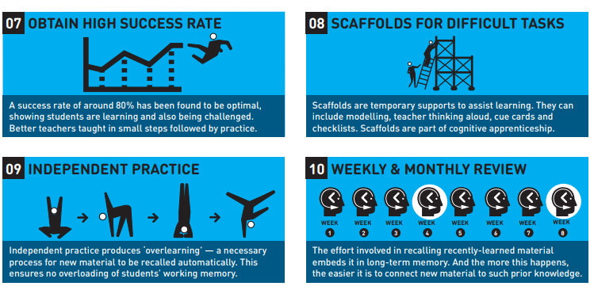

Slide 20
John Hattie: selected effect sizes
Discussion
0.82
Spaced vs mass practise
0.60
Teacher clarity
0.75
Co-operative learning
0.55
Feedback
0.73
Scaffolding
(worked examples)
0.53
‘Graded’ homework
0.64
Mega-cognition
0.53
Direct instruction
0.60
Goal setting
0.53

Slide 21
John Hattie: selected effect sizes
Frequent testing
0.52
Web-based learning
0.18
Questioning
0.52
Within-class grouping
0.18
Enquiry-based teaching
0.35
Problem-based learning
0.12
Simulations & gaming
0.32
Ability grouping
0.10
Individualised instruction
0.20
Student control over learning
0.01

Slide 22
Minute-by-minute (checking, quizzing, testing)
Interactive questioning: pose, pause, pounce, bounce
  Show-me boards
Active assessment methodologies
  True / false
  Multiple choice
  Odd one out
Practise questions

Slide 23
Lesson-by-lesson (checking, quizzing, testing)
Beginning with a review of previous learning
  “5-a-day”
  Asking questions about learning in a previous lesson

Slide 24
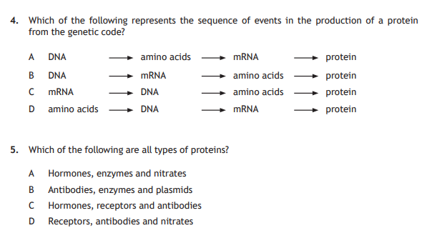

Slide 25
Example
Recent lesson where the task was to draw a graph based on a table of results from an experiment in the previous lesson.
Started by asking them: “What was this experiment about?”
EVERYONE was asked to THINK about this, and everyone was asked to WRITE IT DOWN

Slide 26
Examples of what was written
“To find out how much voltage was in the bulb.”
“To find out how much voltage you can get from a bulb when the brightness changes.”
“To find out if increasing or decreasing the voltage impacts on the brightness of a bulb.”

Slide 27
Lesson-by-lesson (checking, quizzing, testing)
Conclude with a review of learning from this lesson

Slide 28
Suggested Plenary
Overall understanding | Write down two things you learned in today’s lesson.
G / A/ R OR 1-10 | 1. 2.
Anything you didn’t understand | Specifically, write down what you will do to improve your understanding of anything in today’s lesson that was difficult.

Slide 29
Exit Tickets
Amber
I didn’t understand…
…
…
I am going to…

Slide 30
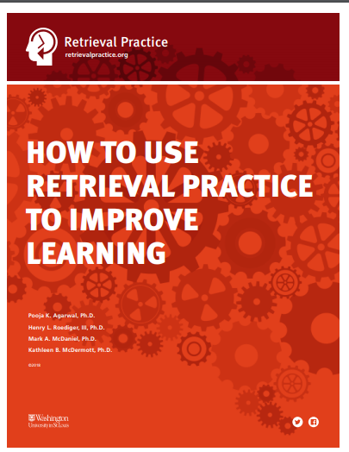
“Retrieval Practice”
What if you could raise students’ grades from a C to an A? The solution isn’t technology. It’s not more money. It’s not more class time. Curious?
When we think about learning, we typically focus on getting information into students’ heads. What if, instead, we focus on getting information out of students’ heads?
“Retrieval practice” is a learning strategy where we focus on getting information out. Through the act of retrieval, or calling information to mind, our memory for that information is strengthened and forgetting is less likely to occur.

Slide 31
Deliberately recalling information forces us to pull our knowledge “out” and examine what we know. For instance, I might have thought that I knew who the fourth U.S. President was, but I can’t be sure unless I try to come up with the answer myself (it was James Madison).
Often, we think we’ve learned some piece of information, but we come to realize we struggle when we try to recall the answer. It’s precisely this “struggle” or challenge that improves our memory and learning – by trying to recall information, we exercise or strengthen our memory, and we can also identify gaps in our learning.

Slide 32
Week-by-week & Month-by-month (checking, quizzing, testing)
Formal Weekly Review and Monthly Review
  Tasks which require recall (and evidence of recall)

Slide 33
Weekly Review examples
Every Friday, part of a National 5 English lesson is given over to a 15 minute Weekly Review
  Students are asked specific questions about key learning from that week
  They write down their responses
  There is exploration of common mistakes and errors are addressed
A Higher Biology class is set weekly homework consisting of 20 marks-worth of SQA Past Paper questions
  Some questions cover recent learning, some less recent
  Each week, part of a lesson is used to go over the answers, explore common mistakes and address errors

Slide 34
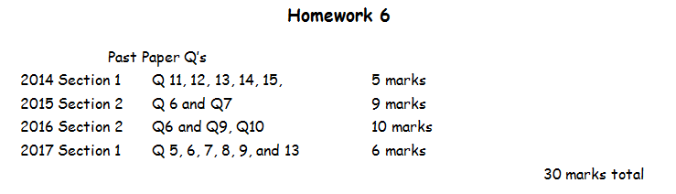

Slide 35
Monthly Review
All S4-6 students are expected to complete a G/A/R Monthly Review on pages 11-12 of their Planner
I would like us to link this to an assessment (“test”, “quiz”) which promotes recall
  How they get on in this informs the G/A/R

Slide 36
Break things down to assess chunks of knowledge
Multiple choice quizzes
Liberal ideology…
Was invented in the eighteenth century to serve the interests of the British Liberal Party.
Developed as a hostile response to the emergence of industrial capitalism.
Is a compromise between socialism and conservatism.
Is a long-established creed which focuses on individual freedom.

Slide 37
Easy to assess
Easy to home in on specific misconceptions and errors
Easy for students to record progress (e.g. 6/10 in Weekly Review or Monthly Review)

Slide 38
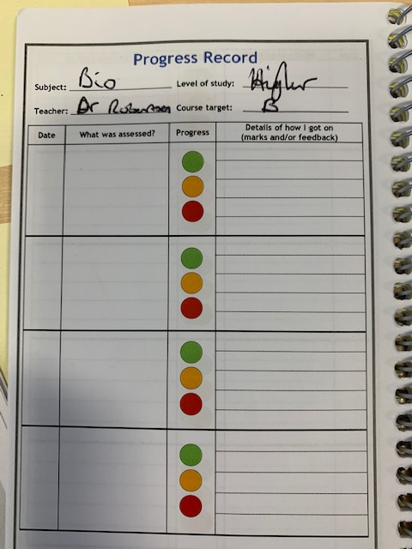
Link it to the Planner
This should help get over the issue of Progress Records not having anything recorded in them
  Weekly Review
  Monthly Review
  End-of-topic assessments

Slide 39
Summary: re-call opportunities
Use starter activities to test students’ retention of prior learning.
Use homework to test knowledge that should have been learned a week, a month and three months previously.
Use low-stakes quizzes in lessons on a frequent and regular basis, including as Weekly and Monthly Review.

Slide 40
Next steps
Discuss Weekly and Monthly Review at your next faculty meeting
Start to implement
  Please don’t wait until next session – it is imperative that we start to address this now, particularly in the Senior Phase

Slide 41
Lesson Evaluation Toolkit
The future

Slide 42
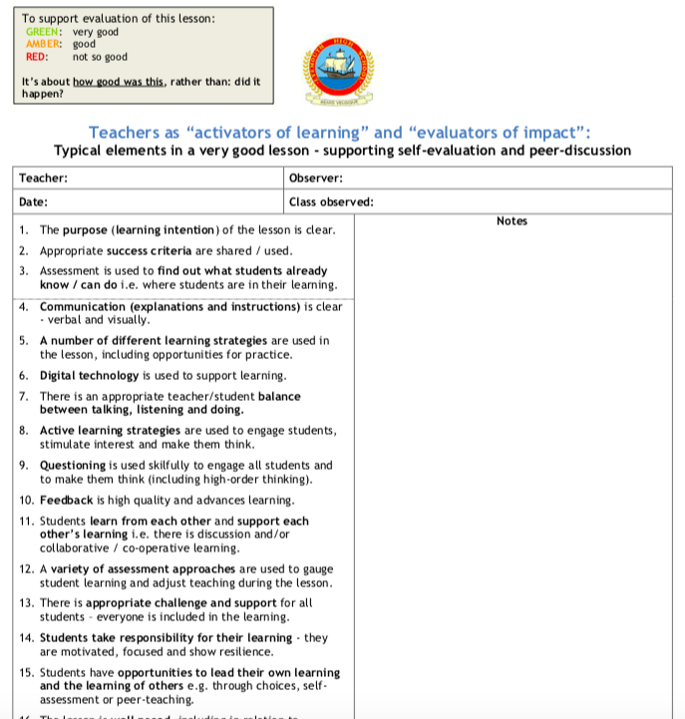

Slide 43
Key question
Is the current version of our Toolkit the right one to take teaching and learning in our school to “very good”?
In answering, please read and consider:
  Principles of Instruction – summary poster 1 (blue)
  10 Reasons Lessons Can Be Less Effective Than They Could Be (Tom Sherrington)
  Durham University posters

Slide 44
Possible answers
Yes – leave it as it is
No
  Change the wording of some (or all) elements
  Add / remove particular elements
  Re-design the structure of it
  A combination of the above

Slide 45
The task
Work in 2s or 3s (please ‘mix-up’ your faculty)
60 minutes allocated today
Engage with the reading and ‘pull out’ what for you are the key messages / features of very good teaching and learning
Update our Toolkit based on this
  Electronically or on paper
Send your return to be by the end of the day today, or by Friday 1st March

