Slide 1

Getting The Best Results You can
September 2018

Slide 2
THINGS YOU CAN DO IN SCHOOL
PART 1

Slide 3
Take notes during lessons (may seem fairly obvious, but a lot of people don't).
Ask teachers for resources they use like PowerPoints (many teachers are happy to give you copies; some share them using Edmodo or Glow).
Ask your teachers for additional work e.g. old Past Papers.
Keep your Progress Record up-to-date – this will help guide your revision at home.

Slide 4
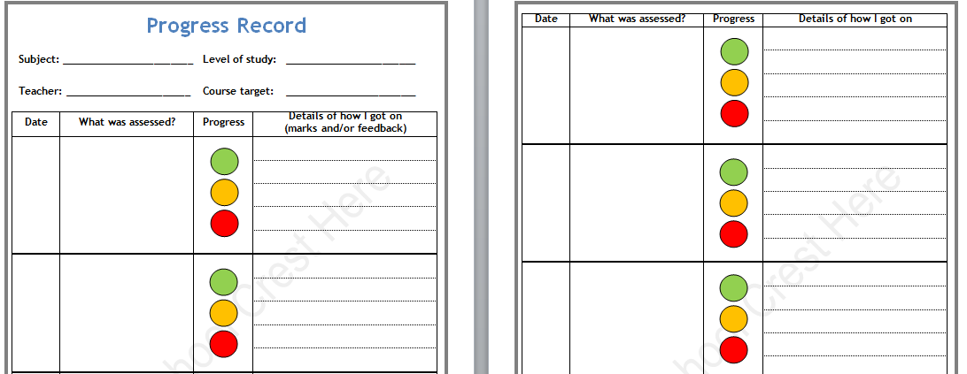
Page 14-41

Slide 5
Speak to teachers about areas you are finding difficult. Ask for help – don’t wait for them to come to you.
Find out when each subject offers Study Support and attend the sessions throughout the year (Planner – page 53).
  This may be before school, at break, lunchtime, afterschool or in their non-teaching periods.
  This also includes Study Zone.

Slide 6
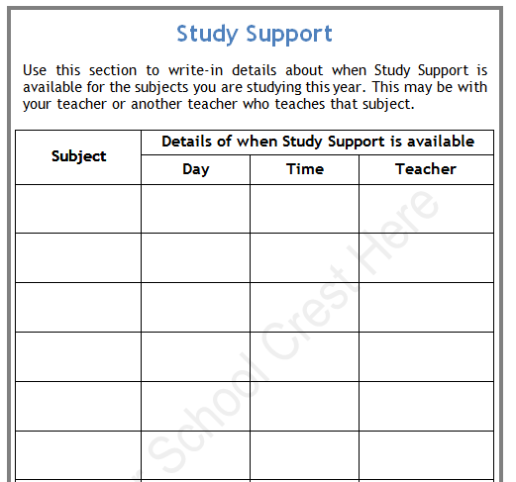
Page 53

Slide 7
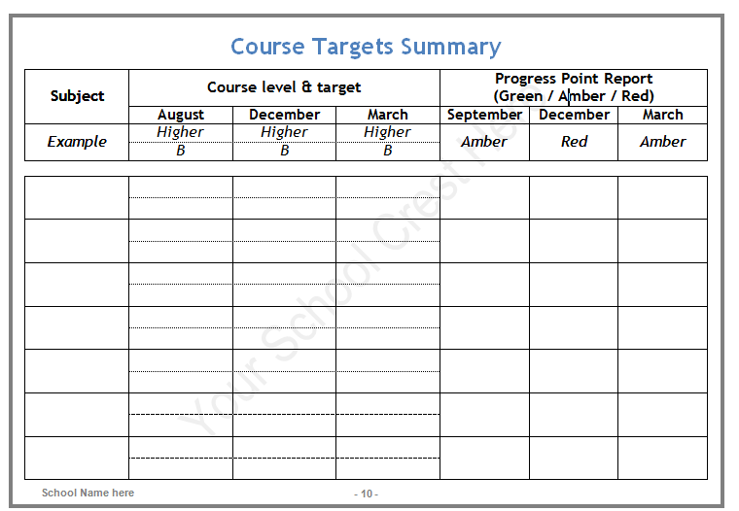
Page 9

Slide 8
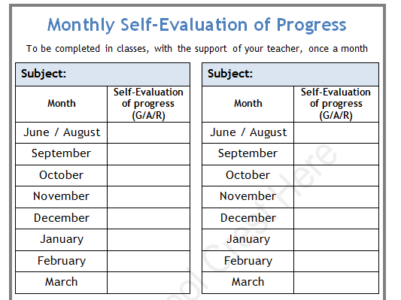
Page 11-12

Slide 9
Keep on top of deadlines by using your Planner.
Always keep a note of which questions you struggle with (for example, after a class test, write down which questions/areas were difficult and do more work on these before the exam).
Make good use of any Study Periods and “free” periods. Make sure you are prepared for these and have meaningful work to do. Use them well and you’ll save yourself time at home.

Slide 10
THINGS YOU CAN DO AT HOME
PART 2

Slide 11
If you’re going to get the best grade you can, you need to invest time working at home.
Your work in school is just a small part of what you need to be doing.
The people who do the best go the extra mile – they ask for more help, they take the initiative and practise more questions.
For National 5 courses, you should be putting in a minimum of one hour’s study per week per subject;
for Higher and Advanced Higher courses, this should be a minimum of two hours per week per subject.

Slide 12
Read through notes that you’ve made in class – don’t just wait for a test to revise.
Self-quiz:
  Read
  Cover
  Copy
  Check
  Correct

Slide 13
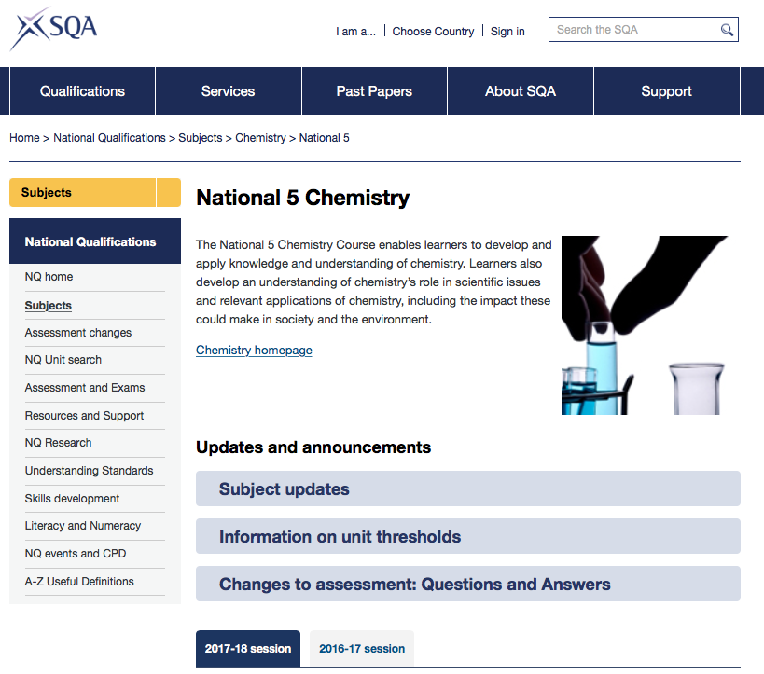

Slide 14
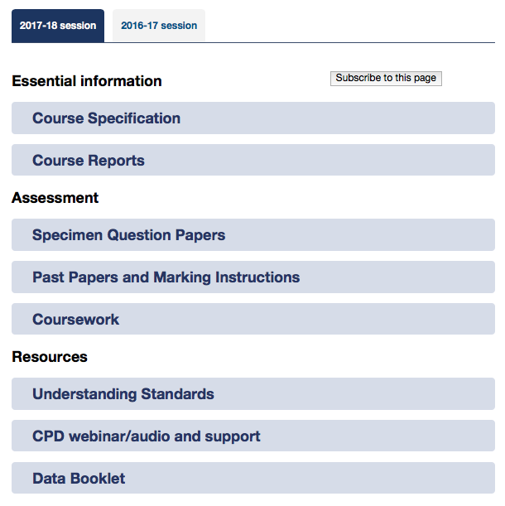

Slide 15
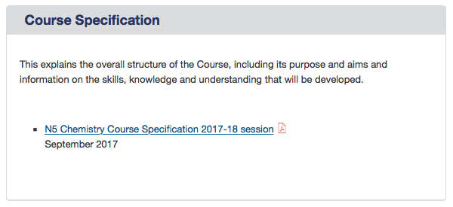
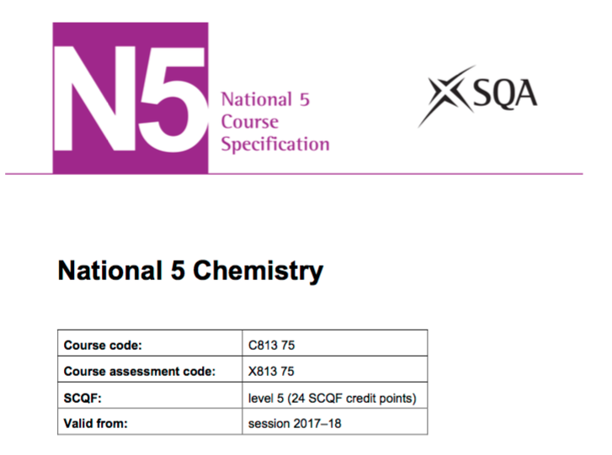

Slide 16
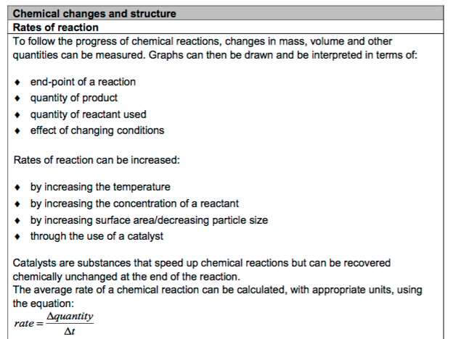

Slide 17
Rewrite as more concise bullet points to help you to learn key facts. Also, you can use these to get someone to test you.
Create mind-maps or sets of cue cards for different topics.
Look at subject pages from other schools because sometimes these have lots of material – ask your friends if they’ve come across anything good from another school.

Slide 18
Do EXTRA questions e.g. complete SQA Past Paper questions (available on the SQA website).
Use the marking instructions on this website to self-assess or peer assess.
Arrange to meet your teacher to discuss anything you’re not sure about.

Slide 19
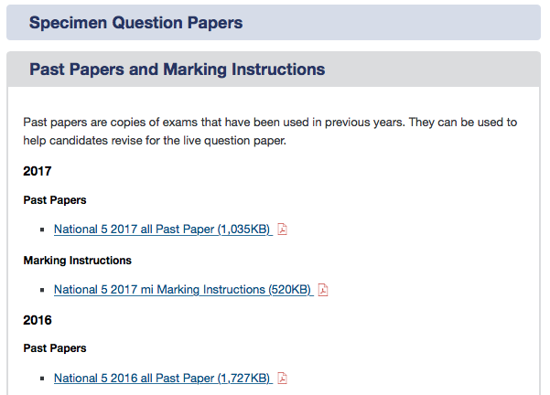

Slide 20
Collect all the SQA Past Papers you can find and decide which ones to do to prepare for Prelims but also save some for the real exams (save more of the recent ones) so that you have had plenty of practise for both (this means you can record the scores you get and which bits are more difficult than others).
  This can take a bit of time and research it will help keep you more organised and is very helpful when you get to real exams.
  It can help you see how much progress you’re making.

Slide 21
When working alone or in face-to-face groups, switch off mobile phones and tablets. If using a computer to complete work, shut down social media apps like Skype, Whatsapp & Facebook. Don’t have the TV on.
Review deadlines. Look at all of the workload and plan to hit deadlines in good time. Many students find it useful to develop a weekly at-home study timetable (Planner, P50)
Take your time with homework and make sure it’s your best work – don’t hand in something that’s only partly done or that you’ve rushed.

Slide 22
If you’ve done poorly in something (e.g. a homework exercise) re-do it and ask your teacher if they’ll re-mark it.
Catch up on any schoolwork you’ve fallen behind with or missed due to absence.
Use websites like Scholar and BBC Bitesize.

Slide 23
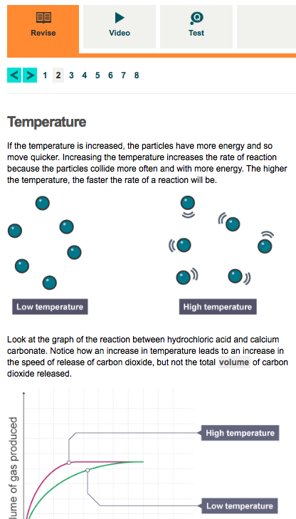
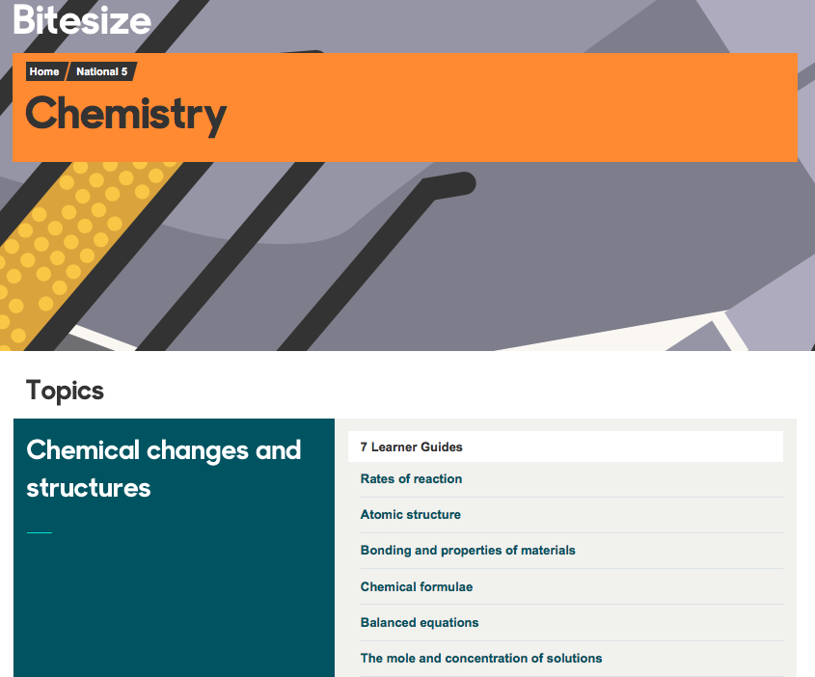

Slide 24
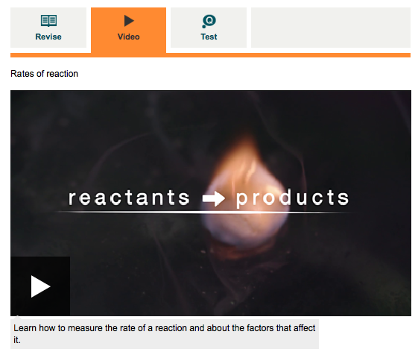
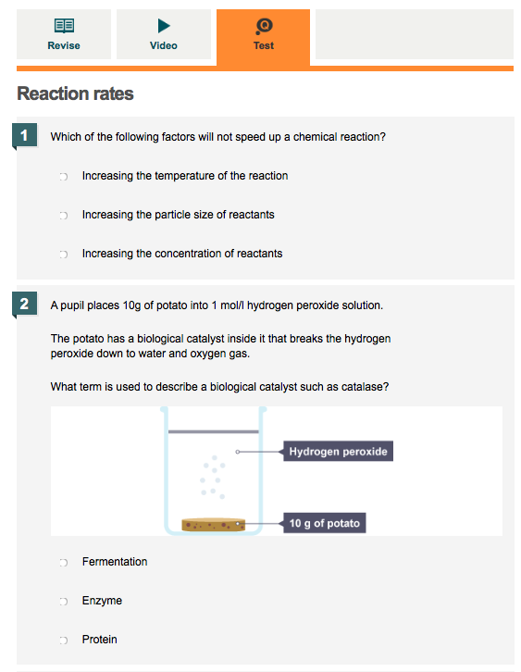

Slide 25


Slide 26


Slide 27
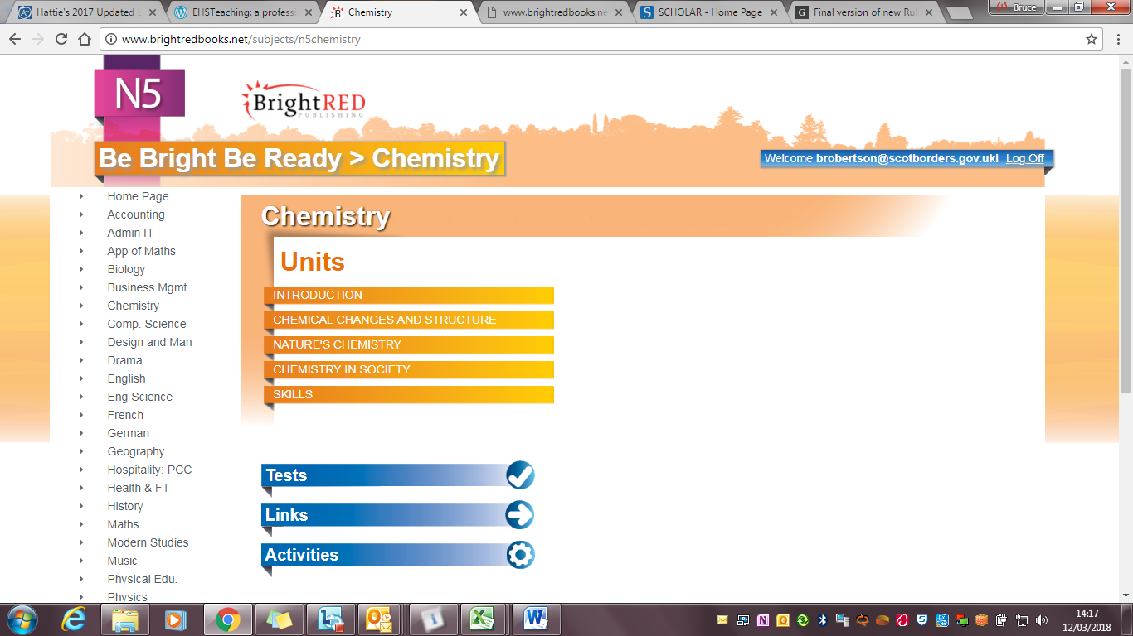

Slide 29
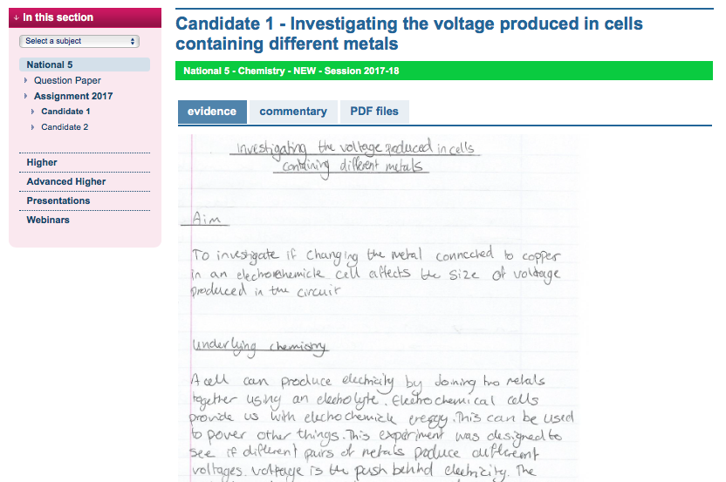
Coursework

Slide 30
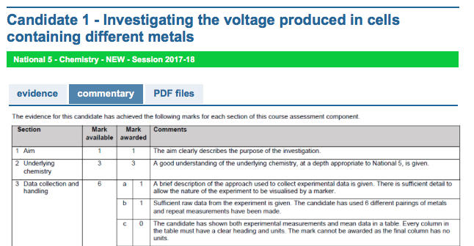
Coursework

Slide 31
THINGS THAT WON’T REALLY HELP
PART 3

Slide 32
Students often make the mistake of focusing their revision on topics they are interested in and which they know well, while avoiding revising more challenging topics. Don't practise exam questions you're already good at.
Reading and the re-reading notes and books without doing anything else. You need to do more than that.
  Self-quizzing
  Practising questions, marking these and getting teacher or peer help/feedback is key
  Bullet points
  Cue Cards
  Mind-maps

Slide 33
Excessive note taking from books. It's easy to basically just copy your textbook and while it's important to put notes into your own words it can sometimes take up too much time and isn't very effective.
Ignoring deadlines or trying to postpone work.
Focusing on one subject to the exclusion of others. You need to develop a study timetable (Planner, page 50) with includes ALL of your subjects.
Attending Study Support or Study Zone without a particular focus in mind.
Being frightened of Past Papers, not using them early enough, not getting feedback from teachers about how you’ve done with them.

Slide 34
REVISION CHECK-LIST
PART 4

Slide 35
I am spending an appropriate amount of time revising each of my subjects each week (at least one hour for National 5 subjects and 2 hours for Higher and Advanced Higher subjects).
I have a Revision Timetable which I stick to each week (Planner, p50)
I am using SQA Course Specifications to check and self-assess my learning for each of my subjects each week (including self-quizzing).
I am using SQA Specimen Papers and Past Papers to practice exam-style questions each week for each of my subjects, using Marking Instructions to assess how I have done.

Slide 36
I am using the BBC Bitesize website or app, Scholar and/or Bright Red website on a weekly basis to revise each of my subjects and to test my knowledge.
When preparing for Coursework, I have studied the Marking Instructions and Understanding Standards examples which are available from the SQA website.
I know when Study Support is available for each of my subjects and I am attending this when I feel that I need to (Planner, p53).
I plan to attend the school’s Study Zone in the lead-up to Prelims and final exams.

