Slide 1

Getting The Best Results You can
Summary
September 2018

Slide 2
General
Progress Point Reports
Uniform
Attendance and punctuality
Course evaluations
Planners
  On desks, including Registration

Slide 3
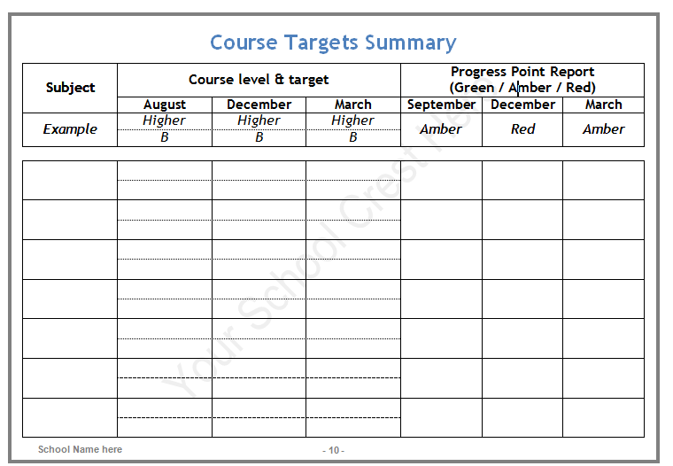
Page 9

Slide 4
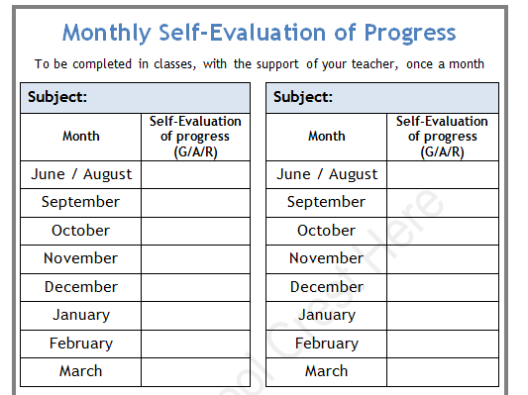
Page 11-12

Slide 5
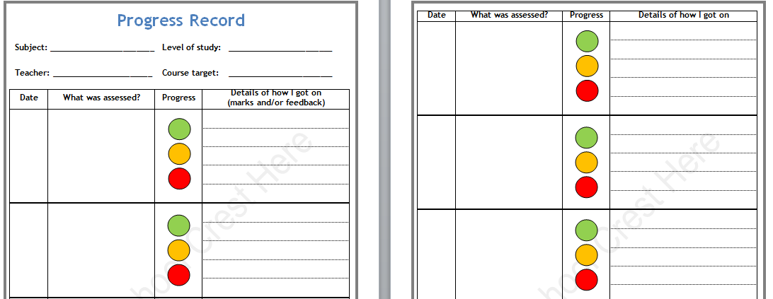
Page 14-41

Slide 6
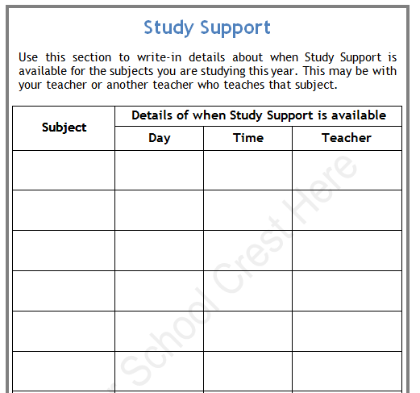
Page 53

Slide 7
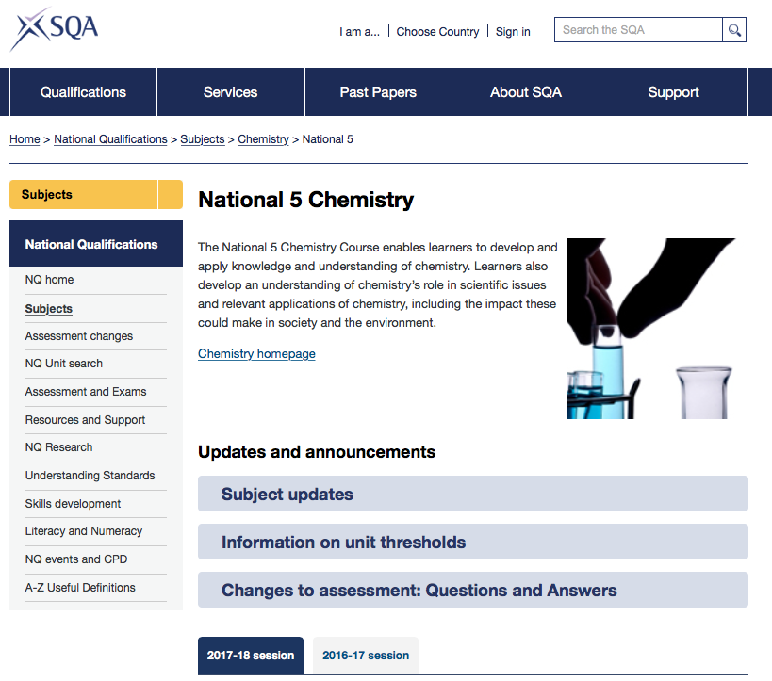

Slide 8
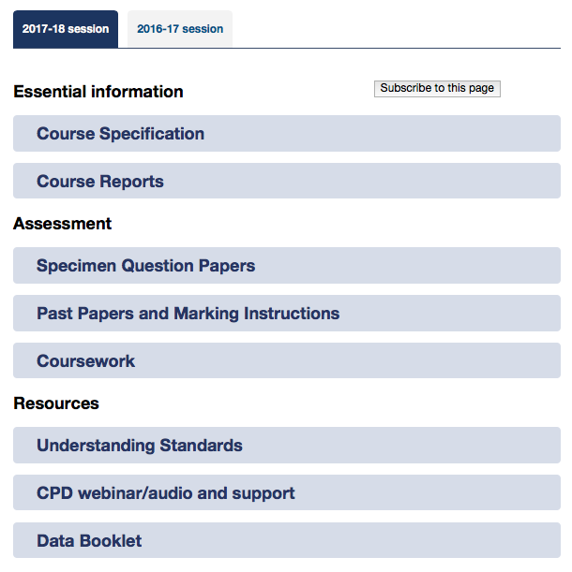

Slide 9
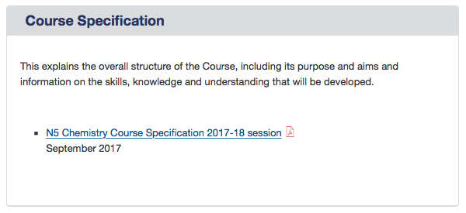
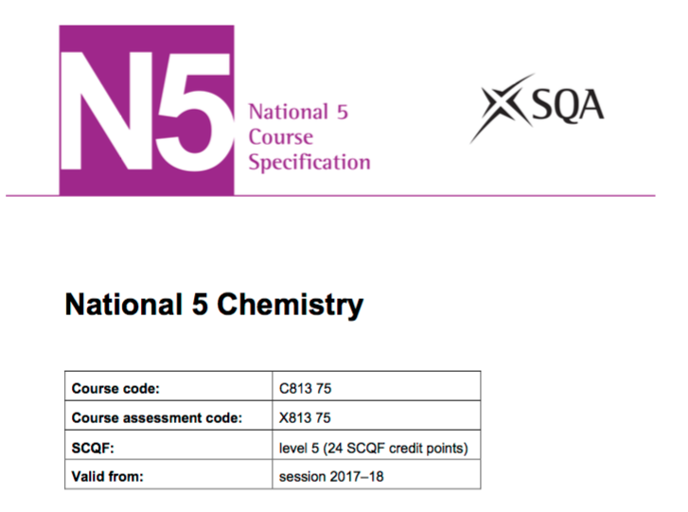

Slide 10
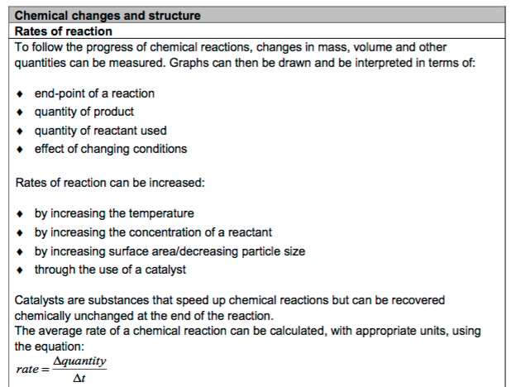

Slide 11
Read through notes that you’ve made in class – don’t just wait for a test to revise.
Self-quiz:
  Read
  Cover
  Copy
  Check
  Correct

Slide 12
Rewrite as more concise bullet points to help you to learn key facts. Also, you can use these to get someone to test you.
Create mind-maps or sets of cue cards for different topics.
Practise questions

Slide 13
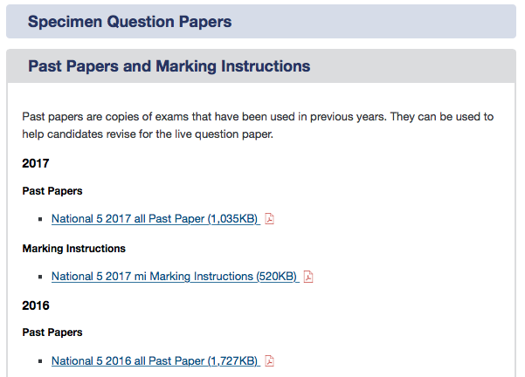

Slide 14
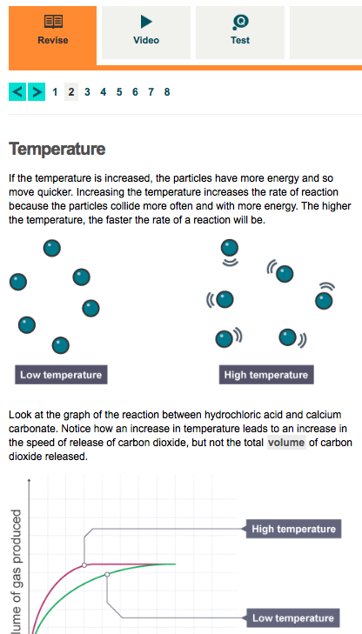
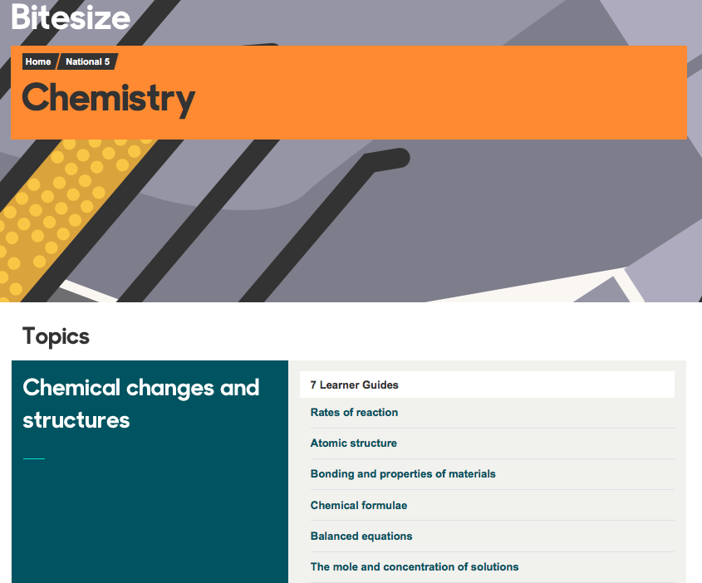

Slide 15


Slide 17
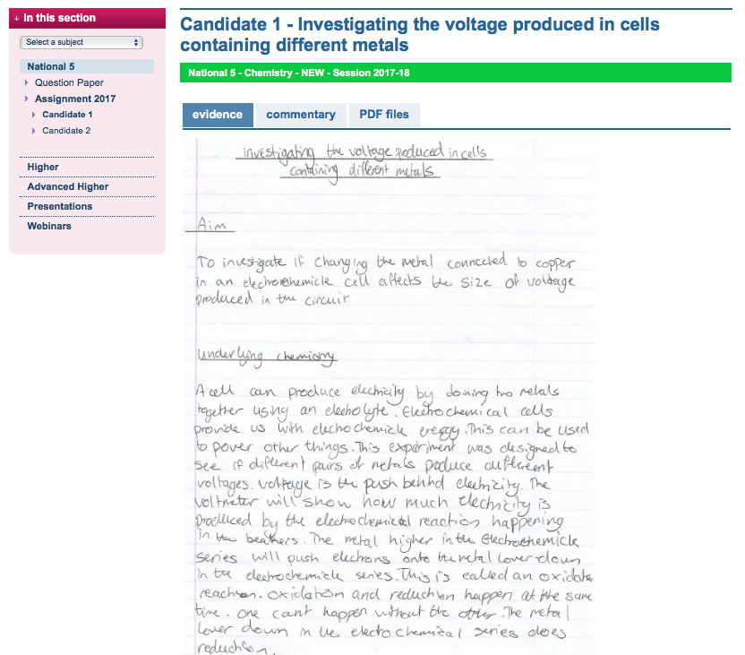

Slide 18
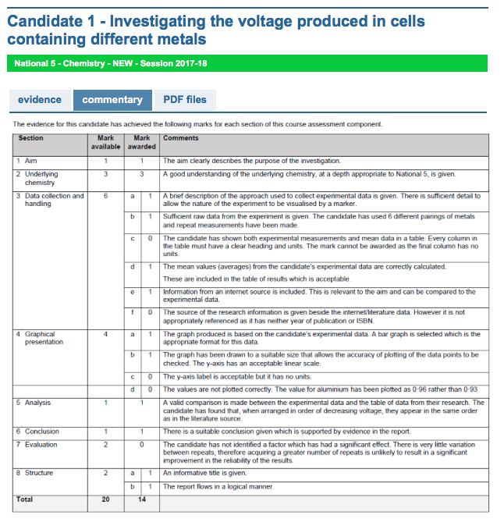

Slide 19
REVISION CHECK-LIST
Planner, page 49

Slide 20
I am spending an appropriate amount of time revising each of my subjects each week (at least one hour for National 5 subjects and 2 hours for Higher and Advanced Higher subjects).
I have a Revision Timetable which I stick to each week (Planner, p50)
I am using SQA Course Specifications to check and self-assess my learning for each of my subjects each week (including self-quizzing).
I am using SQA Specimen Papers and Past Papers to practice exam-style questions each week for each of my subjects, using Marking Instructions to assess how I have done.

Slide 21
I am using the BBC Bitesize website or app, Scholar and/or Bright Red website on a weekly basis to revise each of my subjects and to test my knowledge.
When preparing for Coursework, I have studied the Marking Instructions and Understanding Standards examples which are available from the SQA website.
I know when Study Support is available for each of my subjects and I am attending this when I feel that I need to (Planner, p53).
I plan to attend the school’s Study Zone in the lead-up to Prelims and final exams.

Slide 22
S6 only

Slide 23
Uniform
Common Room
Supervision

Slide 24



Uniform

Slide 25
Uniform
Common Room
Supervision

