Slide 1
Types of Staging
Understanding the positions of actors and audience

Slide 2
End on staging
This is the most common type that you will use in your own work
It is easy to block as the audience is only on one side, so masking can be avoided
However, the audience do not always feel fully involved in the drama

Slide 3
Proscenium arch staging
This is a the type of staging found in traditional theatres
It creates a ‘picture frame’ effect – the 4th wall
It is easy to add items create a set e.g. backcloths, flats, trucks etc.
The stage is often raked to give the audience a better view
The audience is usually far from the action

Slide 4
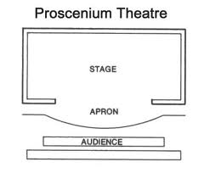
Proscenium Arch Diagram

Slide 5
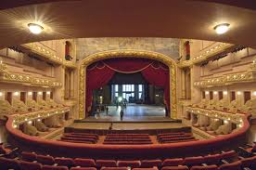
Proscenium arch theatre

Slide 6
Theatre in the round staging
This is also sometimes referred to as ‘arena’ staging
The audience surrounds the actors
It is easier to make the audience feel more involved in the drama
Blocking is difficult and care must be taken to ensure all parts of the audience are fully involved

Slide 7
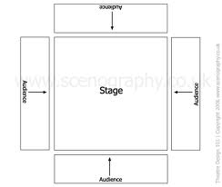
Theatre in the round diagram

Slide 8
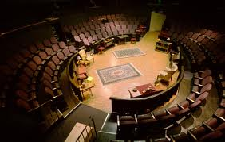
Theatre in the round theatre

Slide 9
Thrust staging
This is sometime referred to as ‘catwalk’ staging
The audience are on three sides of the acting area
Although blocking is still a challenge, there is a ‘back wall’ area that can be used for set
The actors are able to move into the audience at times

Slide 10
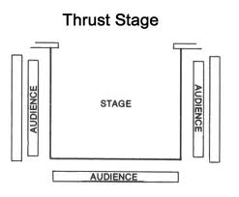
Thrust diagram

Slide 11
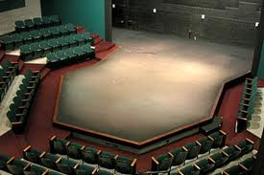
Thrust theatre

Slide 12
Avenue staging
This involves the audience sitting on two sides of the performance area
It can also be referred to as ‘traverse’ staging
The audience can usually see the reactions of those opposite them
Different areas of the stage might be set up to represent different time and places

Slide 13
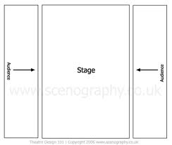
Avenue diagram

Slide 14
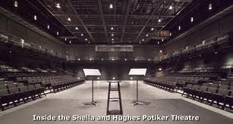
Avenue theatre

Slide 15
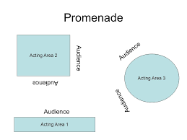
PROMENADE
Promenade theatre is when the audience move from place to place during the performance

Slide 16


