Slide 1
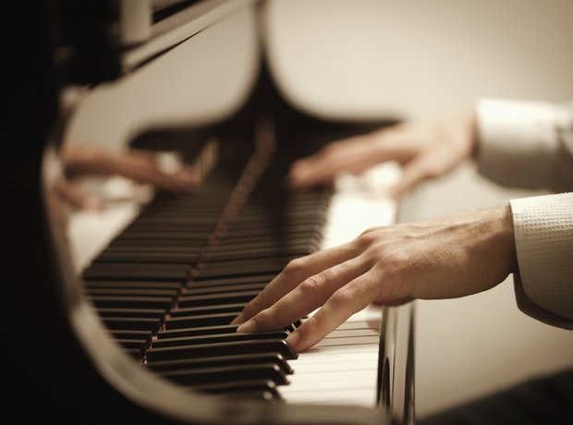
Activity
Are you listening to a symphony or a concerto?

Slide 2
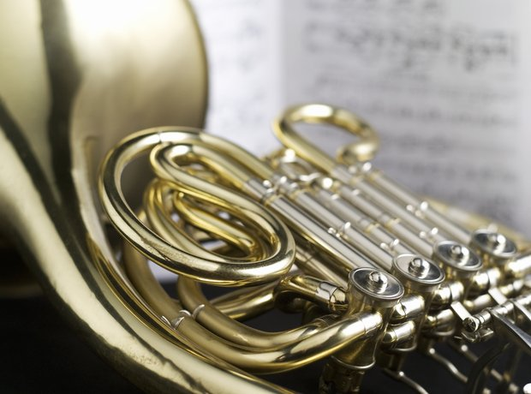

1
Concerto or Symphony?

Slide 3
2
Concerto or Symphony?

Slide 4
3
Concerto or Symphony?

Slide 5
4
Concerto or Symphony?

Slide 6
5
Concerto or Symphony?

Slide 7
6
Concerto or Symphony?

Slide 8
Answers
1
Concerto
2
Symphony
3
Concerto
4
Symphony
5
Symphony
6
Concerto

